Slide 1
Reminders

Slide 3
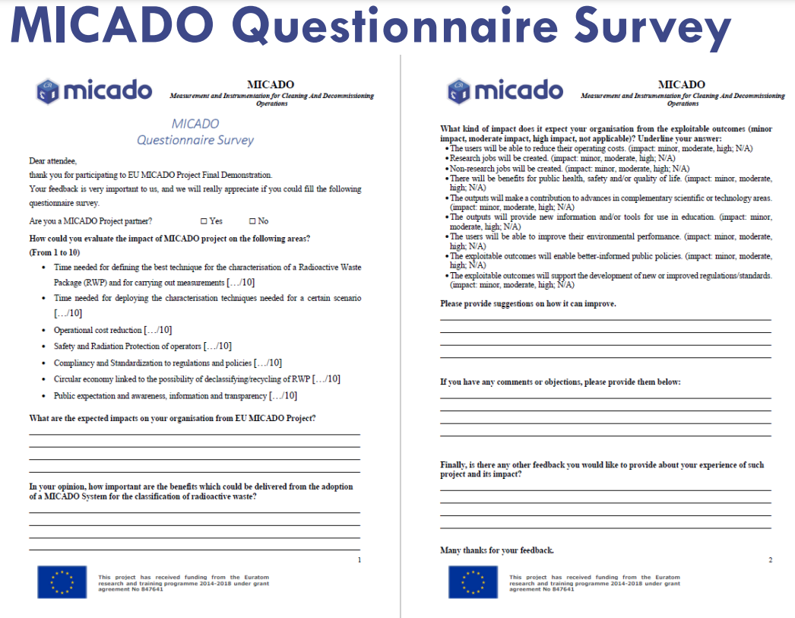
Paper copy in your conference bag
If you need a new questionnaire, some are available at the entrance desk
We ask you to complete it (also MICADO Partners) and return it before the end of the day

