Slide 1
The FINAL DEMO MICADO Social Events
Rome, 25th January 2023
Nadia Cherubini

Slide 2
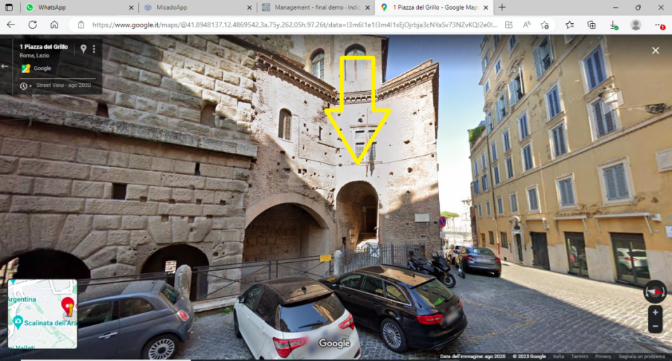
Social Dinner tonight January 25th at 7:00 P.M.
Casa dei Cavalieri di Rodi
(House of the Knights of Rhodes)
Piazza del Grillo, 1, 00184 Roma
(https://goo.gl/maps/HxWgn9pvCeMr8wAQ7 )
People joining by bus: the bus will leave ENEA at 5:30 p.m., stop at Massimino, then to Rome directly;
the bus will arrive at Via Claudia (6:45 p.m., about 1 km away from the location) a guided walk will take place from Via Claudia till the location;
at the location, we will join other participants to the guided tour of the House of the Knights of Rhodes (begin at 7:00 p.m.);
dinner starts at 8:00 p.m.
Note that there is no bus to come back to the hotel. You need to come back yourself!
Luigi Lepore will be on the bus with you for any needs!!
People joining by car: be at the House of the Knights of Rhodes at 7:00 p.m. for the guided tour to start.
Parking: point on Google Maps the “Casa dei Cavalieri di Rodi”, any parking lot near the place is good, but check for white/blue lined spaces.
Parking toll: be aware that you should pay for parking usually. Blue stripes identifying parking lots that you need to pay! Bring some coins with you.
ATTENTION: do not enter any “ZTL VARCO ATTIVO” but it open at 6 PM
YOU CAN GET FINED!!!

Slide 3
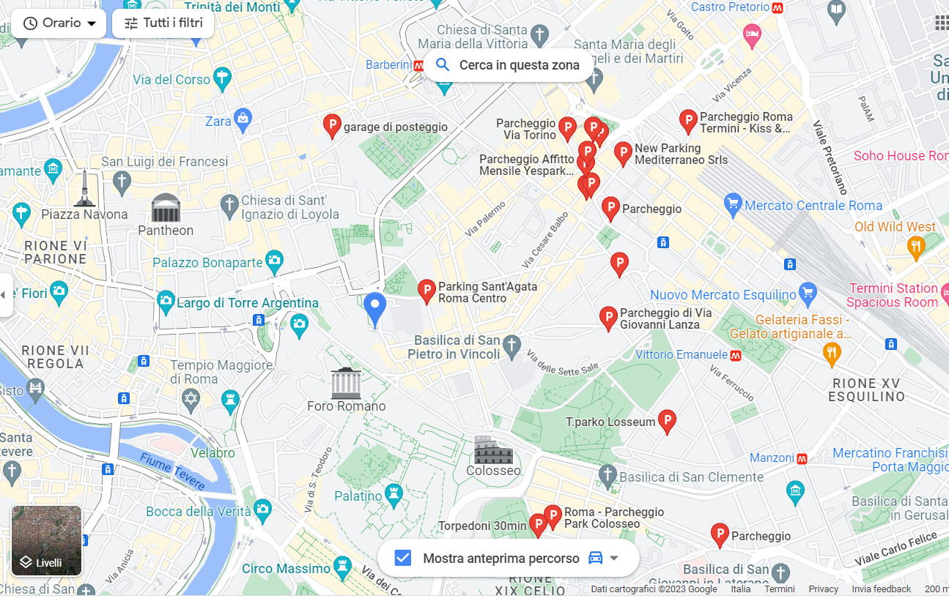
Suggestions for car owners
UBER from House of Knights to Massimino (Anguillara) 70 -120 Euro (120 for a small van)
Parking nearby have blu stripes => You need to pay the parking
Not an easy parking
Parking roma termini
Parking Sant’agata (https://www.parcheggioromacentro.it/en/)
25 min by
foot
5 min by
foot

