Slide 1
The importance of the waste characterization for D&D activities and the MICADO potential in the EU program and for industrial activities
Final DEMO
Federica Pancotti - SOGIN

Slide 2
Contents
Sogin at Glance
Radioactive Waste from a Nuclear Installation
Radioactive Waste Management Approaches
Sogin Modular System for Waste Cementation
Sogin IT Tool for RWM
Radioactive Waste Characterisation
Sogin Approach for Waste Packages Characterisation
Challenges and Issues for Waste Characterisation
Overall Benefits form MICADO solution
MICADO potential for Sogin
MICADO potential for EU program

Slide 3
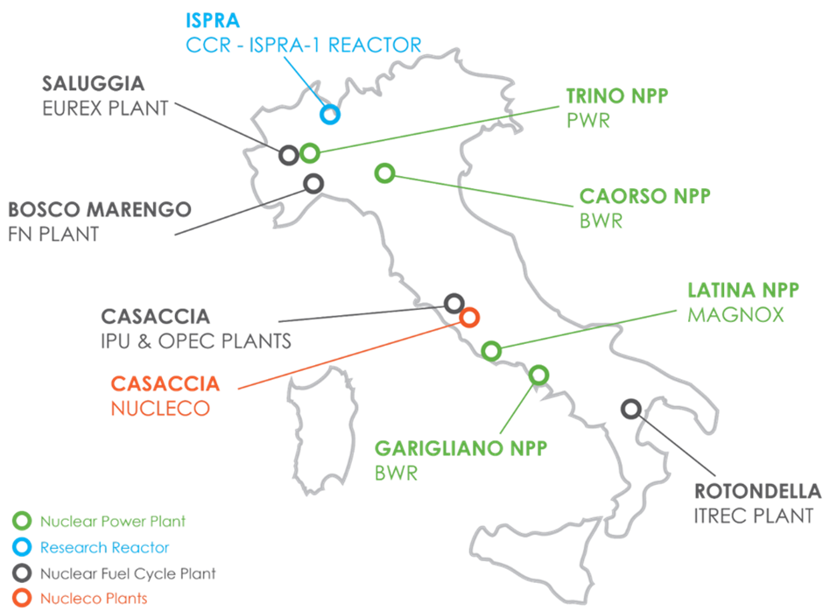
SOGIN at Glance
Sogin is the Italian State owned company responsible for the decommissioning of Italian nuclear plants and for the management of radioactive waste
Sogin is involved in the siting, designing, building and operating of the National Repository and the Technology Park for radioactive waste
Italian nuclear facilities in decommissioning, managed by Sogin, include:
4 NPPs with 3 different kinds of reactors (2 BWRs, 1 PWR and 1 Magnox)
1 Research Reactor
5 Nuclear Fuel Cycle Plants
Sogin has been operating since 2001. It became a Group in 2004 through the acquisition of the majority stake (60%) of Nucleco SpA

Slide 4
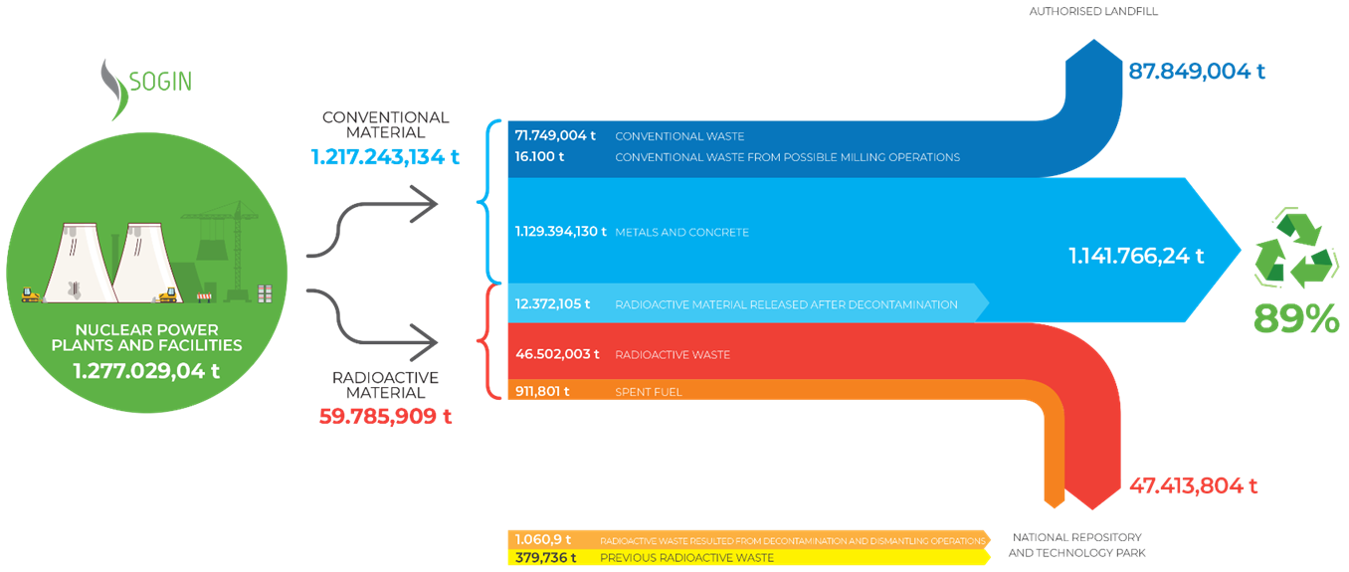
Radioactive Waste from a Nuclear Installation
Radioactive wastes are liquid or solid materials generated by the operations or decommissioning of Nuclear Installations
legacy waste (old waste with not a lot of information)
operational waste (day to day waste from the nuclear sites)
dismantling waste (coming from current and future dismantling projects)
Decommissioning activities generate large quantities of materials most of which are either directly released or cleared after decontamination
Only a small percentage of such materials cannot be reused or recycled and must be treated as radioactive waste

Slide 5
Radioactive Waste Management Approaches
In most of the cases RWM activities are performed on-site with the use of fixed or mobile systems and they include:
RW Segregation: in accordance with the Waste Management Programme, considering the waste properties (e.g. combustible/non-combustible, compressible/non-compressible, metallic/non-metallic, fixed surface contamination/non-fixed surface contamination)
RW Collection: different type of containers depending the WM strategy (standard cylindrical container: 220 l drum)
RW Treatment: depending on the waste properties: e.g. Incineration (off-site), Super- compaction (on-site or off-site in Nucleco), Melting (off-site), Decontamination (on-site)
RW Conditioning: immobilisation in cement matrix on-site or off-site in Nucleco (standard cylindrical packages: 440 l or 380 l drums)
RW Storage/Disposal: each Site has his own long-term storage Facility on-site waiting for the availability of the National Repository for final disposal

Slide 6
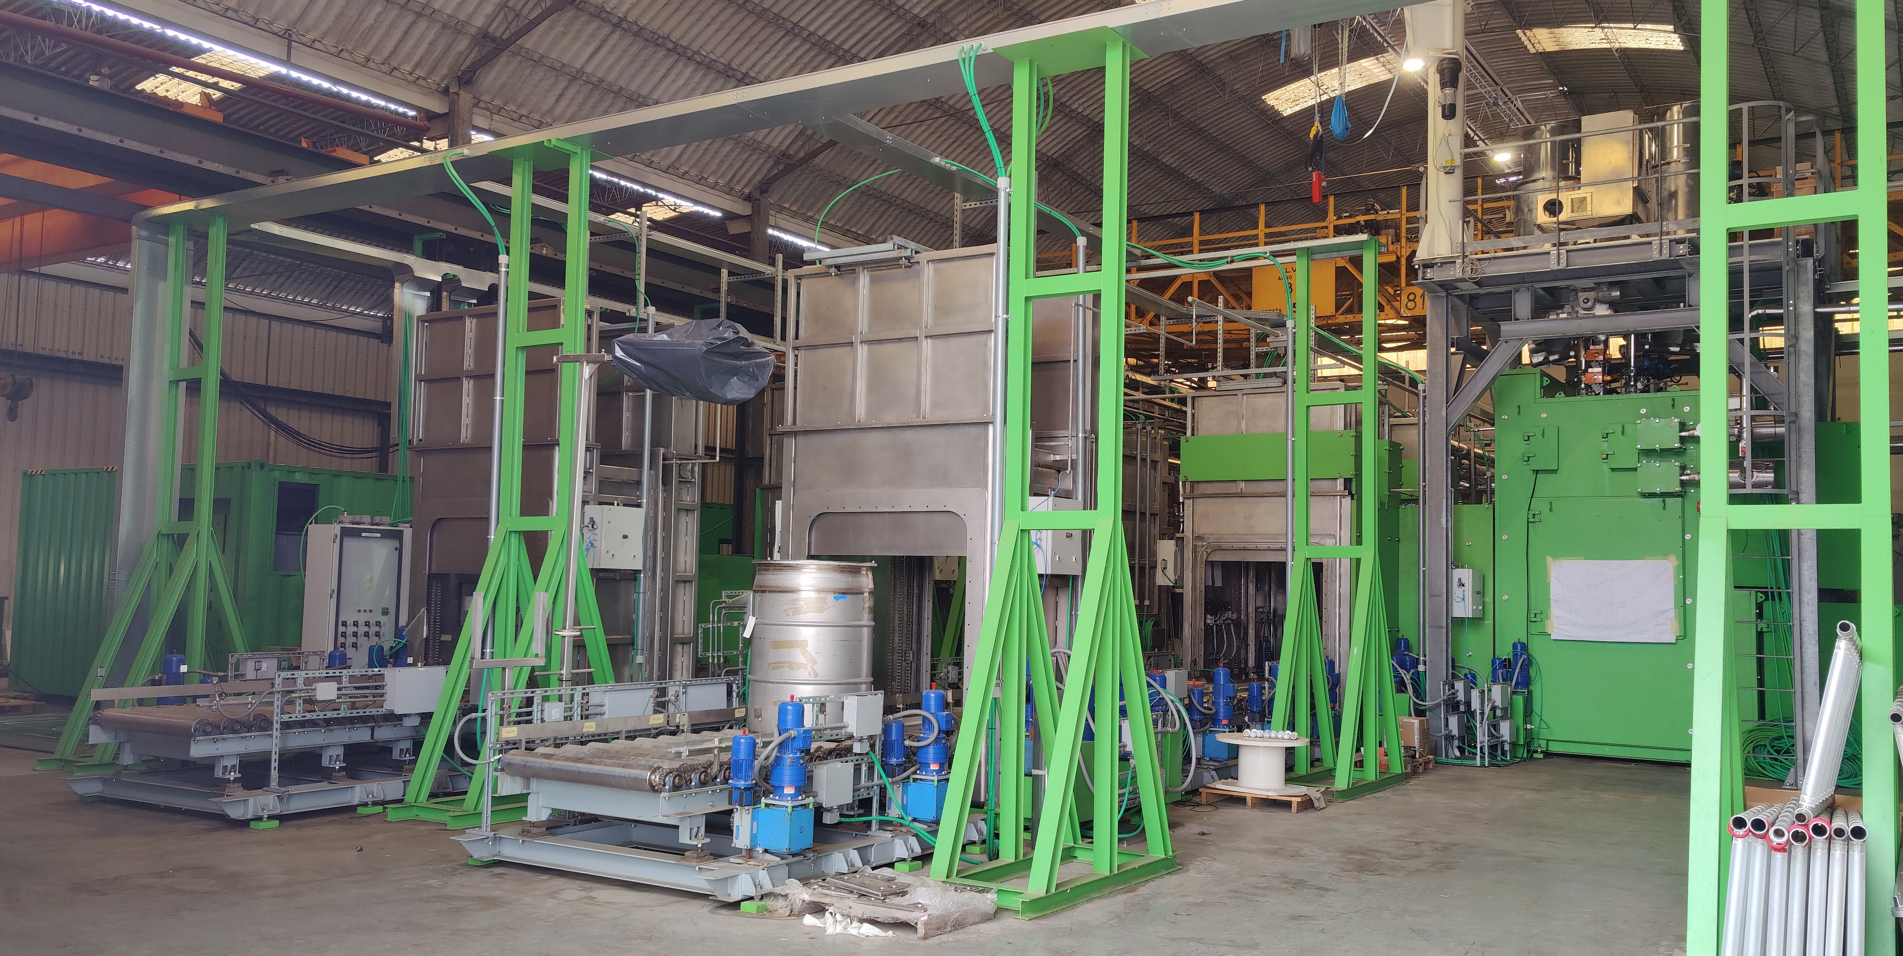
Sogin Modular System for Waste Cementation
SiCoMoR - Modular System for Radioactive Waste Cementation
Able to process different types of radioactive waste (liquid, sludge, resins, powder, etc.), containing beta/gamma and/or alfa emitters
Modular system, transportable and easy dismountable, without any permanent building
Modular and Transportable plant. It can be used for waste conditioning campaigns in different sites to optimize the re-use of resources.
Final waste package: cylindrical 440 l drum

Slide 7
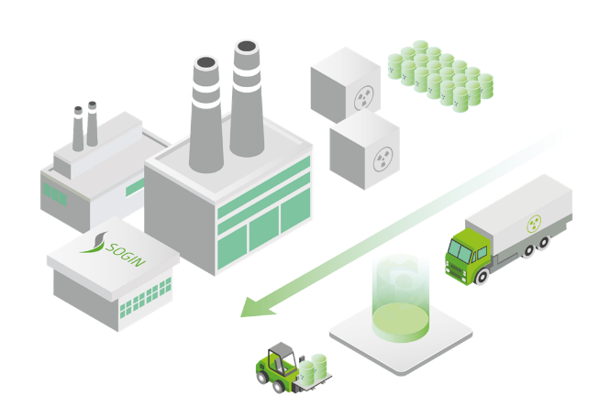
Sogin IT Tool for RWM
AIGOR (IT Radioactive Objects Management System), to optimise RWM by a multi criteria analysis to select the most appropriate Waste Process Route for defined Waste Streams. Based on blockchain, it will ensure the integrity of data and processes, and the safety of information.
Set up a center (at a national level) for collecting and archiving all the quantitative and qualitative data of the radioactive objects managed by Sogin
Guarantee a homogeneous application of terminologies, classifications, treatment processes, etc. for similar types of radioactive objects in all decommissioning sites
Ensure the connection with the historical data of a radioactive object for the purpose of reconstructing the processes to which it has been subjected over time

Slide 8
Radioactive Waste Characterisation
Determines the radiological, physical, chemical and biological properties of waste
Fundamental aspect to properly classify waste in accordance with the requirements established or approved by the regulatory body
Applies within the entire waste management life cycle: it helps determine how to best process, treat, handle, transport, store and dispose of the waste
Demonstrates if waste meets the facility waste acceptance criteria
High priority and importance process: it does not only consist of measurements and analyses of the results, but also involve evaluation of historical information, calculations and collections of existing data

Slide 9
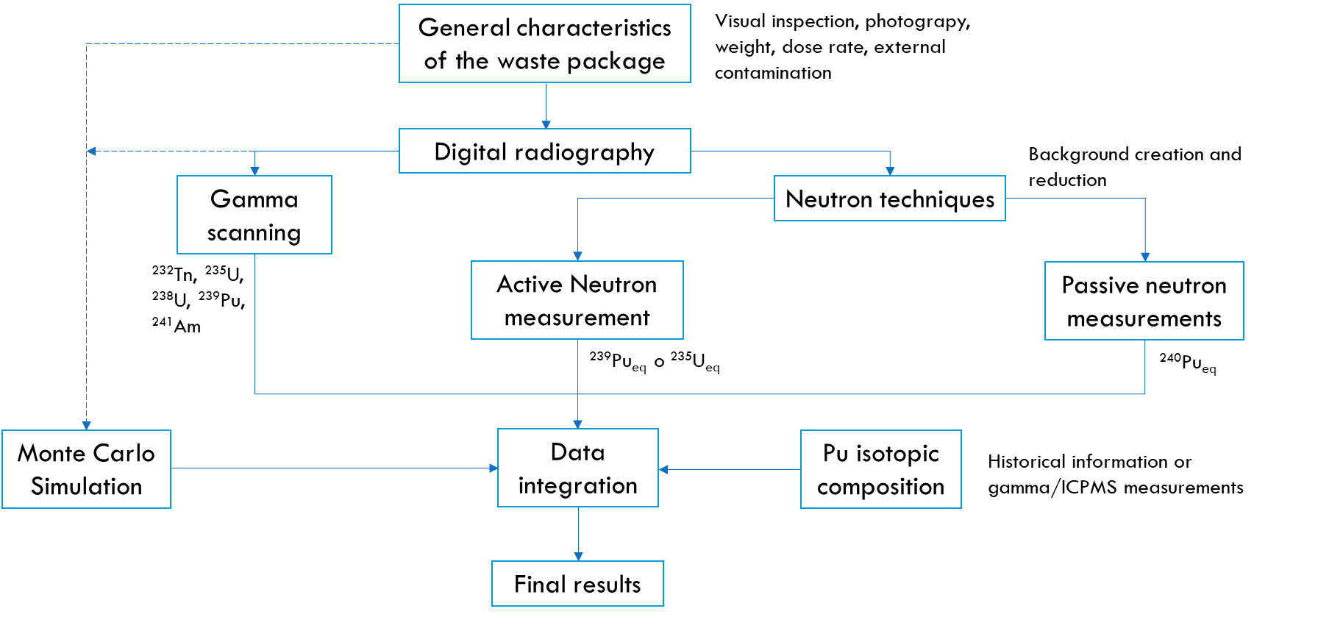
Sogin Approach for Waste Package Characterisation
Manual process
In most of the cases performed on-site
Dose rate
Surface contamination
Gamma scanning
“Integrated System”: in case alpha-emitting radionuclides
Different and multiple technologies and devices
“Integrated System”: gamma scanning and passive and active neutron techniques (when alpha-emitting radionuclides are present) with validation using Monte Carlo codes

Slide 10
Challenges and Issues for waste Characterisation
Waste Variability
Different type of wastes with different matrices and chemical-physical properties
Legacy waste
Measurement approaches and accuracy issues
Variety of measurements often performed separately with specific device, and not necessarily in a well-defined sequence
Not all the technologies are available at the same time in all the sites
Data collection and data management issue
Often separate reports using different software applications
Time consuming and radiation protection issue
Normally it is a manual process
Cost issue
Costs associated with the detection systems to be deployed and the manpower required for the characterization process
Regulatory issue
Compliance with regulatory requirements

Slide 11
Overall Benefits form MICADO solution
Different technologies integration: reduce time and cost
Reduce measurement uncertainty (e.g. NDT for alpha and fissile materials)
Data handling and tagging packages:
capture wide range of characteristics in format suitable to locate and support decision making
provide all information about the package
Modular and automate system: reduce the deployment time
Automation of the full measurement process: contribute to ALARA principle
Long-term monitoring: enable a safe long-term storage
Overall minimization of waste volume by optimizing waste classification

Slide 12
MICADO potential for Sogin
Integrated solution that can be used in different sites reducing time and costs and avoiding the need for waste transport from a site to another
Standardisation and automation of approaches: reduce uncertainties and time needed (included dose to the workers)
Optimisation of the waste classification: reduce waste volume and optimize waste management strategies
Enable the long-term monitoring of the packages stored on-site
Example of possible integration with other Sogin Systems:
SiCoMoR- MICADO: the MICADO platform could be integrated as an additional module to the SiCoMoR plant to perform the final characterization of the waste packages
AIGOR – MICADO: DigiWaste Platform could be integrated with the AIGOR tool to have a direct link with characterization data

Slide 13
MICADO potential for EU program
MICADO answers to some specific challenges/needs highlighted during surveys and webinars conducted in the framework of recent H2020 projects (e.g. CHANCE (C), SHARE (S) and PREDIS (P))
(C) photofission (active photon interrogation with high energy X-rays) to measure and identify nuclear materials in large and dense packages
(C) mobile measurement systems: to deal with difficulties on transport of radioactive waste packages (complex authorizations procedures for waste with high activity or limited knowledge) and increase the number of waste package characterizations
(C) Characterisation data handling and (measurement) uncertainty management
(S) Opportunity for further developments of technologies in terms of automation, remote control, integrated systems. The main impact would be the reduction of characterisation time and cost, as well as the optimisation of waste segregation and the recycling and reuse of material
(S) Digitalisation, modelling and simulation.
(P) Quick operative, reliable, robust, efficient and economic characterisation methods (e.g., in D&D projects, legacy waste inventory, etc.)
(P) Characterisation of heterogeneous waste items or containers (also inside cemented packages), characterisation of fissile material inside waste drums/materials
(P) Mobile monitoring or characterisation systems and integrated technologies for containerized RW and unconventional legacy waste
(P) Need for more/better accuracy in radiological measuring techniques, e.g., by combining different techniques

