Slide 1
WP3 - Exploitation, Dissemination & Intellectual Property
MICADO Final Demo
January 2023

Slide 2
Slides
WP goals & overview
MICADO Website
Dissemination Activities
Exploitation & IP

Slide 3
WP3 - Goals
To provide the project with the adequate link with the external world, potential customers, international organizations and other main stakeholders and to develop a marketing and commercialization strategy to bring the results rapidly to the market;
To disseminate to different audiences the achievements of the project and academics;
To manage the Intellectual Properties according to the Consortium Agreement (CA) during the project lifetime to support patent requests, technology licensing and protection of commercial interests of the companies involved;
To manage the data assessment in term of policy, validation and security of the information used and transferred to the database.

Slide 4
Participants
Partners involved | PMs
1 – CAEN | 10
2 – ORANO | 2
3 – CEA | 6
4 – XIE | 2
5 – CTU | 2
6 – ENEA | 1
7 – INFN | 1
8 - SCK•CEN | 1
TOTAL PMs | 25
WP Leader
Alessandro Iovene (CAEN)
Deputy
Ferdinando Giordano (CAEN)

Slide 5
GANTT
 | 2019 |  |  |  |  |  |  | 2020 |  |  |  |  |  |  |  |  |  |  |  | 2021 |  |  |  |  |  |  |  |  |  |  |  | 2022 |  |  |  |  |  |  |  |  |  |  |  | 2023
 | 6 | 7 | 8 | 9 | 10 | 11 | 12 | 1 | 2 | 3 | 4 | 5 | 6 | 7 | 8 | 9 | 10 | 11 | 12 | 1 | 2 | 3 | 4 | 5 | 6 | 7 | 8 | 9 | 10 | 11 | 12 | 1 | 2 | 3 | 4 | 5 | 6 | 7 | 8 | 9 | 10 | 11 | 12 | 1 | 2
 | M 1 | M 2 | M 3 | M 4 | M 5 | M 6 | M 7 | M 8 | M 9 | M 10 | M 11 | M 12 | M 13 | M 14 | M 15 | M 16 | M 17 | M 18 | M 19 | M 20 | M 21 | M 22 | M 23 | M 24 | M 25 | M 26 | M 27 | M 28 | M 29 | M 30 | M 31 | M 32 | M 33 | M 34 | M 35 | M 36 | M 37 | M 38 | M 39 | M 40 | M 41 | M 42 | M 43 | M 44 | M 45
WP3 - Exploitation, dissemination and IP (CAEN) |  |  |  |  |  | 
T3.1 - Commercial exploitation (CAEN)
T3.2 - Dissemination (CAEN)
T3.3 - Mgt of IP and Data Mgt Plan (CAEN)
D3.1-Project Website (Web, P) – CAEN |  |  |  | ✪
D3.2-Dissemination and communication Plan (R, P) – CAEN |  |  |  |  |  | ✪
D3.3-Data management plan (R, P) – CAEN |  |  |  |  |  | ✪
D3.4-Dissemination Kit for conferences and events (O, P) – CAEN |  |  |  |  |  |  |  |  |  | ✪
D3.5-Marketing Strategy (R, CO) – CAEN |  |  |  |  |  |  |  |  |  |  |  |  |  |  |  |  |  |  |  |  |  |  |  |  |  |  |  |  |  |  |  |  | ✪
D3.6-Societal impact report (R, P) – ENEA |  |  |  |  |  |  |  |  |  |  |  |  |  |  |  |  |  |  |  |  |  |  |  |  |  |  |  |  |  |  |  |  |  |  |  |  |  |  |  |  |  |  |  |  | ✪
D3.7-Report on market exploitation results (R, CO) - CAEN |  |  |  |  |  |  |  |  |  |  |  |  |  |  |  |  |  |  |  |  |  |  |  |  |  |  |  |  |  |  |  |  |  |  |  |  |  |  |  |  |  |  |  |  | ✪

Slide 6
T3.1- Commercial exploitation (M1-M45)
Task leader: CAEN; Participants: All partners
This task will be focused on:
Identifying the exploitable results;
Identifying the best exploitation strategy for every result (commercial, further R&D...);
Monitoring the market needs and the targeted users;
Establishing a good communication channel among industry, academia and market;
Linking the project with International Organizations;
Creating a marketing strategy for the products;
Building a sales network.
A permanent group led by industrial partners (CAEN, ORANO, XIE) will be created during MICADO and will persist after the end of this project in order to ensure a follow-up after the formal completion of the project, with particular attention to the following fields:
Improvements and adaptation of the final demonstrators to changing conditions (international regulations, user requirements…)
Intellectual Property issues
Training of potential users

Slide 7
T3.2 - Dissemination (M1-M45)
Task leader: CAEN; Participants: All partners
The first step of this task will enable to develop and deliver a dissemination and communication plan at M13. In a second step, activities indicated in the communication and dissemination plan will be implemented. This task also aims at creating awareness of and promoting MICADO developments and its findings during the project duration.
The activities led by CAEN will include the following steps:
Creation of a visual identity for the MICADO project (“look & feel”): logo, templates
Edition of press releases at the start and at the end of the project to communicate about the project objectives, approach and results
Setup of the project public website with information about the project and its results and including a page dedicated to the general public using laymen language. Interrelation and cooperation with the other selected projects websites will be established
General communication material (presentation, flyer, poster)
Organisation of a dedicated public workshops addressing societal impact of nuclear waste management
In addition, MICADO partners will use their organisations’ corporate communication tools (Company newsletters or websites, social media like Linkedin), to communicate on the project major achievements or upcoming events. Dissemination and valorisation of results obtained in the frame of the project will also be done by means of papers presented in international conferences (ANIMMA, SORMA, IEEE/NSS). All project partners will be encouraged to attend important and targeted international events in order to integrate regional and national programmes and initiatives and allow other organizations not directly participating in the project to know the objectives, evolution and conclusions of MICADO. Moreover, a workshop will be organized at the end of the project with the participation of the entire party and invited experts and stakeholders.
Task results: press releases, public web site, communication material, public workshop

Slide 8
T3.3 – Mgt. of IP and DMP (M1-M45)
Task leader: CAEN; Participants: All partners
In this task, the Innovation Management Team will manage the Intellectual Property of the MICADO results, in accordance with the MICADO Consortium Agreement. This task includes essentially the adaptation and implementation of the strategy for portfolio of IP, strategy for patenting and for publications.
Furthermore, the work package will manage the evolution of the Consortium Agreement and market watch. This task will be strongly related the commercial and exploitation activities, T3.1.
This task will also oversee issuing the Data Management Plan, which will support the management lifecycle for all data that will be collected, processed or generated. It will be under the responsibility of CAEN but all partners will contribute.

Slide 9
MICADO website (www.micado-project.eu)

Slide 10
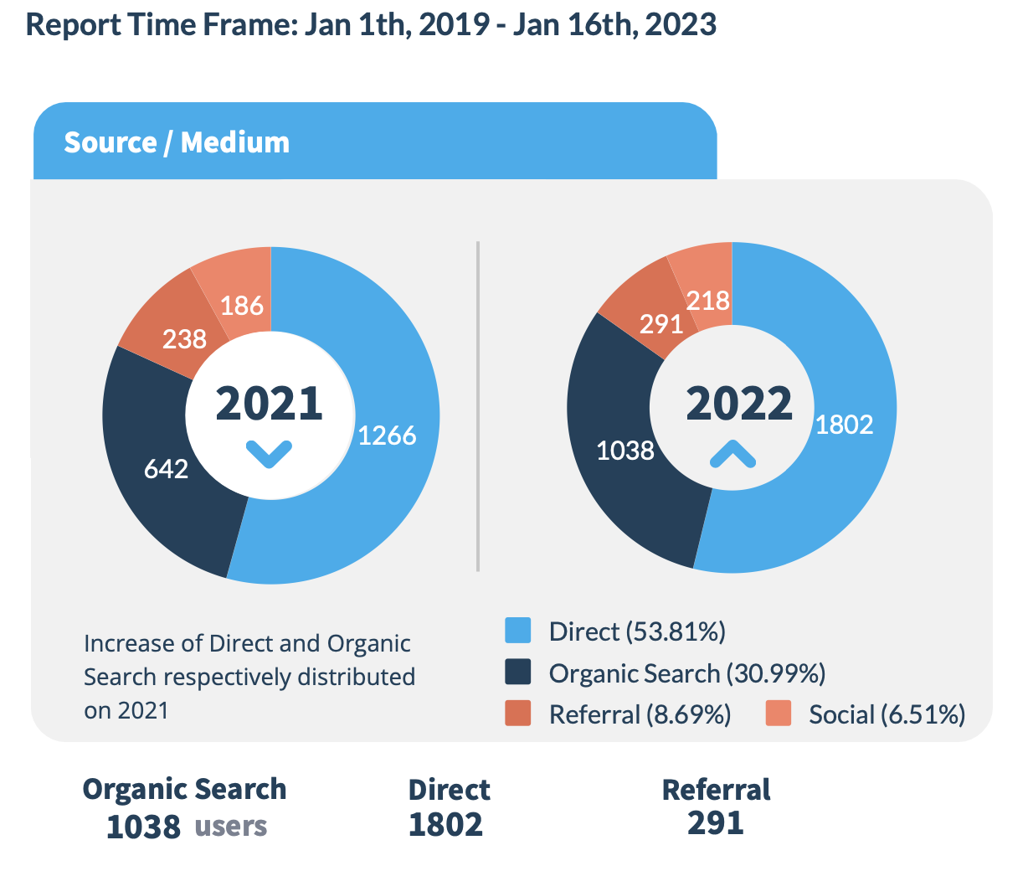
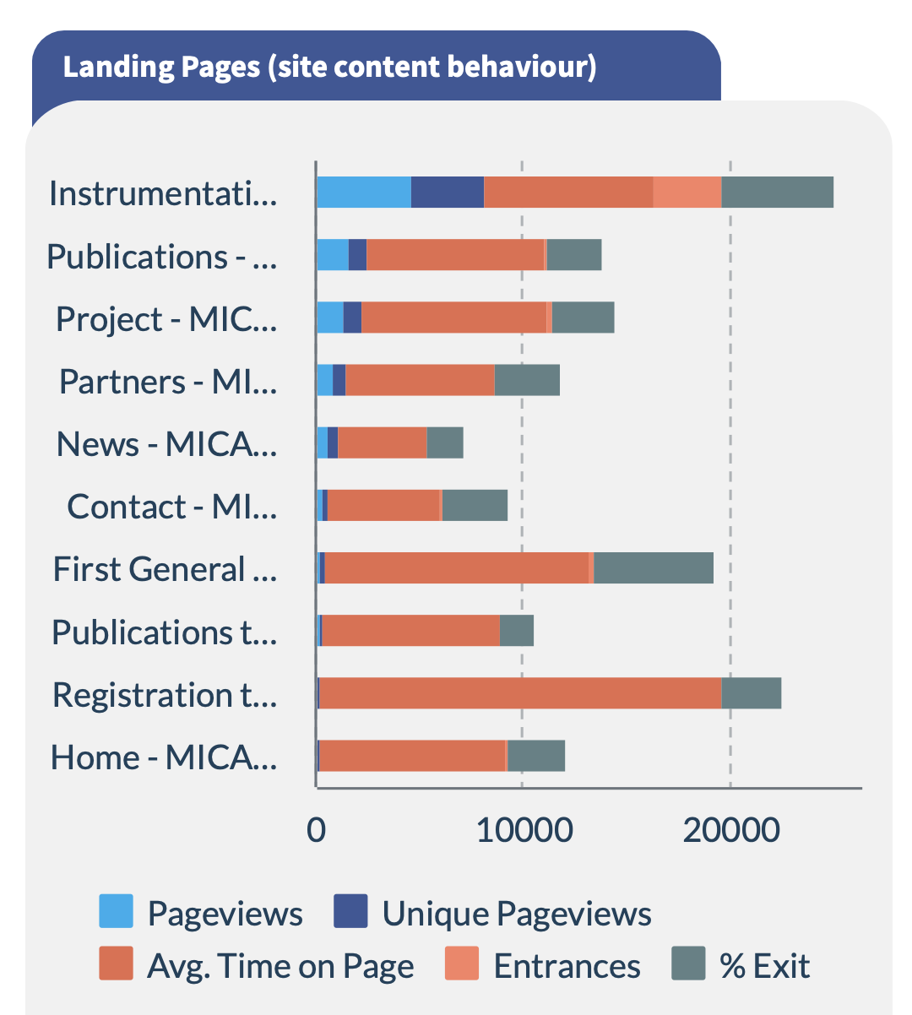
Website activity

Slide 11
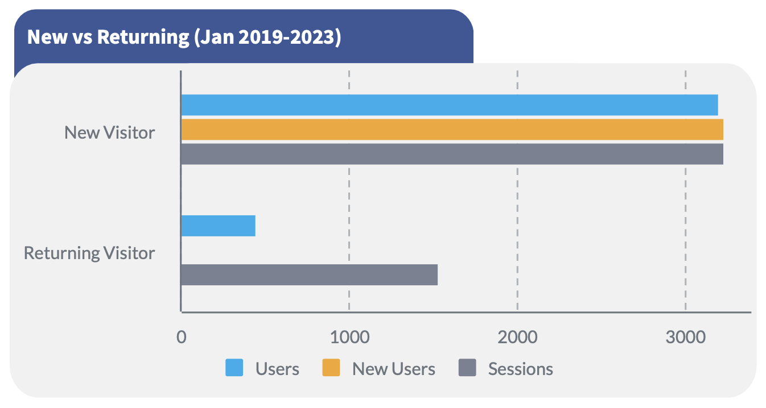
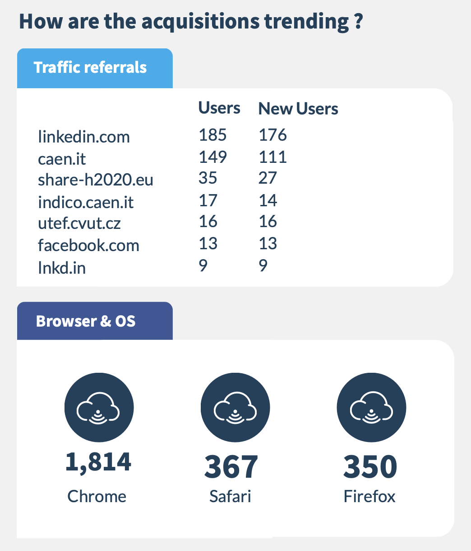
Website activity

Slide 12
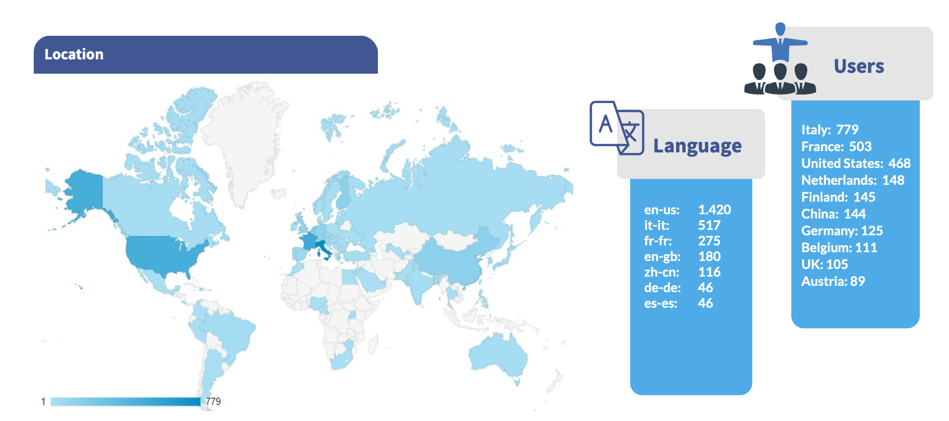
Website activity

Slide 13
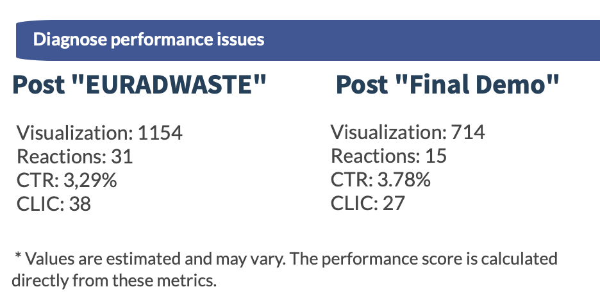
Website activity

Slide 14
Conferences/Events
SPIE Symposium X- and Gamma ray detectors San Diego 2020 | ago-20 | San Diego (US) | https://spie.org/OPO/conferencedetails/x-ray-gamma-ray-neutron-detector-physics
LINAC2020 | set-20 | Liverpool (UK) | http://linac2020.org/
IAEA General Conference 2020 | set-20 | Wien (A) | https://www.iaea.org/about/governance/general-conference
PREDIS - Public session for Stakeholders | ott-20 | online | https://predis-h2020.eu/public-session-for-stakeholders-on-21-october-2020/
ESARDA conference 2020 | nov-20 | Luxembourg (L) | https://esarda.jrc.ec.europa.eu/
2020 IEEE Nuclear Science Symposium (USA) | nov-20 | Boston (US) | https://nssmic.ieee.org/2020/
International Conference on Radiation Safety | nov-20 | Wien (A) | https://www.iaea.org/events/international-conference-on-radiation-safety-2020
ICOND 2020 | nov-20 | Aachen (D) | https://www.icond.de/welcome.html
SHARE workshop | dic-20 | online | https://share-h2020.eu/
PREDIS - Webinar | gen-21 | online | https://predis-h2020.eu/
SNETP forum 2020 | feb-21 | Rome (IT) | http://www.snetp.eu/snetp-forum-2020-towards-innovative-rd-in-civil-nuclear-fission/
Waste Management Symposia 2021 | mar-21 | Phoenix (US) | http://www.wmsym.org/
ANIMMA 2021 | giu-21 | Prague (CZ) | https://www.showsbee.com/fairs/IEEE-ANIMMA.html
iWoRID 2021 | giu-21 | Ghent (B) | https://indico.cern.ch/event/820476/
IAEA LABONET - Technical Meeting on Achievements and Challenges in Radioactive Waste Characterization | ago-21 | Wien (A) | https://nucleus-qa.iaea.org/sites/connect/LABONETpublic/Pages/default.aspx
ESARDA and INMM joint annual meeting 2021 | ago-21 | Wien (A) | https://esarda.jrc.ec.europa.eu/
DEM 2021 - Decommissioning Challenges: Industrial Reality, Lessons learned and Prospects | set-21 | Avignon (FR) | https://www.sfen-dem2021.org/
SIF 2021 | set-21 | Italy | 107° Congresso Nazionale (sif.it)
ICOND 2021 | ott-21 | Aachen (D)
2021 IEEE Nuclear Science Symposium | ott-21 | Yokohama (JP) | https://nssmic.ieee.org/2021/
WNE 2020 (postponed) | nov-21 | Paris (F) | https://www.world-nuclear-exhibition.com/en-gb.html
nternational Conference on Radioactive Waste Management: Solutions for a Sustainable Future | nov-21 | Wien (A) | https://www.iaea.org/events/international-conference-on-radioactive-waste-management-2021
Nuclear Decommissioning & Waste Management Summit | feb-22 | London (UK) | https://www.wplgroup.com/aci/event/nuclear-decommissioning-waste-management-summit/
Waste Management Symposia 2022 | mar-22 | Phoenix (US) | http://www.wmsym.org/
Technical Meeting on International Safeguards in the Design of Radioactive Waste Management Programmes | mar-22 | Wien (A) | https://www.iaea.org/events/evt1904461
ESARDA conference 2022 | mag-22 | Luxembourg (L) | https://esarda.jrc.ec.europa.eu/
FISA 2022 – EURADWASTE ’22 | mag-22 | Lyon (F) | Save the date: FISA 2022 – EURADWASTE ’22 | Commissione europea (europa.eu)
SORMA 2022 | giu-22 | Ann Arbor (US) | http://rma-symposium.engin.umich.edu/
2022 IEEE Nuclear Science Symposium | nov-22 | Milan (IT) | https://nssmic.ieee.org/2022/
DIGIDECOM 2022 | ott-22 | Halden (NO) | https://decommissioning.com/en/events/digidecom-2022/
The complete file is available on sharepoint in the WP3 folder

Slide 15
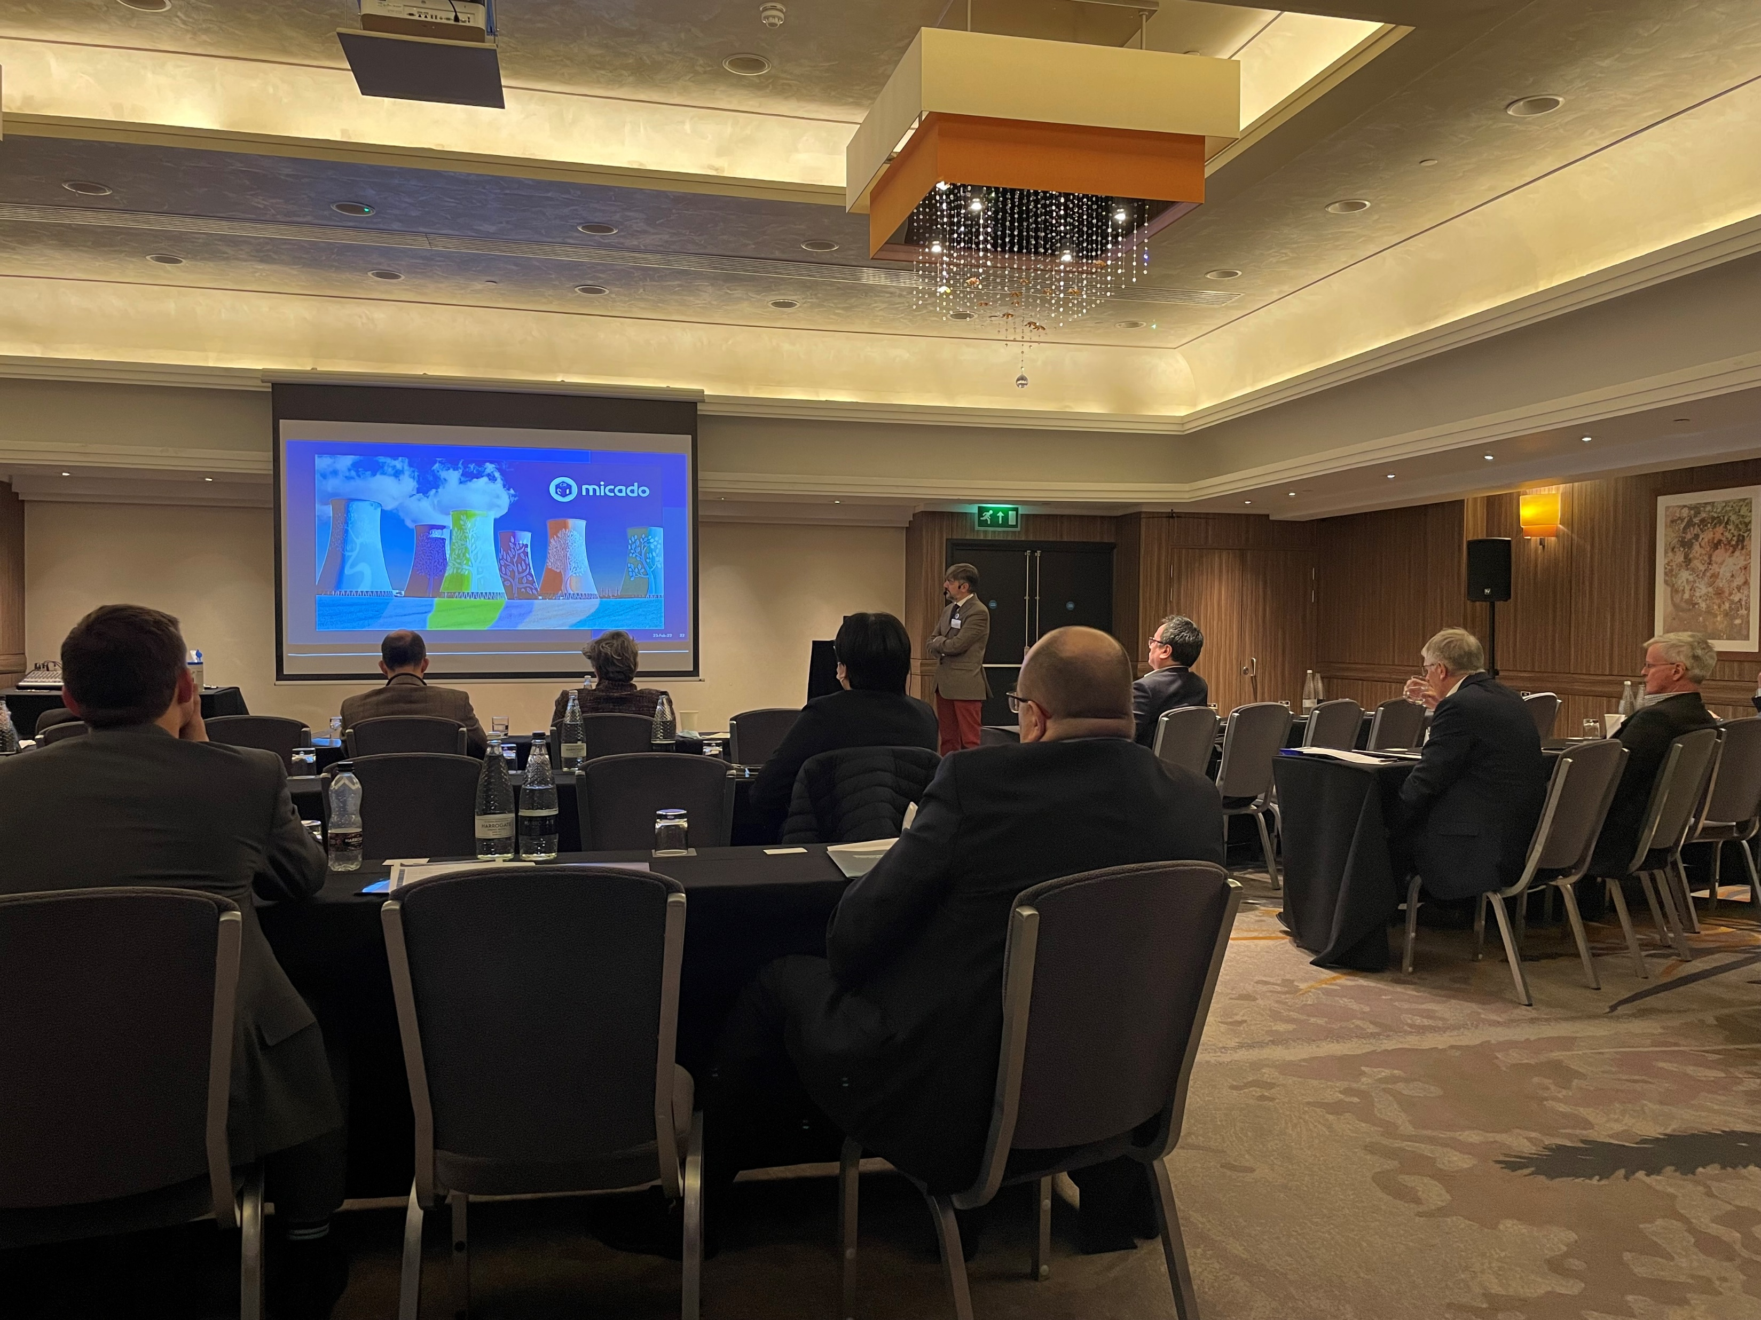
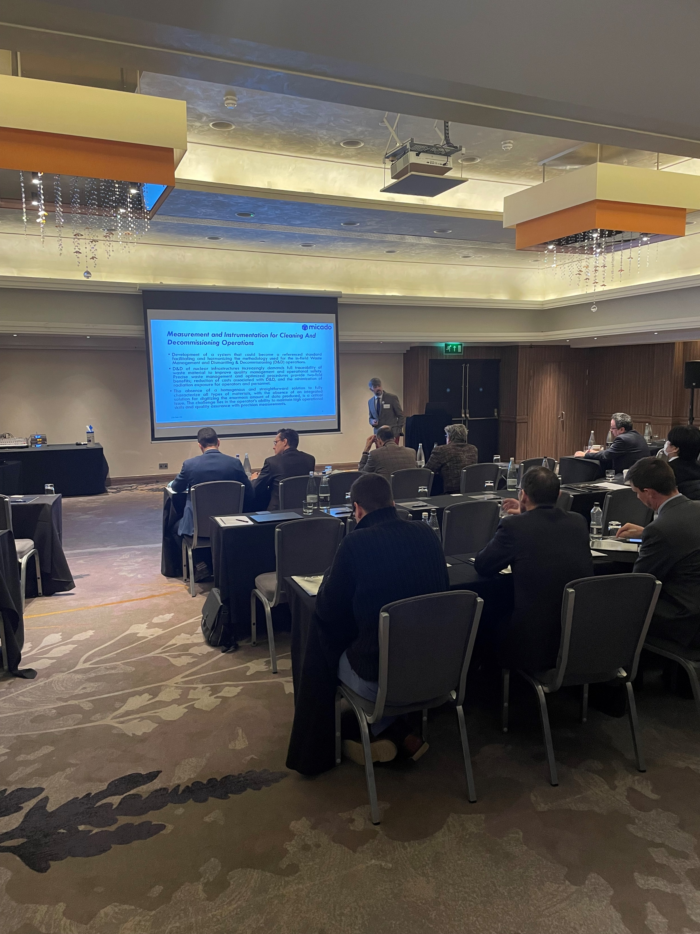
MICADO @ Nuclear Decommissioning & Waste Management Summit – London, UK

Slide 16
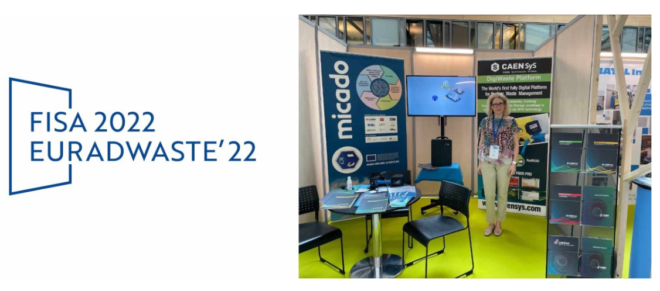
MICADO @ FISA-EURADWASTE

Slide 17
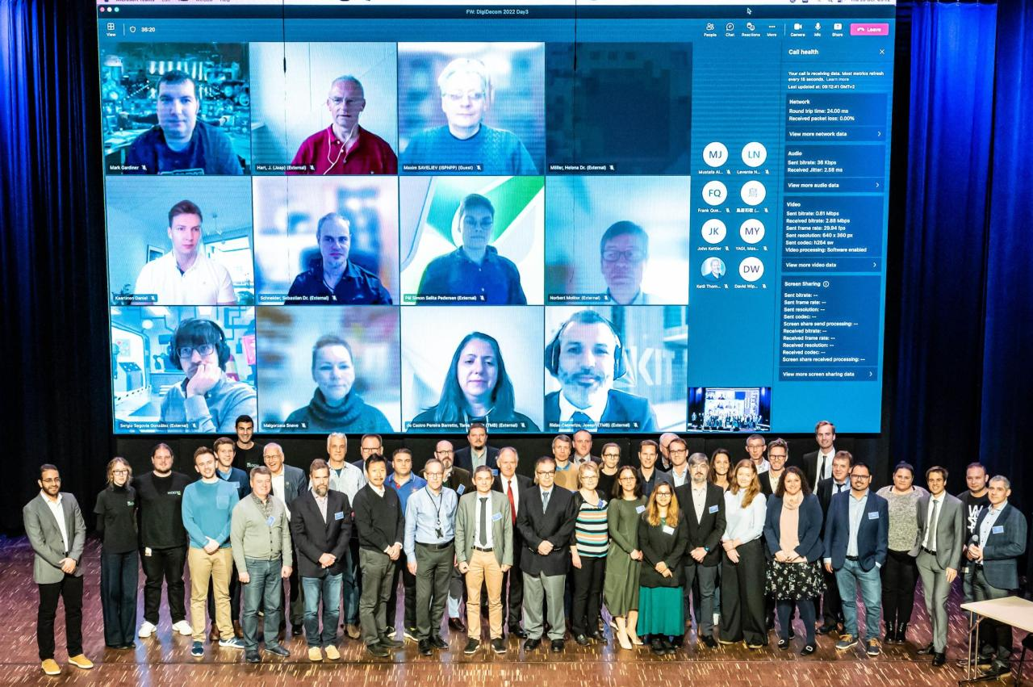
MICADO @ DIGIDECOM 2022

Slide 18
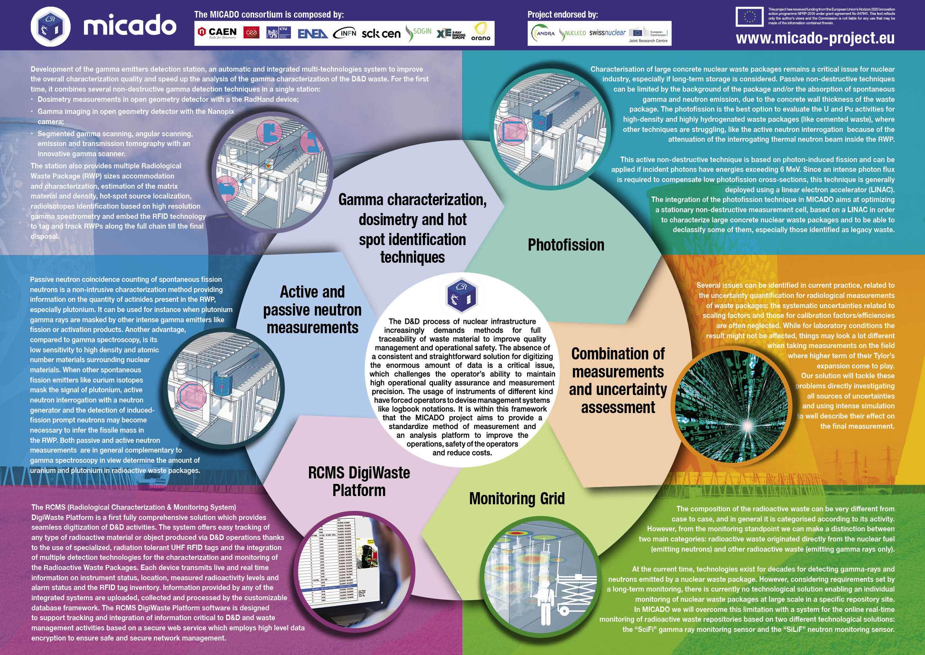
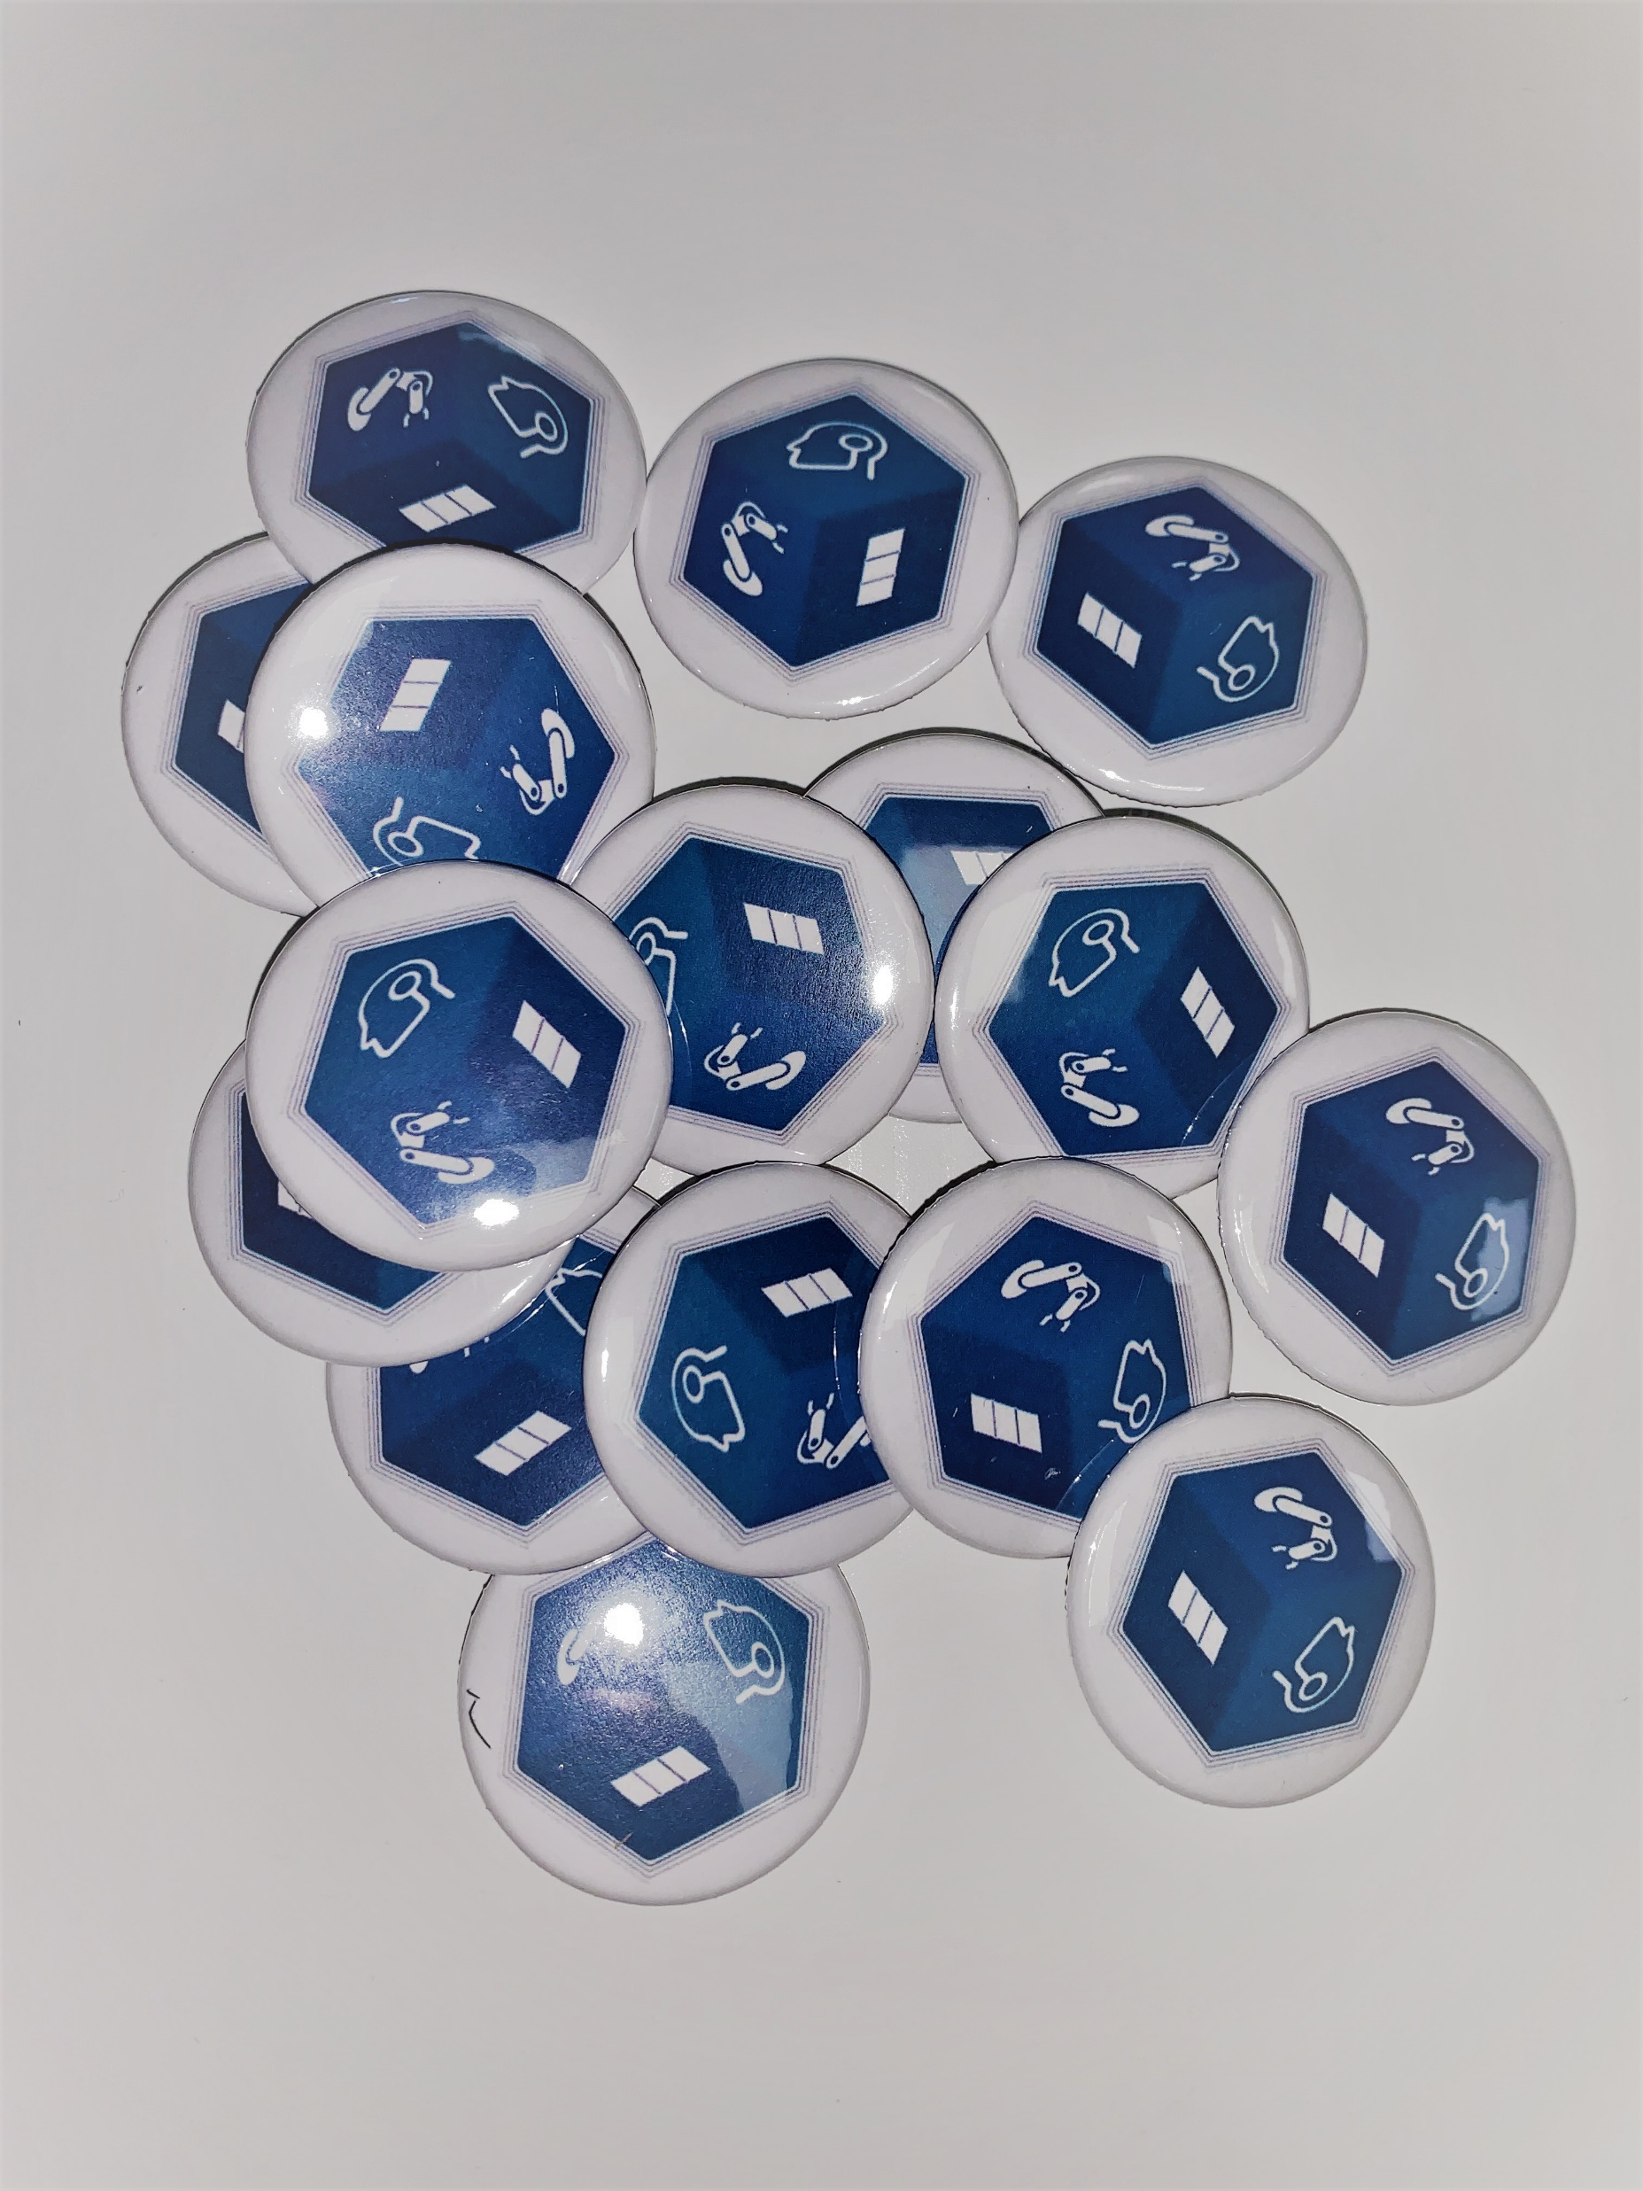
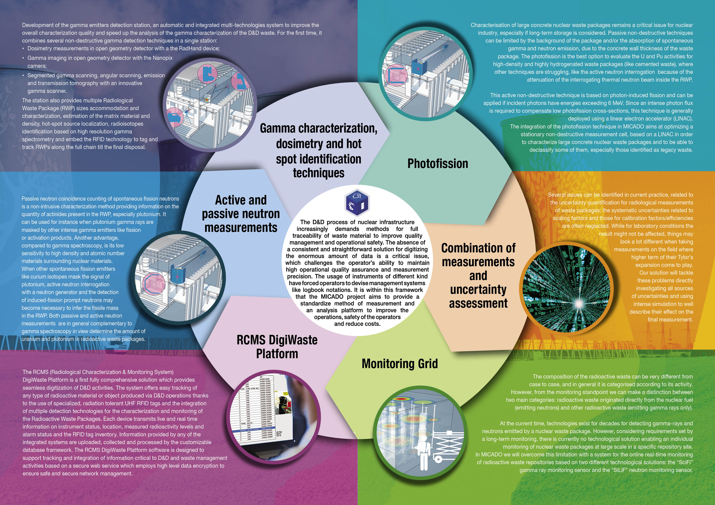
Conference Kits
Folded leaflet
MICADO Pins
A0 Poster (file)

Slide 19
Abstracts Submitted
number | title | corresponding author | Conference
1 | Monitoring of the Photon and Photoneutron Beams Stability Induced by 6 or 9 MeV Bremsstrahlung Fluxes from Linear Electron Accelerator for Photofission Applications | Iaroslav Meleshenkovskii | LINAC2020
2 | Design of advanced MICADO’s passive and active neutron measurement system for radioactive waste drums assays | Quentin Ducasse | 2020 IEEE Nuclear Science Symposium and Medical Imaging Conference
3 | Design of advanced MICADO’s passive and active neutron measurement system for radioactive waste drums assays | Quentin Ducasse | Paper submitted to NIM A for review the 8th of january 2021
4 | Design of advanced MICADO’s passive and active neutron measurement system for radioactive waste drums assays | Quentin Ducasse | ANIMMA 2021
5 | Design of a 9 MeV Linac-Based Stationary System Dedicated to the Characterization of 220 Liter Nuclear Waste Drums by Photofission | Adrien Sari | 2020 IEEE Nuclear Science Symposium and Medical Imaging Conference
6 | Design of a mobile linac-based system for characterization of nuclear waste packages by photofission | Iaroslav Meleshenkovskii | SFEN DEM 2021
7 | The gamma and neutron monitor counters for the MICADO project | Paolo Finocchiaro | ANIMMA 2021
8 | Characterization of nuclear waste packages by active photon interrogation with mobile or stationary systems based respectively on 7 or 9 MeV linacs | Adrien Sari | ANIMMA 2021
9 | The Euratom project MICADO and its innovative characterization process of the Nuclear Waste Packages | Erica Fanchini | ANIMMA 2021
10 | MICADO Project - Measurement and Instrumentation for Cleaning and Decommissioning Operations | Giacomo Mangiagalli | ICOND 2020
11 | Timepix3 detector network for nuclear waste monitoring | Bartolomej Biskup | ANIMMA 2021
12 | Comprehensive optimization strategies for Compton imaging applications based on hybrid pixel detectors | Martin Pichotka | ANIMMA 2021
13 | The Euratom project MICADO and its innovative characterization process of the Nuclear Waste Packages | Erica Fanchini | IAEA Conference on Radioactive Waste Management 2021
14 | Nuclear waste monitoring and hazard detection software for Timepix3 detector network | Lukas Meduna | iWoRID 2021
15 | The Euratom project MICADO and its innovative characterization process of the Nuclear Waste Packages | Erica Fanchini | SFEN DEM 2021
16 | SIF - 107° Congress of the Italian Physical Society | Fabio Longhitano | https://www.sif.it/attivita/congresso/107
The complete file is available on sharepoint in the WP3 folder

Slide 20
Papers/Thesis
number | title | corresponding author | Journal
1 | From nuclear physics to applications: detectors for beam handling, medical diagnostics and radioactive waste monitoring | Paolo Finocchiaro | European Physical Journal Plus
2 | Optimization of a 9 MeV electron accelerator Bremsstrahlung flux for photofission-based assay techniques using PHITS and MCNP6 Monte Carlo codes | Iaroslav Meleshenkovskii | Nucl. Instr. Meth. B
3 | Bayesian inference of 1D activity profiles from segmented gamma scanning of a heterogeneous radioactive waste drum scanning of a heterogeneous radioactive waste drum | Eric Laloy | Applied Radiation and Isotopes
4 | Design of MICADO advanced passive and active neutron measurement system for radioactive waste drums | Quentin Ducasse | Nucl. Instr. Meth. A
5 | Neutron Counters to Monitor Nuclear Materials in the MICADO Project | Paolo Finocchiaro | Sensors
6 | Gamma—Ray Counters to Monitor Radioactive Waste Packages in the MICADO Project | Paolo Finocchiaro | Instruments
7 | Feasibility study of the photofission technique for characterization of 220-L concrete-lined nuclear waste drums at 7 or 9 MeV energies | Iaroslav Meleshenkovskii | Nuclear Instruments and Methods section A
8 | Timepix3 detector network for nuclear waste monitoring | Bartolomej Biskup | EPJ Web of Conferences
9 | Rivelatori di gamma e neutroni per il monitoraggio di rifiuti radioattivi nel progetto MICADO | Fabio Longhitano | Atti del 107° congresso della Società Italiana di Fisica
10 | Gamma-Ray Counters for the MICADO Project | Fabio Longhitano | INFN-LNS activity report 2020
11 | SiLiF Neutron Counters for the MICADO Project | Fabio Longhitano | INFN-LNS activity report 2020
number | title | Student | Defence date | Link/comment
1 | I rivelatori del progetto MICADO per il monitoraggio dei rifiuti radioattivi | Martina Giuffrida | 07-giu-21 | 110/110 cum laude
The complete file is available on sharepoint in the WP3 folder

Slide 21
MICADO Short Video
https://youtu.be/3xV6WtOUkRk

Slide 22
MICADO Products for exploitation
KEY EXPLOITABLE
RESULTS (KER)
Higher TRL
Further R&D not strictly required
Mature product definition
Clear market positioning
ADD-ON
TECHNOLOGIES
Lower TRL
Further R&D beneficial
Preliminary product definition
Clear added value, to be positioned
GAMMA STATION
GAMMA CAMERA
PHOTOFISSION
NEUTRON STATION
AI
WASTE DATABASE
MONITORING GRID

Slide 23
Partners Roles / IPs
A questionnaire is going answered by project partners after the demo.
Results will be analyzed and summarized in D3.7.
Potential Roles | Yes/No | DETAILS
Partners willing to go to the market |  | Accept the share of investments & risks
Porte-parole partner (not contributing) |  | For coordination purpose only
Partners providing background knowledge willing to claim rights
Partners providing background knowledge NOT willing to claim rights |  | However, may request NDA on their Foreground Knowledge
Partners providing foreground knowledge willing to claim rights
Partners providing foreground knowledge NOT willing to claim rights |  | However, may request NDA on their Foreground Knowledge
 | Yes/No | DETAILS
M |  | Manufacturing, Realization
A |  | Assembly
R |  | Research
C |  | Consultancy, Training
U |  | Utilization in other business
SD |  | Selling, Distribution
S |  | Services

