Slide 1
WP9 – Digital Waste Platform
Final Demo Meeting, 25th January 2023 Andrea Pepperosa, Daniele Ninci, Andrea Della Maggiora

Slide 2
Summary
Introduction
Project Objectives
System’s Description
Work Carried Out
Results

Slide 3
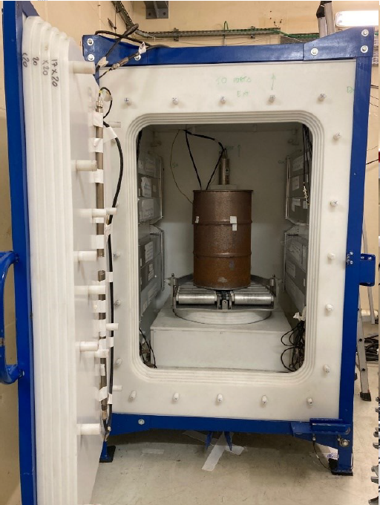
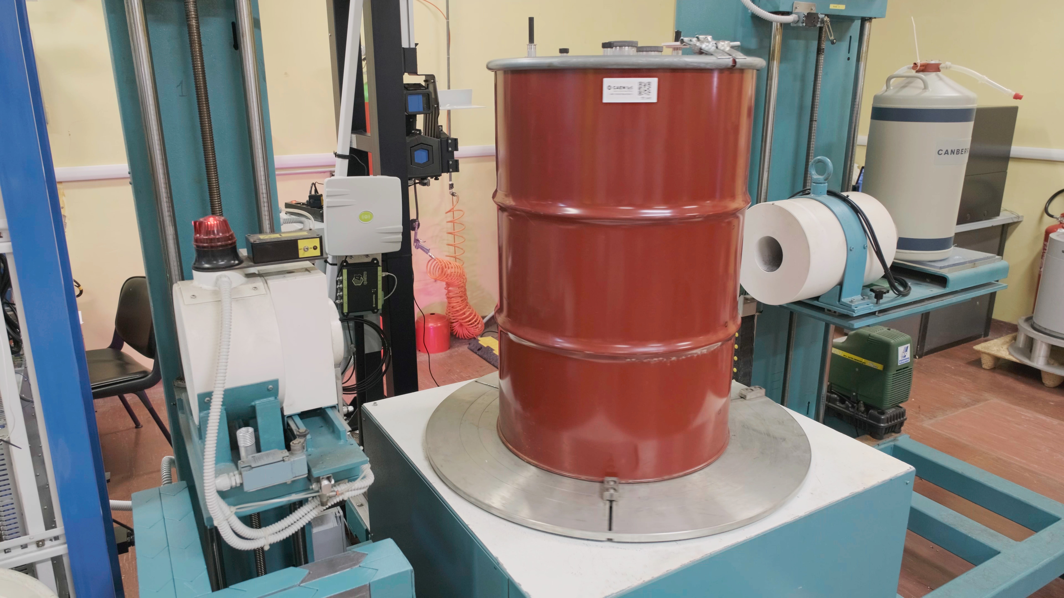
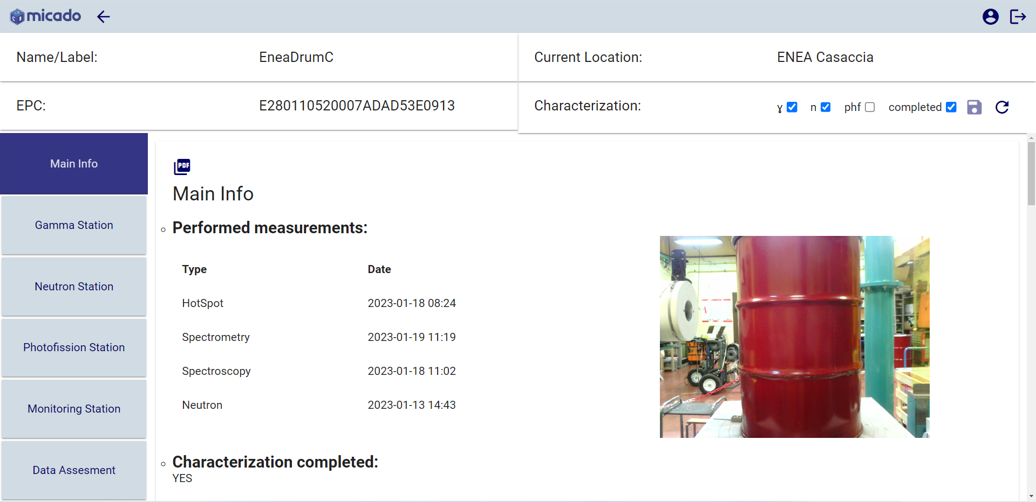
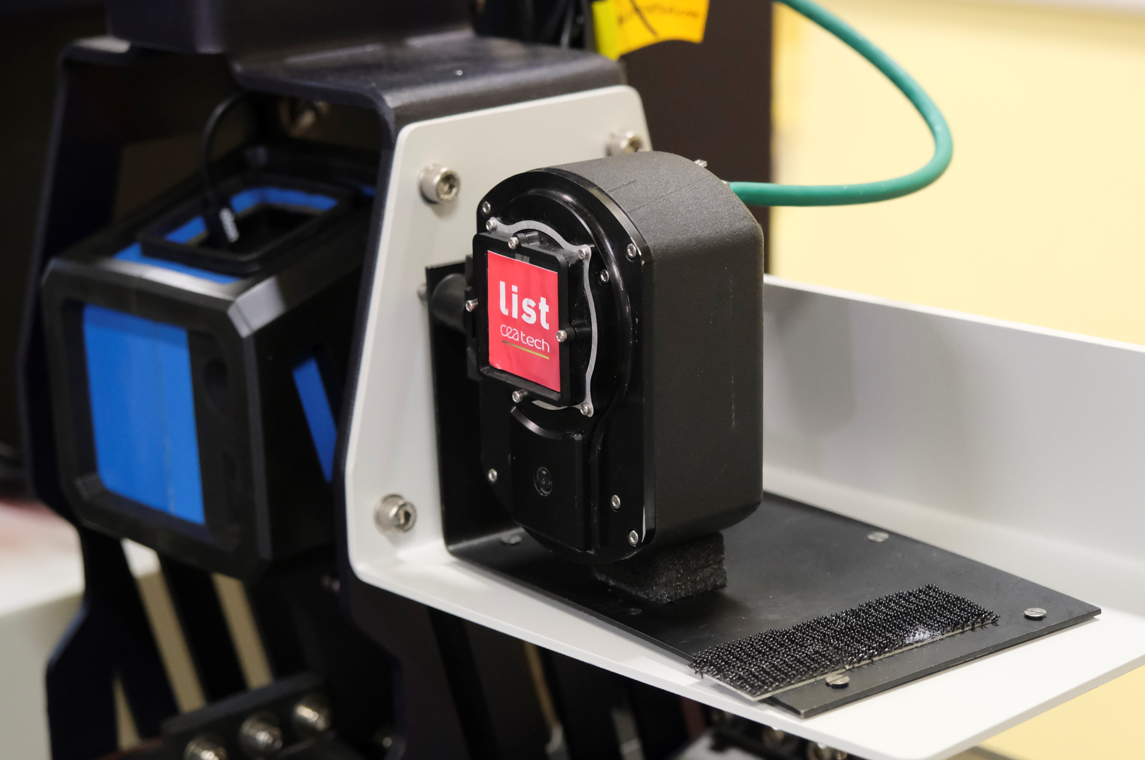
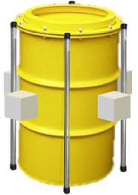
Digital Waste Platform
SOFTWARE PLATFORM for the full digitization of the Nuclear Waste data
Gamma Spectroscopy, Imaging and Spectrometry
Neutron measurements
Pipeline Analysis – Reduction of uncertainties
Long Term Monitoring

Slide 4
Objectives
The primary objective in the MICADO project has been the development of such a software platform:
Defining data transfer protocols and software structure
Integrating and securely transferring external inputs, analyzing and combining them
Associating a digital unique ID of the waste
Applying computational algorithms to optimize results and workflow
Guaranteeing the full operationalities
MODULAR
HOMOGENEOUS
FLEXIBLE in terms of expertise needed
SECURE

Slide 5
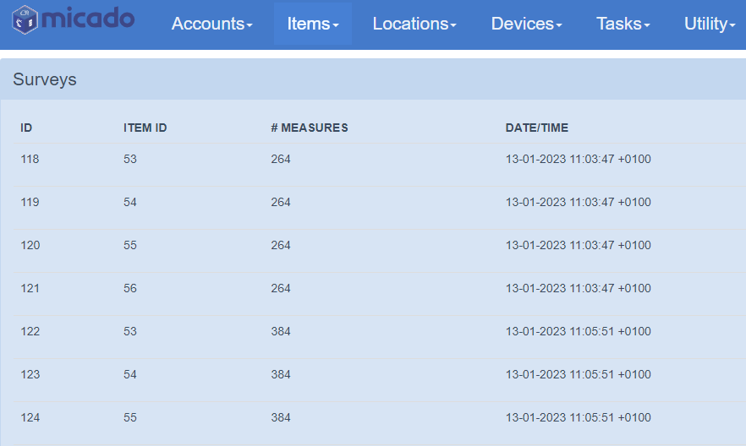
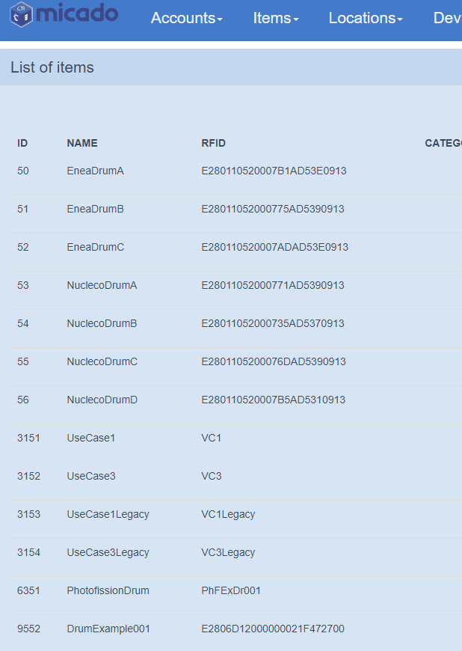
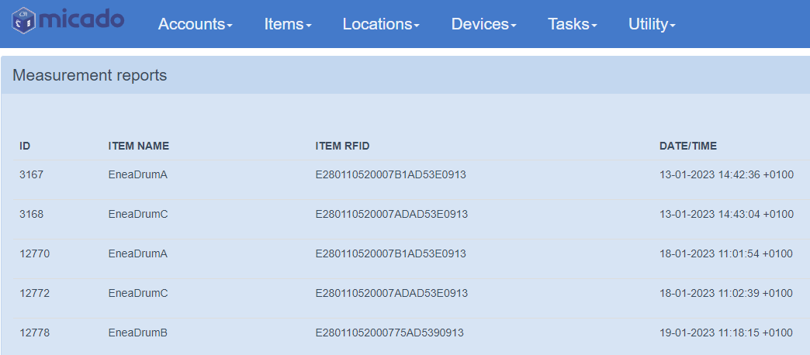
System’s Description
The MICADO Database
SQL RELATIONAL DATABASE
Developed from RadBASE for MICADO requests
Implemented in JAVA
Data uploaded in single reports. (measurements, spectra, images, files)
MONITORING DATA stored in survey containers
Accounts with DIFFERENT PRIVILEGES on reading/writing
Accessible through HTTP REST-API PROTOCOL
Reports
Items List
Surveys

Slide 6
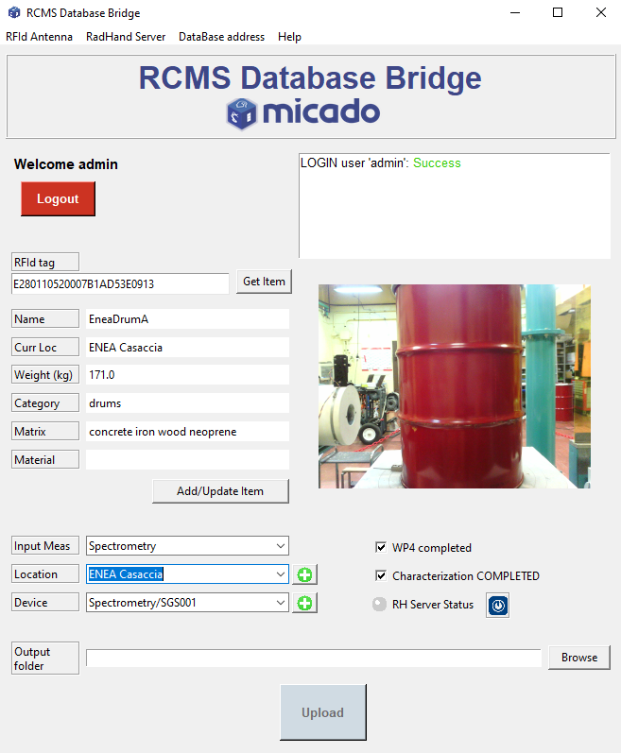
System’s Description
The MICADO Database Bridge
Graphical Interface tool for MICADO experiments written in PYTHON
MULTIPLATFORM
Interfaces the with RFID antenna device (ITEM ID)
Direct communication with MICADO Database through HTTP REST-API PROTOCOL
Manage the PARSING and the UPLOAD on Database the output data of each MICADO technologies
Can be easily EXTENDED for new technologies

Slide 7
System’s Description
The MICADO Database GUI
MICADO interface GUI to the Database
WEB APPLICATION written in TypeScript within Angular framework
Adopted functional paradigm
Use of specific purpose functions combined in pipelines to create more complex functions
Item info filtered depending on the USER PRIVILEGES
Direct communication with MICADO Database through HTTP REST-API PROTOCOL

Slide 8
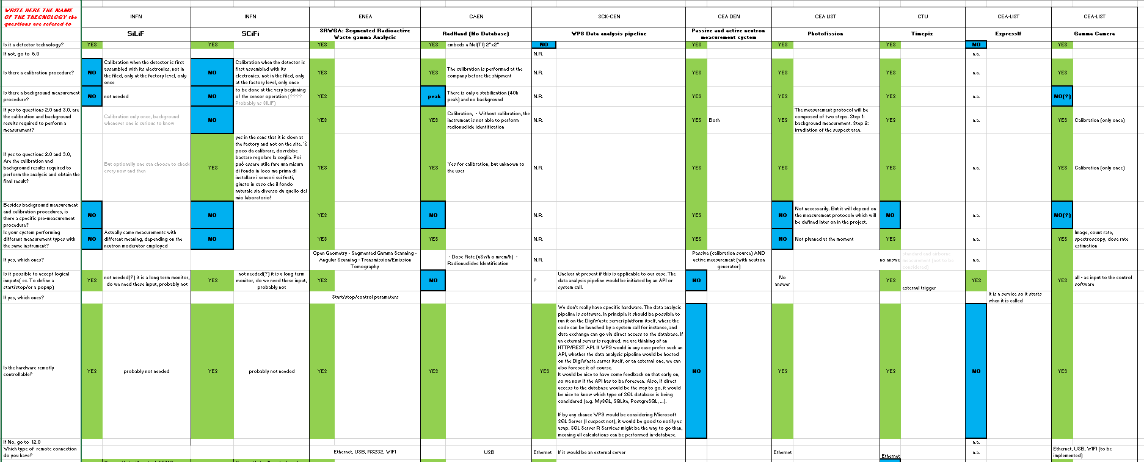
Work Carried Out (I/VII)
Definition of the communication protocols and data formats: Questionnaire sent to every Partner

Slide 9
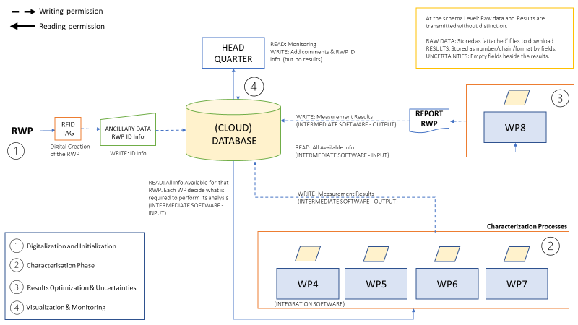
Work Carried Out (II/VII)
Dataflow & Software structure
4
3
1
1
2
2
3
4

Slide 10
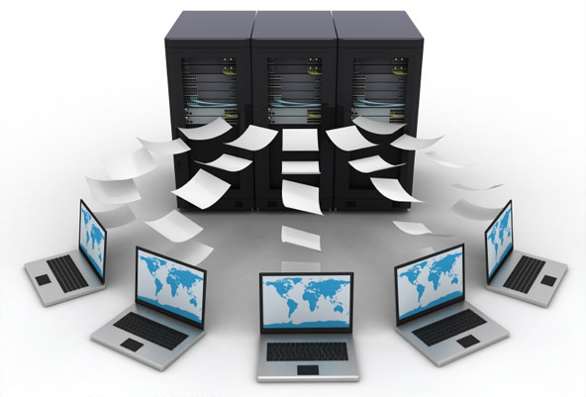
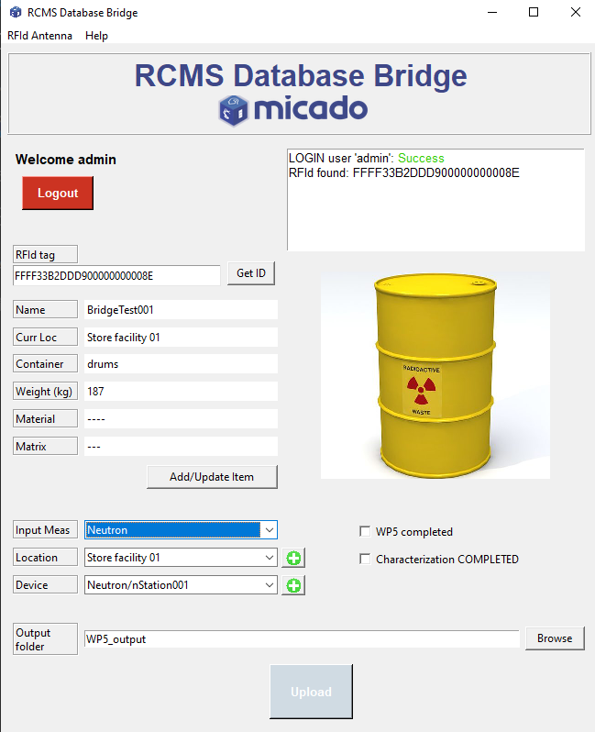
Work Carried Out (III/VII)
Software dvpt and technologies integration
RCMS Database Bridge
RCMS Database

Slide 11
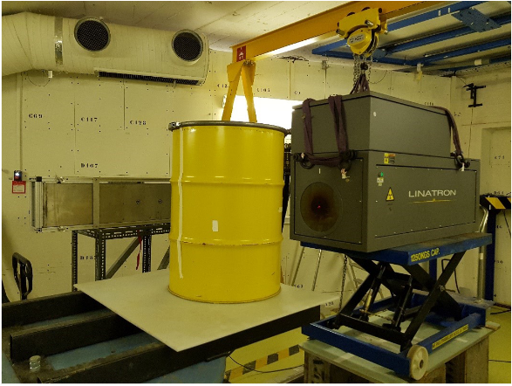
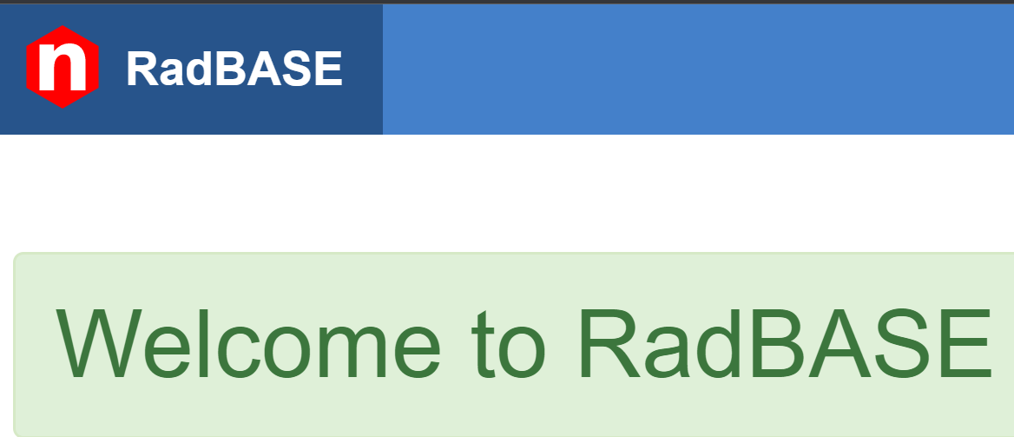
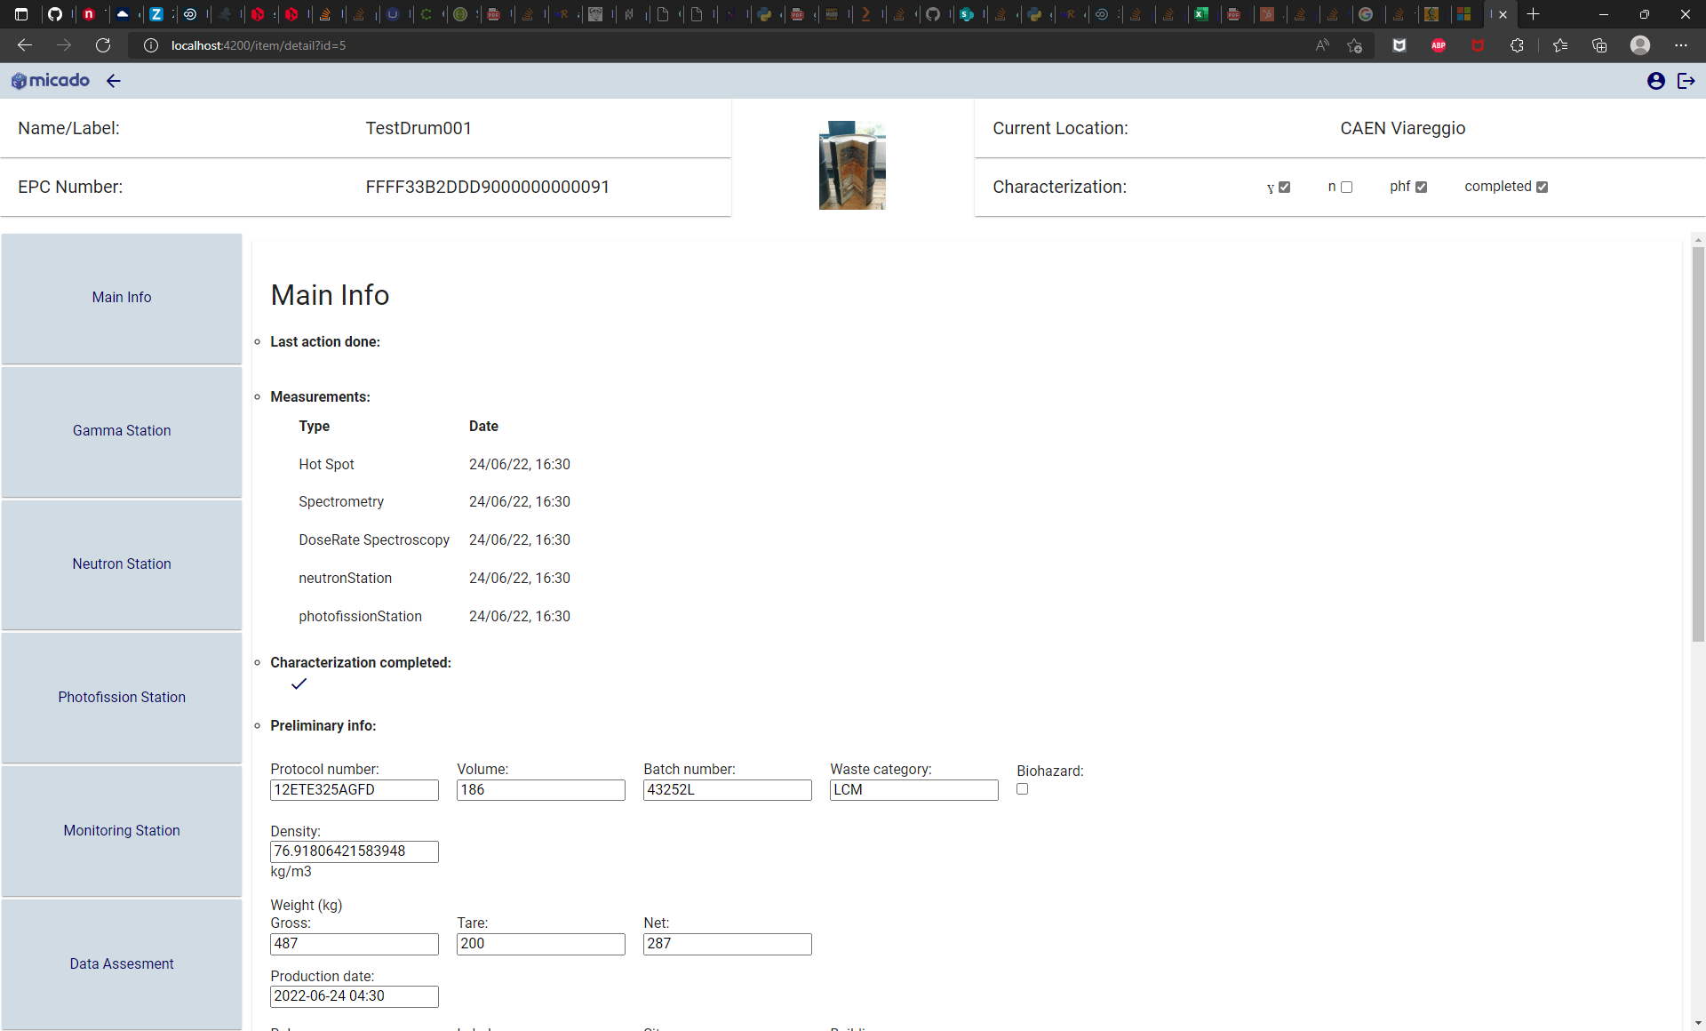
Work Carried Out (IV/VII)
Software development and technologies integration
RadBASE for MICADO
Managed by CAEN
Drums Measurement Site
RCMS Bridge
RCMS Database GUI
Tech and supervisors of WPs
All Micado Users

Slide 12
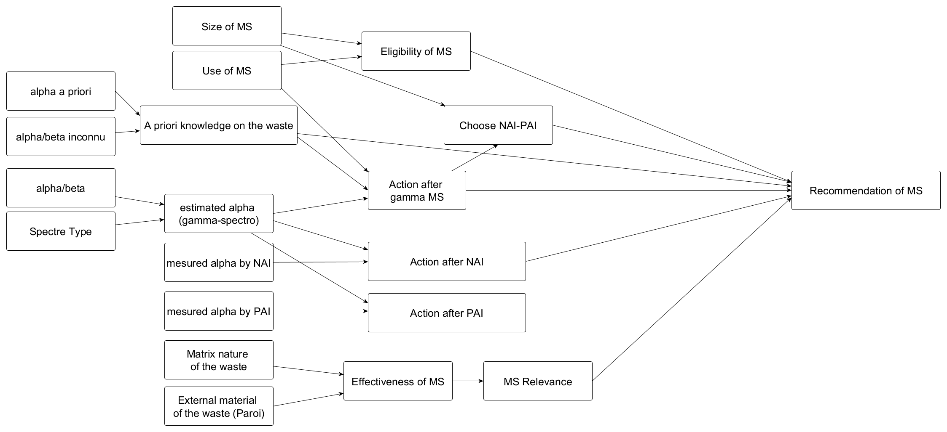
Work Carried Out (V/VII)
AI algorithm implementation
Workflow recommendation
Extract from the rule base that allows which detector can be used next
From MICADO experts’ interview
MS = Measurement System
NAI = Neutron Active Interrogation
PAI = Photonic Active Interrogation
Allows non-expert people to conduct waste characterization

Slide 13
Work Carried Out (VI/VII)
Same AI algorithm applied in conjunction with gamma camera improvement
Control:
Mask/antimask procedure is now automatic
Json format for the results (image, spectrum, etc.)
Embedding AI and treatments
Embedded software have been rethought for more robustness (restful apis)
Noisy pixels automatic cancellation
Implementation of the Bayesian algorithms developed in WP4
Automatic exposure time
Regarding the number of events and the quality of data, ExpressIF® advices if the acquisition must continue or stop

Slide 14
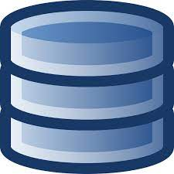
Work Carried Out (VII/VII)
Data Security Assessment and Implementation
Public/private key protocol implemented
Evaluation test of the blockchain technology : software form to test the data encryption and access based on different user configurations
For the test only ancillary and already available drum data/info will be used. No direct connection to the different technologies to minimize the impact.
User dependent
Data encryption blockchain
Data transfer to an external Database
Link to the MICADO database to access the encrypted data
User 1
Form to be manually filled
Par1
Par2
Par3
.
.
.
User 2
User 3
Web form
RadBASE

Slide 15
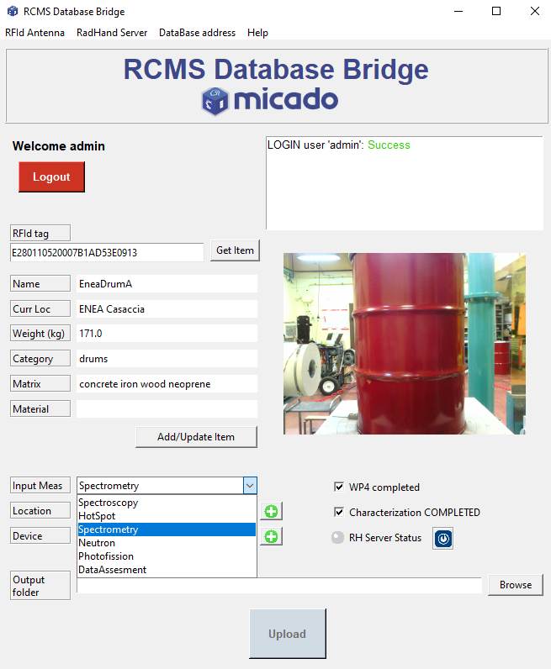
Results
Flexibility
Modularity
Homogeneity
Security

Slide 16
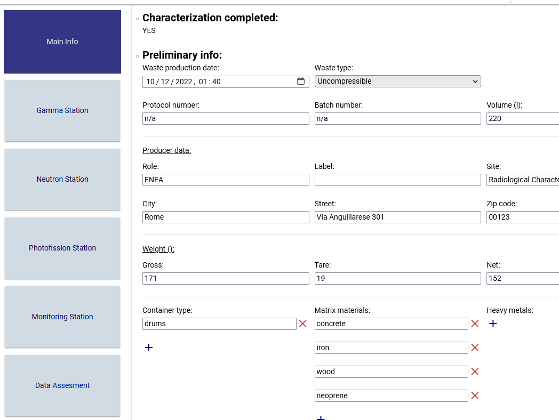
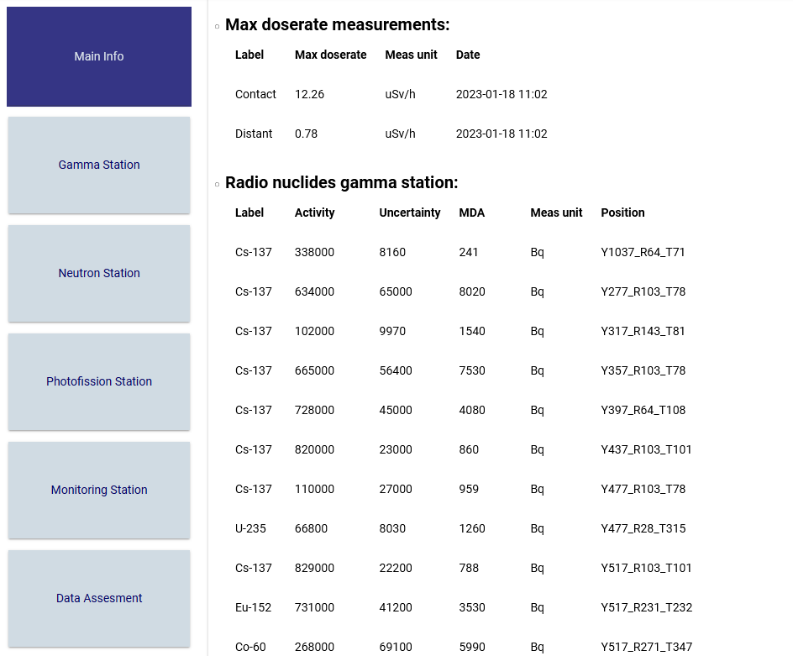
Results
Let’s have a look!

Slide 18
Back up slides

Slide 19
RCMS Database GUI
JavaScript/TypeScript application developed through Angular
Visualization and functionality depend on the user permission
It interfaces with the RMCS DB, but it is decoupled from specific API types
It includes the possibility to download all the information as a document report
1/25/2023
19

Slide 20
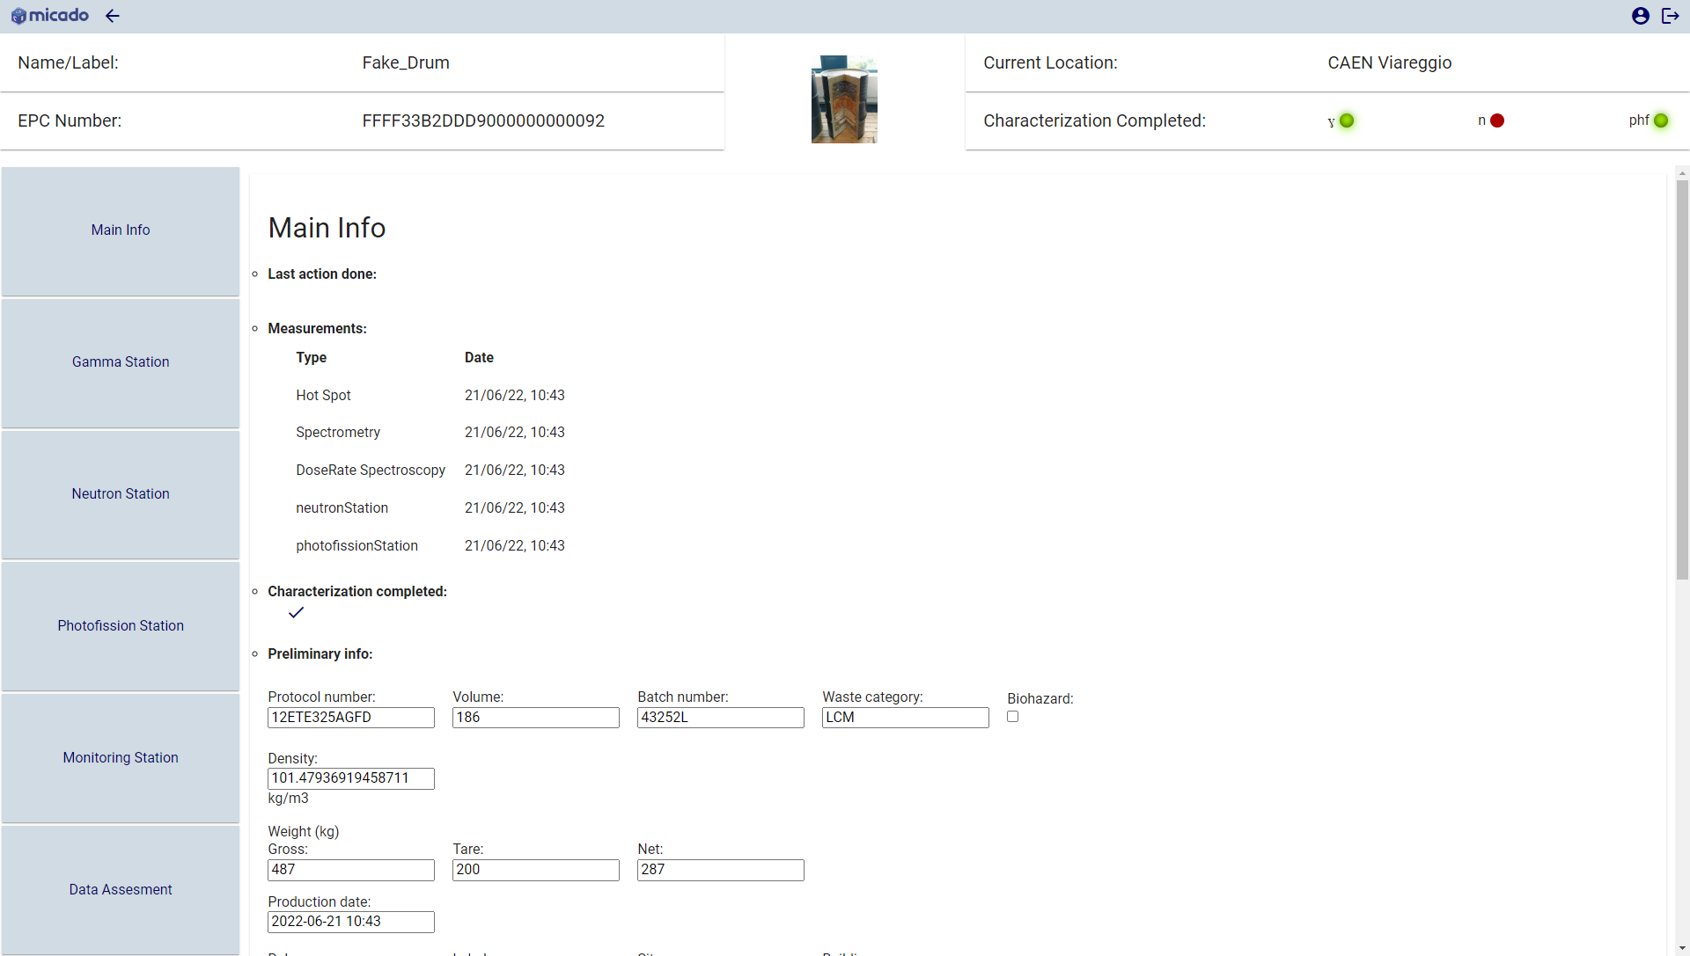
Data Classification
The information reported in the GUI are tagged as ‘PUBLIC’ or ‘EXPERT’
Each quantity characterizing the Drum in term of waste properties are public (i.e. dose rate, radionuclides identified) and each MICADO user has access to them.
All the information related to the technology involved in the characterization or measurement details are classified as ‘EXPERT’ and thus, visible by a restricted group of item.
PUBLIC
EXPERT
1/25/2023
20

Slide 21
RCMS user classification
The Bridge and GUI interaction depends on the type of permission the user has:
 | RCMS Database Bridge |  | RCMS Database GUI
 | Data upload | Create/update item, device, location | PUBLIC info visualization | PUBLIC report download | EXPERT info visualization
Administrator | P | P | P | P | P
WP technician | P | O | P | P | only the own WP
WP Supervisor | P | P | P | P | only the own WP*
External Authority | O | O | P | P | O
*Supervisor can modify the item info and check if the measurement stored lead to a complete characterization of the Drum
1/25/2023
21

Slide 22
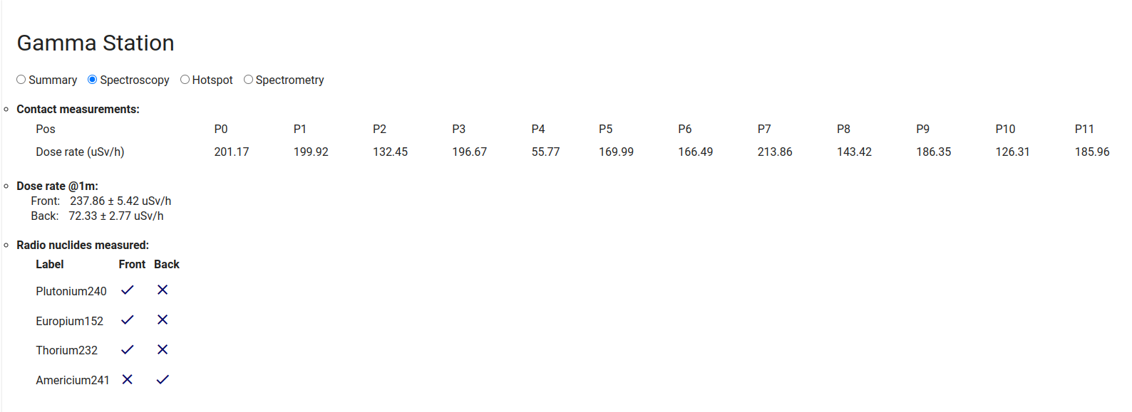
Ex1: RadHAND
PUBLIC
1/25/2023
22

Slide 23
Software dvpt and technologies integration
EXPERT
1/25/2023
23
1/25/2023
23

Slide 24
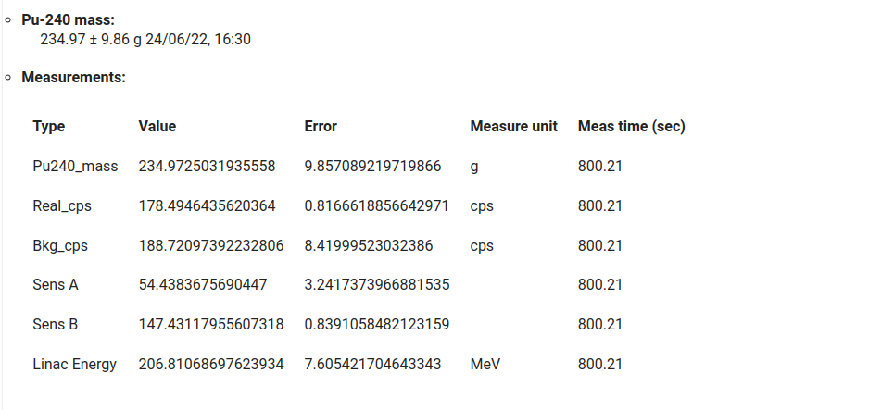
Software dvpt and technologies integration
Ex1: Photofission Station
PUBLIC
EXPERT
1/25/2023
24

Slide 25
RCMS Database GUI
Each technology as a Device Category:
Measurements of each technology are uploaded as a single report
Following the data categorization:
MAIN data section: visualized by every people. Contains results
EXPERT data section: visualized by specific WP user (e.g. WP technician, Supervisor). Contains raw data

Slide 26
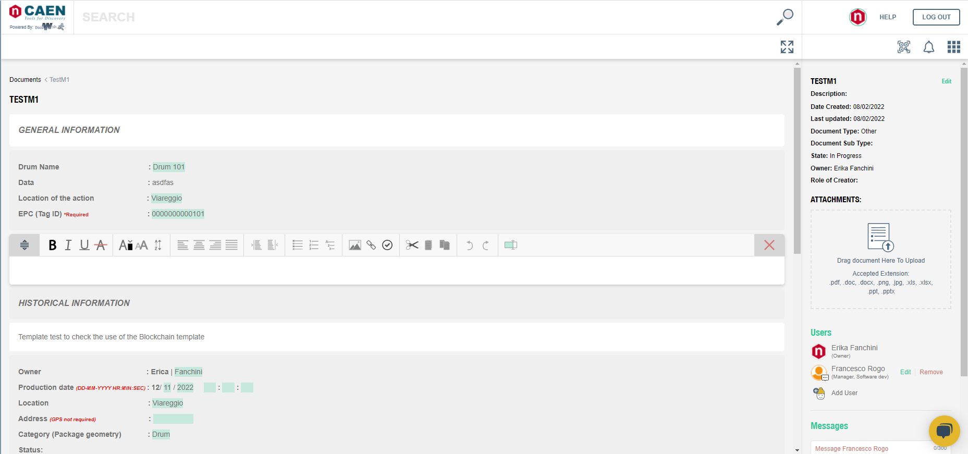
Data security assessment - Blockchain

Slide 27
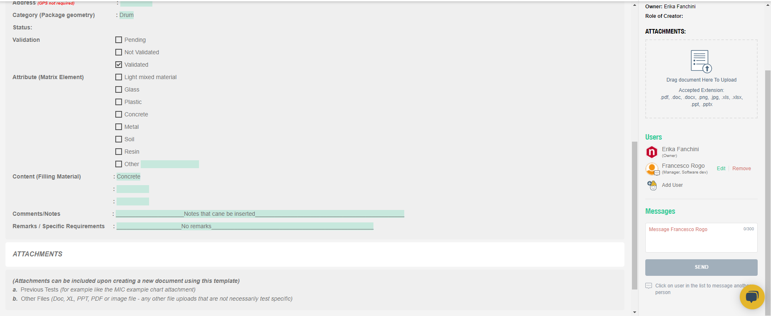
Data security assessment - Blockchain
User based notification system

