Slide 1
WP2: Virtual cases WP8: Combination of measurements and uncertainty assessment
Final Demonstration, 25 January 2023
Eric Breuil (ORANO) & An Bielen (SCK CEN)
Notes:
30 minutes

Slide 2
Outline
WP2: Virtual cases
WP8: Uncertainty assessment
General
Approach
Bayesian inference
True and surrogate models
Results
VC1
VC3

Slide 3
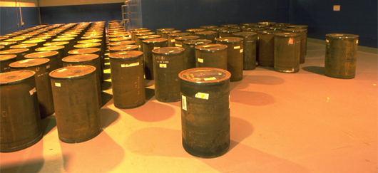
WP2 Virtual Cases
3 virtual cases defined :
Case n°1 : 120L drum containing 5 bags of decontamined wipes
Case n°2 : 120L drum containing metal wastes
Case n°3 : 210L drum containing 6 compacted waste discs
3 MCNP files
To be used by the partners for some developments in the design phasis, e.g. to test algorithms.

Slide 4
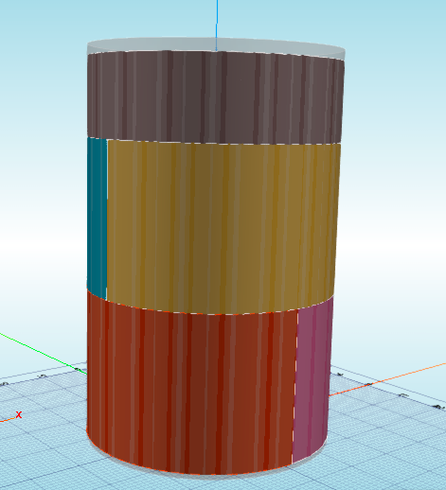
Virtual case n°1 : 120L drum containing 5 bags of decontaminated wipes
Radioactive waste :
5 Bags of wet decontaminated wipes (C₃H₆)
α activity only : 9,48 GBq (0,4 g of Pu) in the drum
Spectrum : Industrial Pu
Each bag has a specific :
Composition and density
Proportion of water
α activity
Package interest :
Realistic packages in the nuclear industry
Package characteristics were established to study the impact of the different measurement methods
Possibility of carrying out an inactive mock-up drum with neutron sources (existing methodology)
Impact of hydrogen in the package, in particular on the neutron characterization methods
Bag n°5
Bag n°4
Bag n°3
Bag n°2
Bag n°1

Slide 5
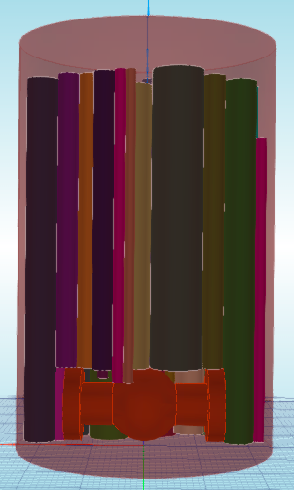
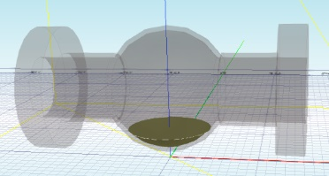
Virtual case n°2 : 120L drum containing metal waste
Radioactive waste :
A valve in the bottom of the drum with 0.68 g of Pu retention (0.77 g of PuO₂)
About fifty pipes in the rest of the drum 0.12 g of Pu distributed inside all the pipes
Spectrum : Very Old Weapon Grade
α activity : : 7.956 GBq in the valve and 1.404 GBq in the pipes
Package interest :
Realistic packages in the nuclear industry
Package containing significant Pu retention (fissile material) at the bottom of the package, which could be underestimated (risk of non-compliance)
Contribution of MICADO compared to classical characterization methods
Set of pipes
Valve
Valve
Residual Pu

Slide 6
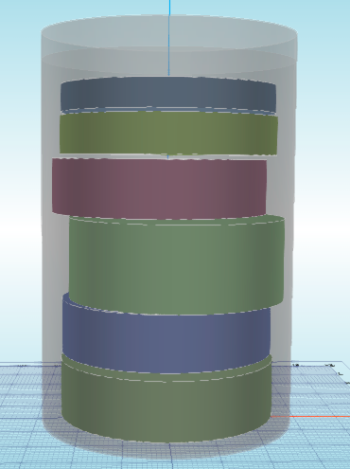
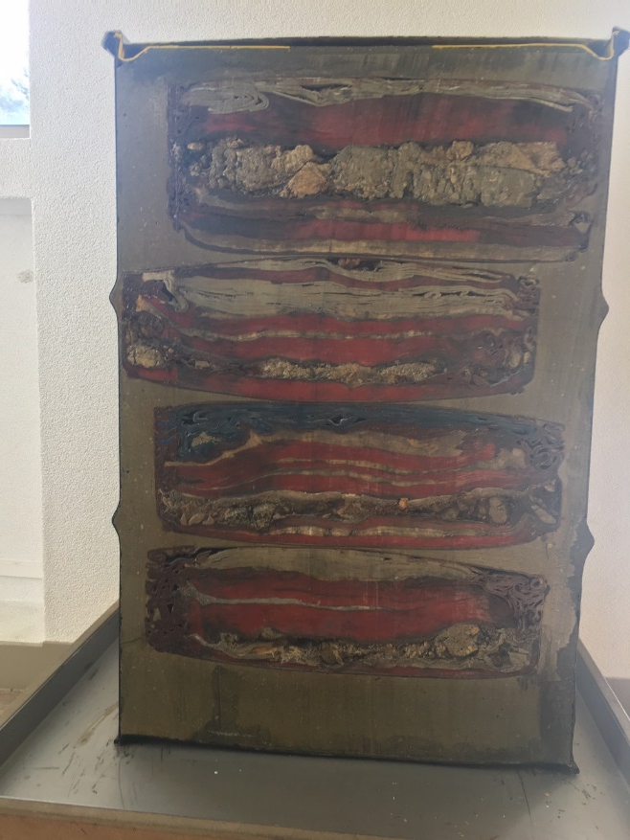
Virtual case n°3 : 210L drum containing 6 compacted waste discs
Radioactive waste :
6 compacted waste discs in a concrete matrix :
2 metallic waste discs
3 technological waste discs
1 PVC waste disc
Each disc has a specific :
Composition and density
Height
Spectrum (α and/or βγ spectrum)
Activity level
Radiological characteristics :
Total α activity : 2.84 GBq (150 mg of Pu)
Total β activity : 11.41 GBq
Package interest :
Realistic packages in the nuclear industry
Package containing α et βγ spectrum (with fissile material)
Contribution of MICADO compared to classical characterization methods (for each primary drum before compaction)
6 compacted waste discs in a concrete matrix
Longitudinal section
of a package

Slide 7
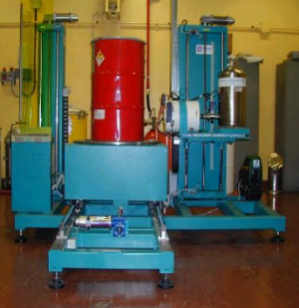
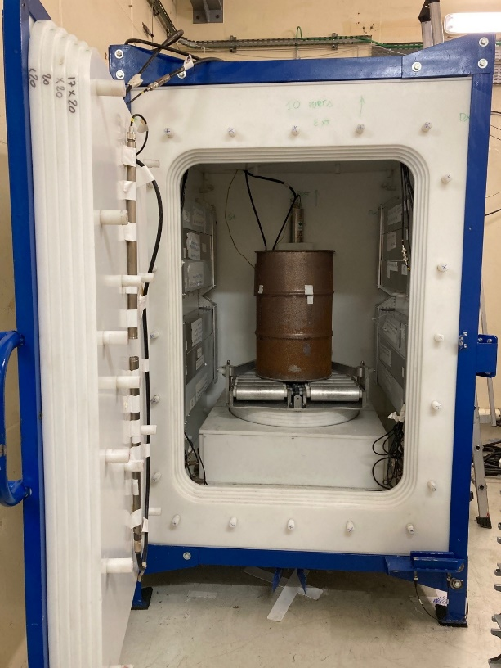
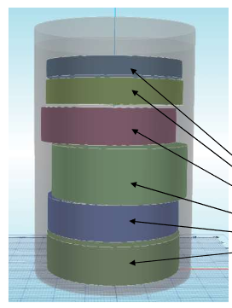
WP8: Uncertainty assessment
Virtual case 1
Bag n°5
Bag n°4
Bag n°3
Bag n°2
Impact of H in the package
Easily modelled
Bag n°1
Gamma spectrometry SGS
Passive & active neutron coincidence (PNCC & ANCC)
Virtual case 3
High density
2 different vectors
Gamma spectrometry SGS
Passive neutron coincidence (PNCC)
Notes:
The criteria for each measurement technique to select two out of three cases comprised the added value, the feasibility (e.g. duration calculations and detection limits) and the work load and calculation time that should stay realistic.
Since VC2 is the most difficult case for performing neutron measurements, as well as for detecting gamma rays, this case has not been considered.
When there is a question about LINAC: Why not LINAC? Many delays due to covid. Besides that, there were some technical issues. So there was no possibility anymore to perform the calculations. And SCK CEN has no experience with calculations for LINAC unlike the techniques of gamma spectrometry and neutron (Has CEA something to add?)

Slide 8
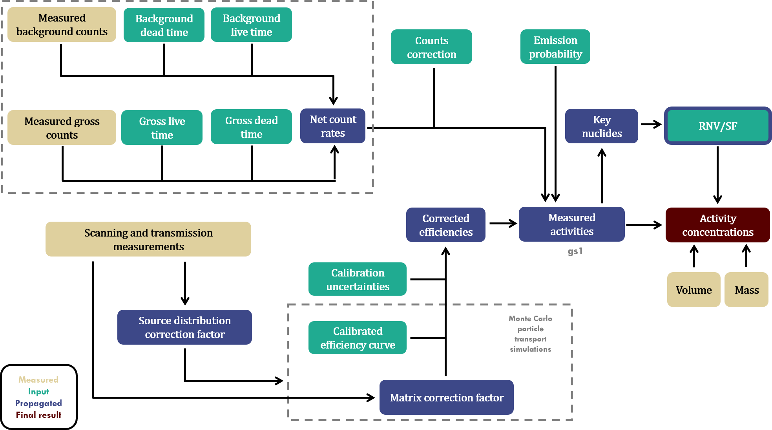
WP8: Uncertainty assessment
Roadmap
Identification of all sources of uncertainties for each measurement technique
Quantification of all sources of uncertainties
MCNP simulations based
Focus on 2 virtual cases
Propagate into final uncertainty
Individual measurement techniques
Combination of measurement techniques
Approach
Bayesian inference
Surrogate modeling
Notes:
Flowchart -> how these uncertainties propagate into a final uncertainty on the inventory for a given waste package.
Measured values -> The actual observed values from the measurements, but also the observed waste package properties (volume, mass)
Input values -> are related to the measurement setup itself
Propagated values -> intermediate results
Final result = activity concentration
Approach is further explained in the following slides.

Slide 9
Approach: Bayesian inference - MCMC
MCMC
MC
prior distribution
input
posterior distribution
measured
gross counts
measured
bkg counts
bkg counts
efficiencies
activities
efficiencies
simulated
gross counts
measured
gross counts
final result
activities
data misfit/likelihood
+ Any distribution
- Multiple observations inform about the same thing
- No check for data-model consistency
+ Updating of prior beliefs according to Bayes theorem
+ Any distribution
+ Multiple observations inform about the same thing
+ Verification if forward model is consistent with observations
Notes:
Standard error propagation = first order Taylor expansion (standard rules for error propagation)
MC -> Monte Carlo = more advances but does not allow improving the result using multiple observations
MCMC -> Markov Chain Monte Carlo = Bayesian approach -> step towards machine learning

Slide 10
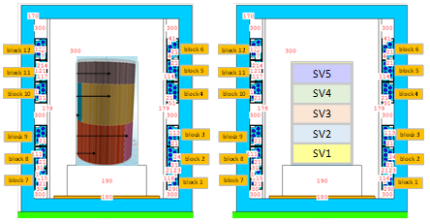
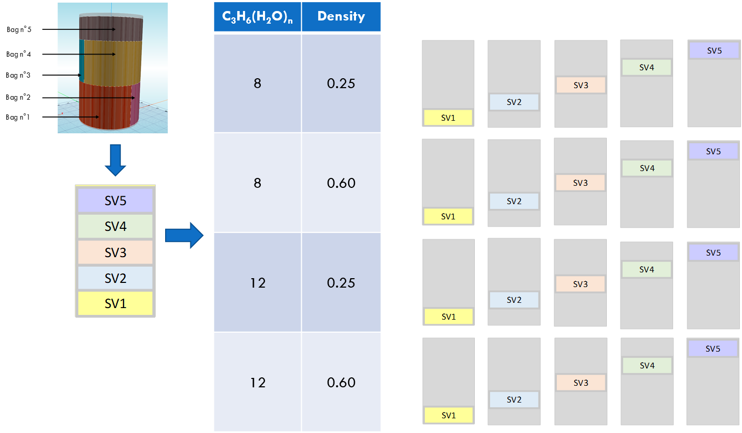
Approach: From true to surrogate model
Example:
Neutron measurement technique VC1
“True” MCNP model
+ simulate result
Surrogate MCNP model + performing simulations
Notes:
Drum is modeled as 1 mm thickness stainless steel
5 sub volumes modeled, each with 2 matrices and 2 densities

Slide 11
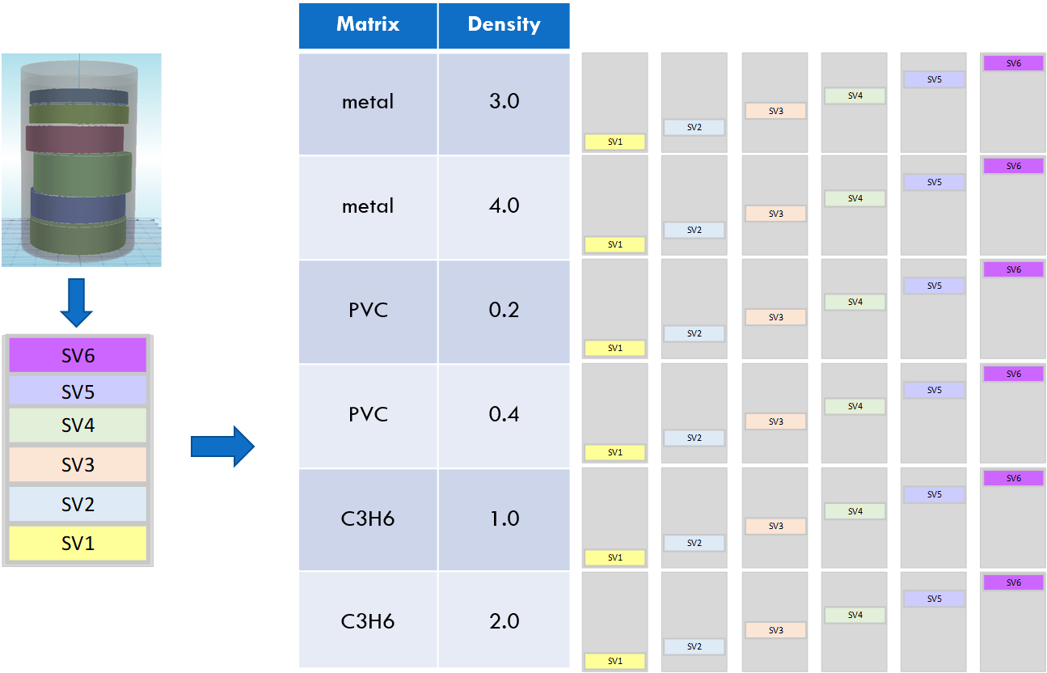
Approach: From true to surrogate model
Example:
Gamma spectrometry
VC3
“True” MCNP model + simulate result
Surrogate MCNP model + performing simulations
Notes:
Drum is modeled as 1 mm thickness of stainless steel.
The concrete is modeled only on the sides of the compacted drums (and not between – above and below) the discs.
Each compacted disc is modeled with an envelope of 1mm stainless steel.

Slide 12
DigiWaste Platform (WP9)
Meta data
Measurement Techniques
Gamma spectrometry
Passive coincidence neutron counting
Active neutron interrogation
Measurement data
Connection
(WP9)
WP8
Data assessment
(MICADO data analysis pipeline)

Slide 13
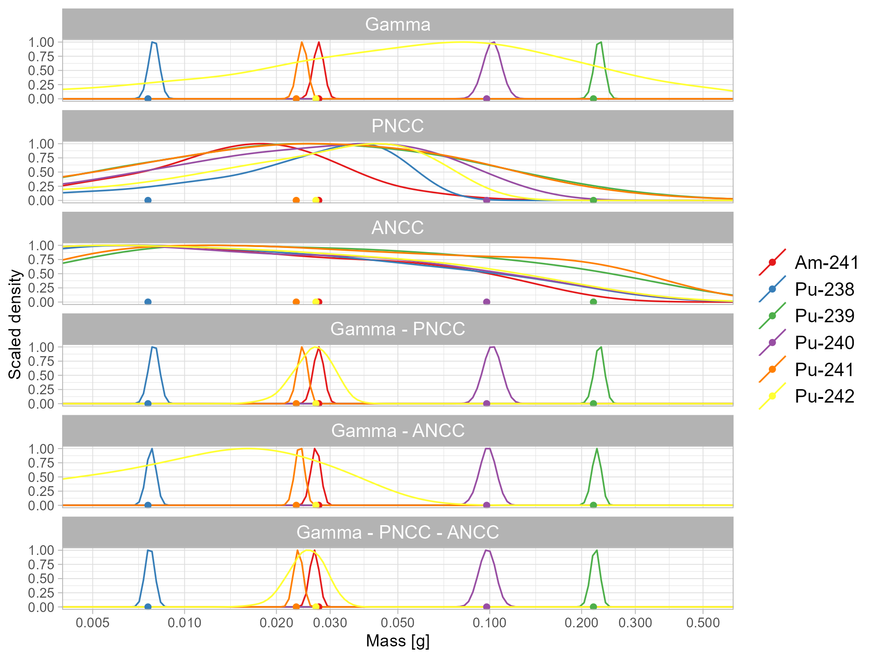
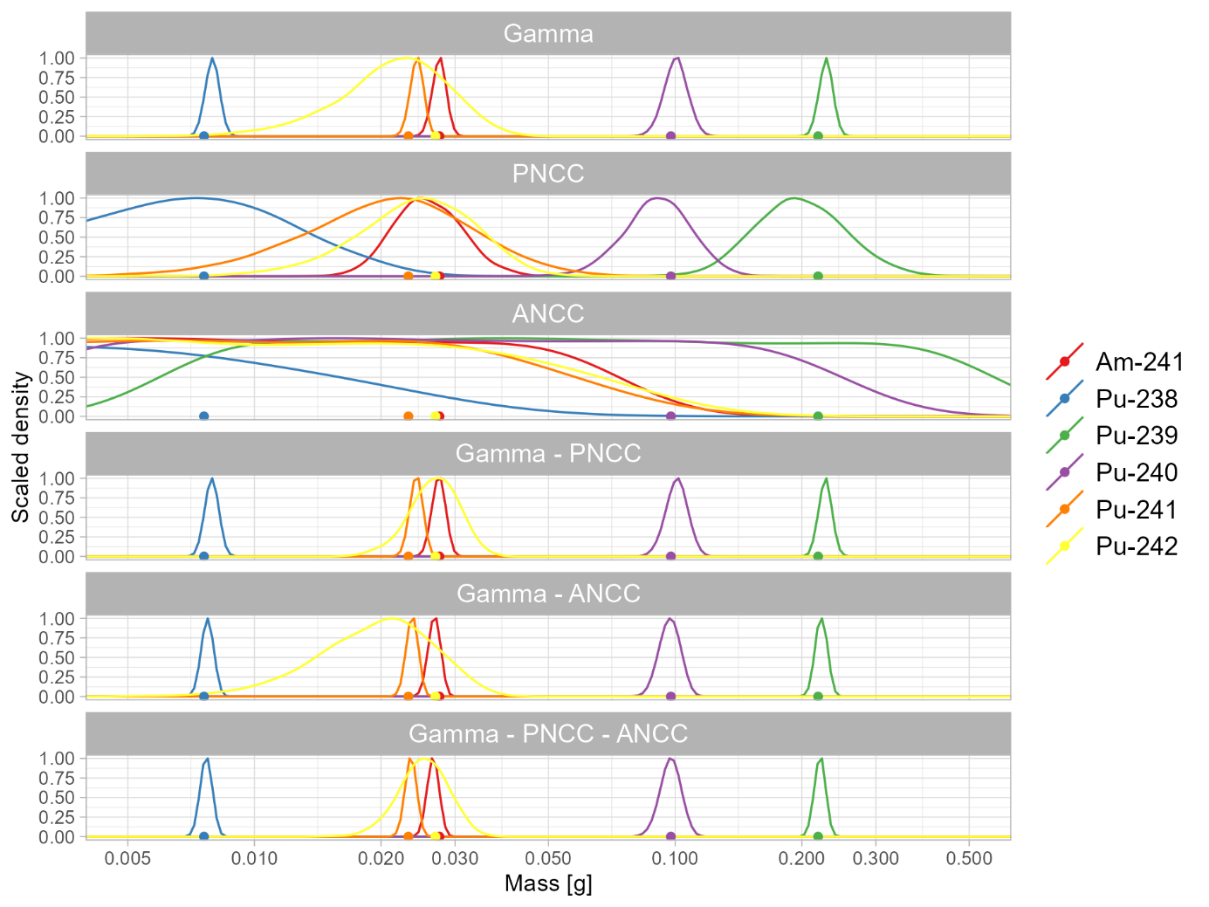
Results VC1: Individual radionuclides
no prior information is available
prior information is available
Notes:
Each nuclide has a different color and the points denote the “true” values.
no prior information about the Pu vector (or anything else) is available
We jointly infer a total Pu mass together with a vector for the 5 Pu nuclides) and nuclide to total Pu ratios (“scaling factors”) for Am-241 and other Pu-related nuclides (if any). So in both cases, the total Pu mass can vary between 0 g and 1 g (uniform prior distribution between 0 g and 1 g). The inferred vector is assigned a flat (Dirichlet) prior, which means that the inferred vector components can take any value between 0 % and 100% (under the constraint that they sum up to 100% - this is guaranteed by the use of a Dirichlet prior distribution).
Adding PNCC to SGS nicely allow for resolving the Pu-242 distribution, which is totally uncertain otherwise. Adding ANCC to SGS also helps but to a (much) lesser extent.
prior information about the Pu vector is available and used to guide the inference
The inferred vector is assigned a (Dirichlet) prior distribution that favors the values of the prior vector estimate. In practice, that means that the inferred vector is allowed to differ by a few percent from the prior vector estimate,
It is seen that all nuclides but the non gamma-emitting Pu-242 nuclide are well resolved by SGS (called Gamma in the figure). Pu-242 is still relatively well constrained by its prior distribution though. Then when adding PNCC to SGS, the Pu-242 posterior distribution becomes well resolved as well. Regarding ANCC, it doesn’t bring much here.

Slide 14
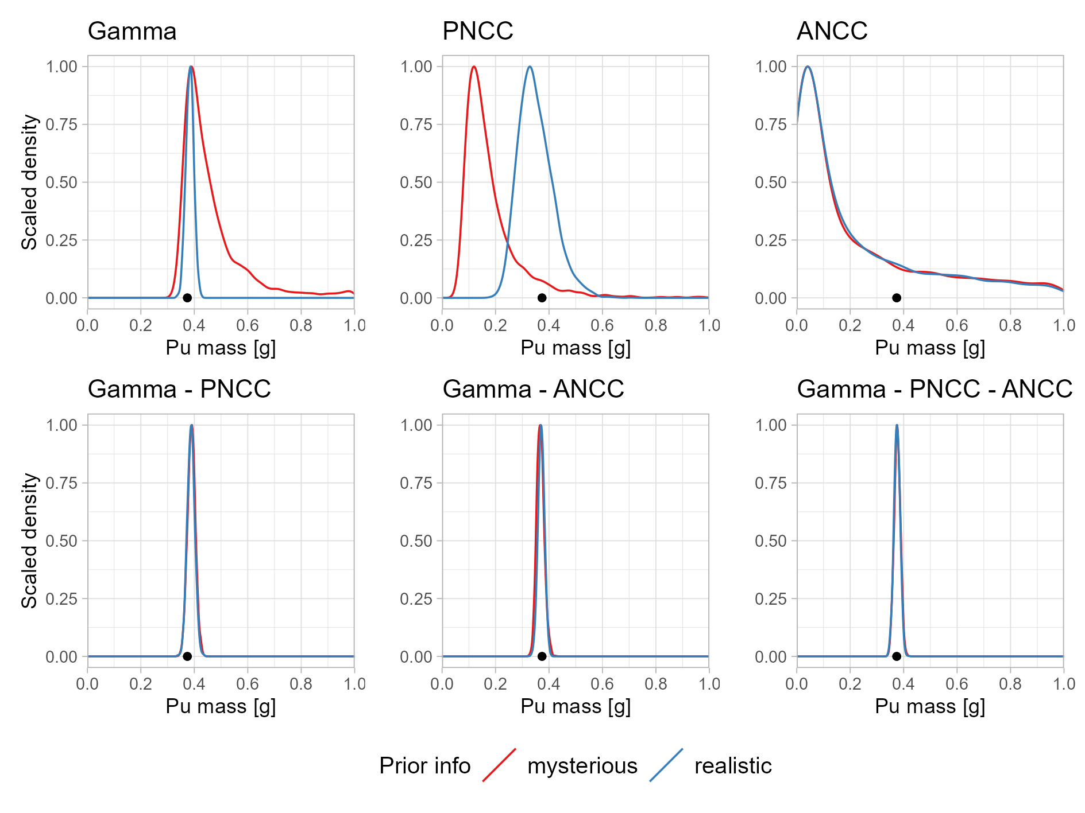
Results VC1: Total Pu mass
Notes:
Summary
Total Pu mass
Gamma resolves good, but more accuracy when PNCC and ANCC are added

Slide 15
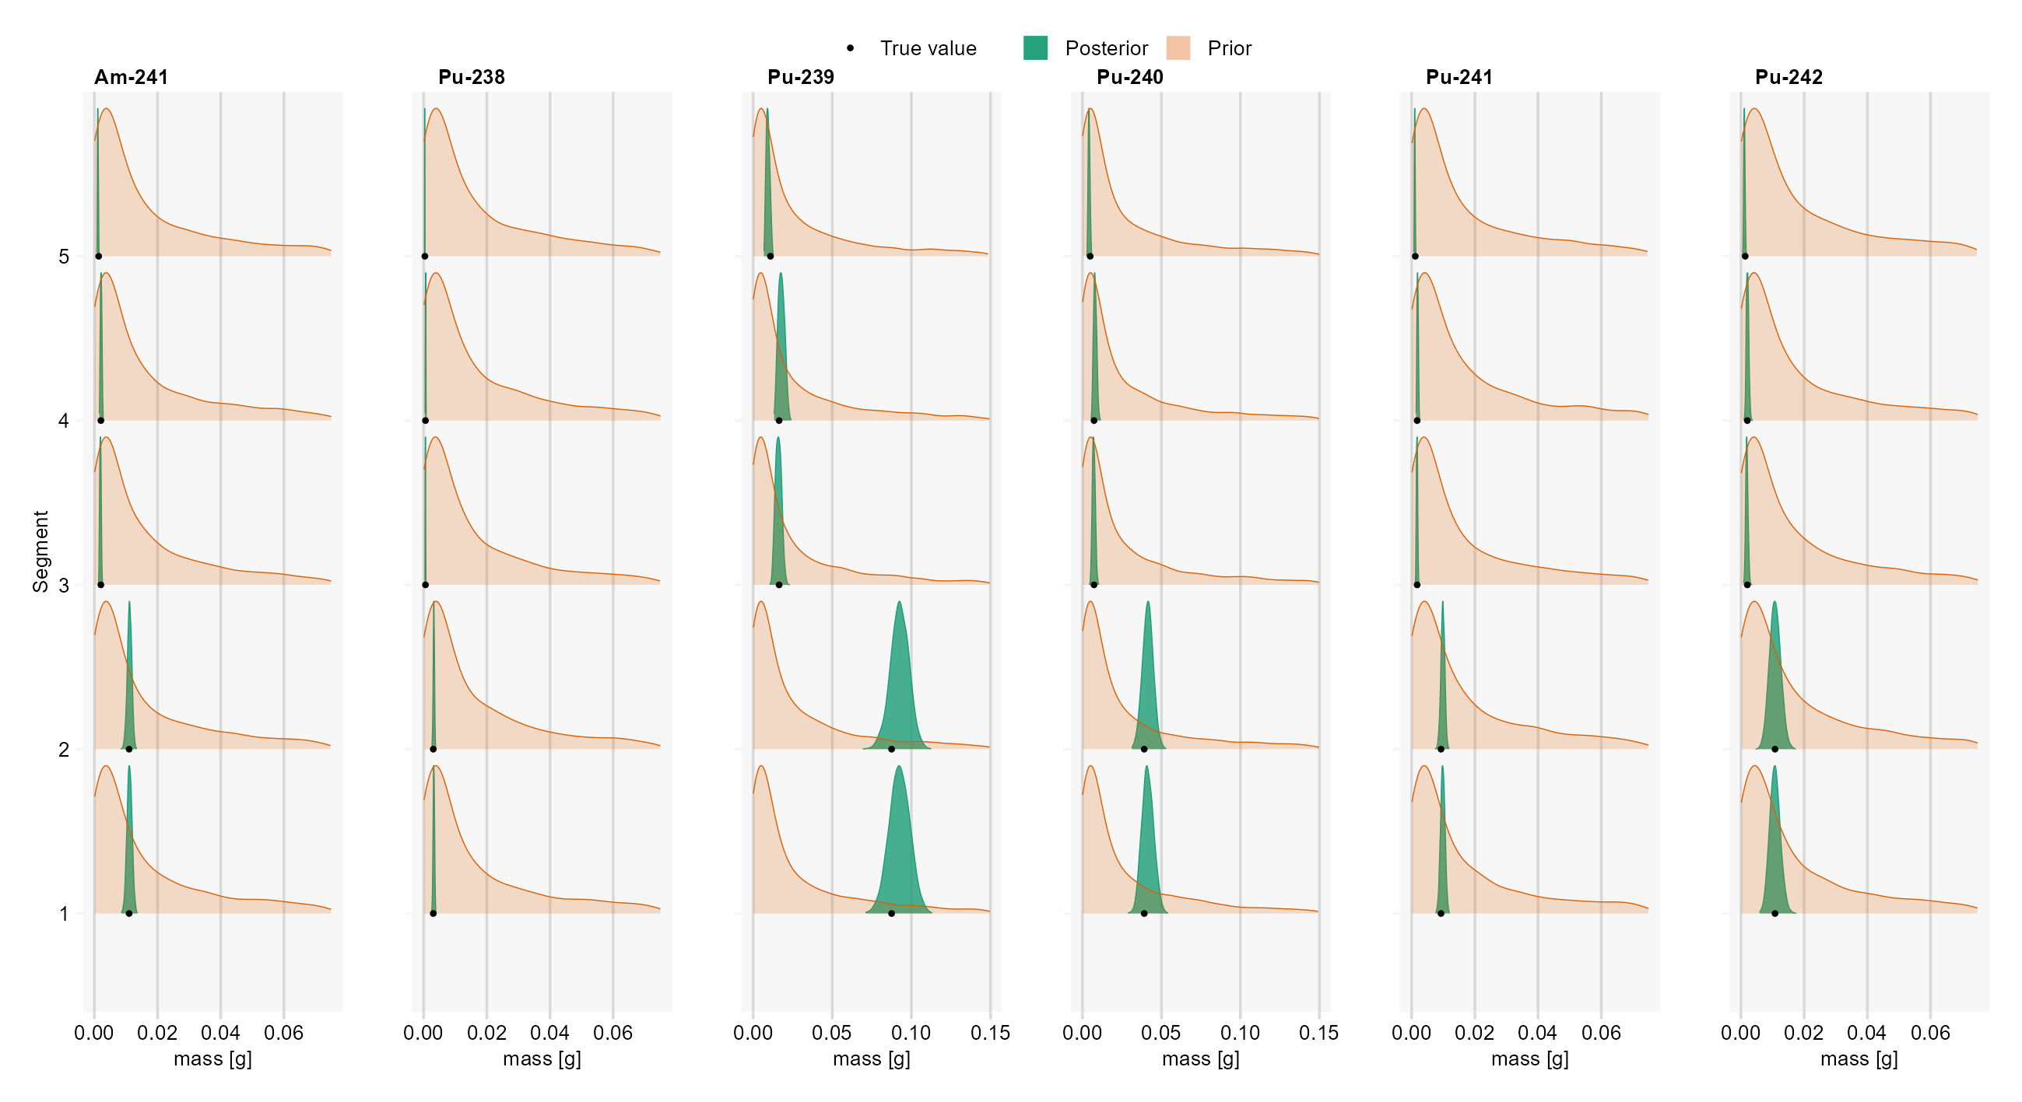
Results VC1: Sub-volumes surrogate model
Gamma & PNCC (no prior information)
Notes:
This picture is to show that more detailed information can be obtained, this per segment for the individual radionuclides.
Most of the Pu mass is situated at the bottom of the drum.

Slide 16
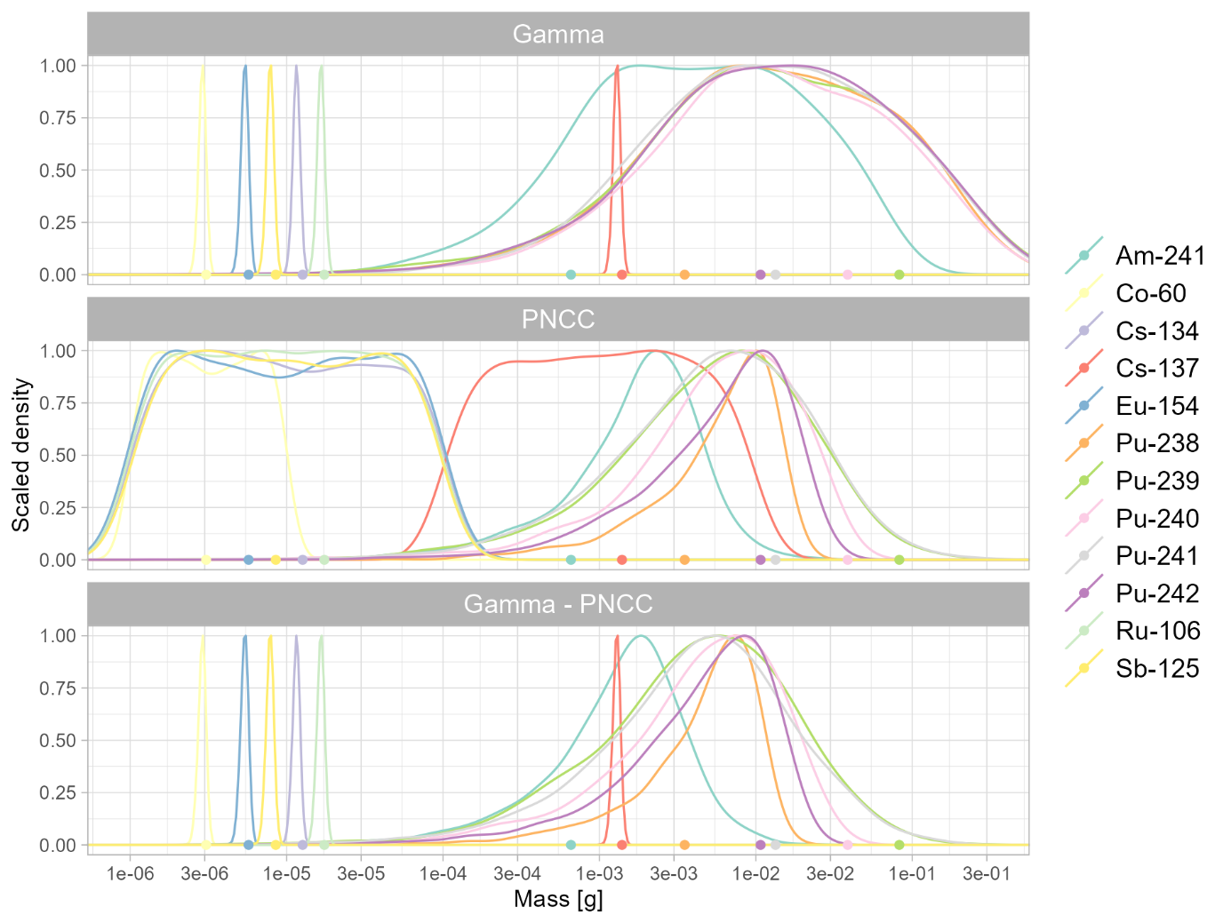
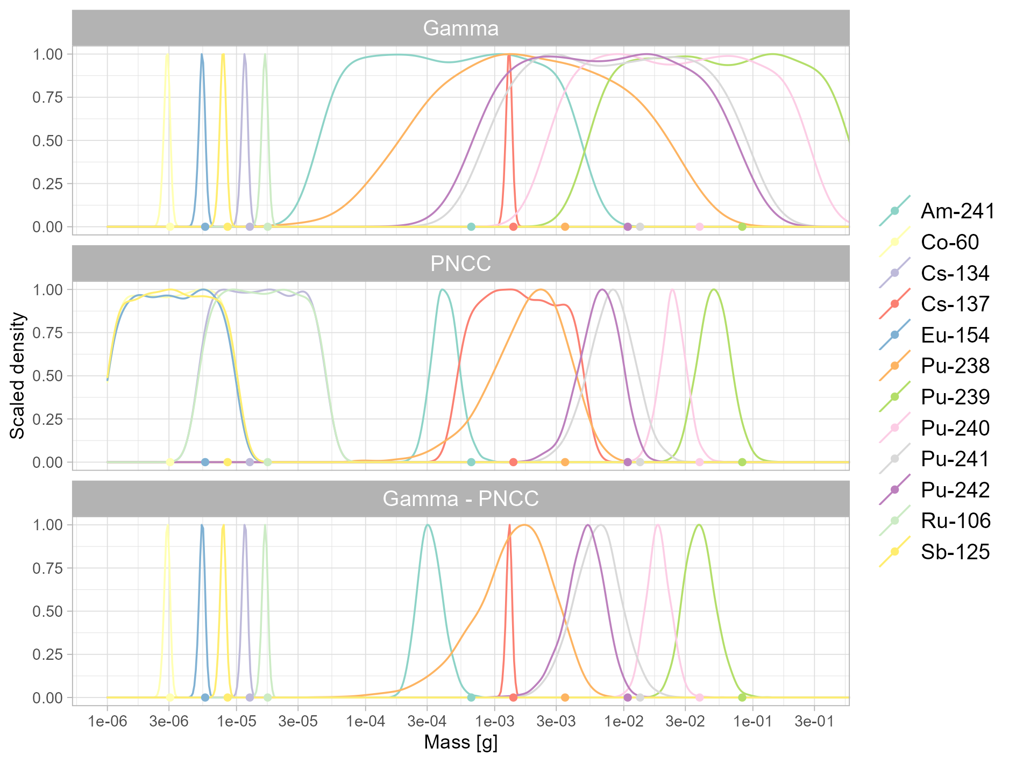
Results VC3: Individual radionuclides
no prior information is available
prior information is available

Slide 17
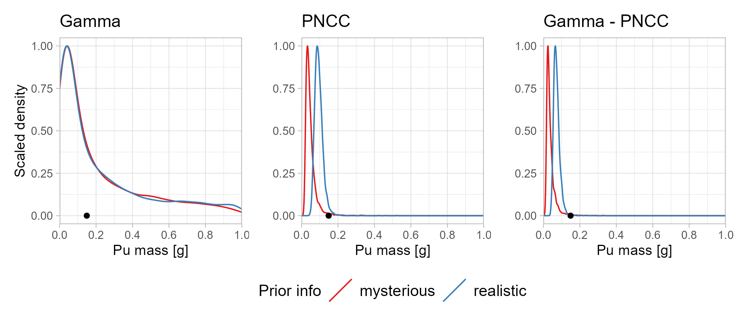
Results VC3: Total Pu mass

Slide 18
Conclusions
Results
VC1
Combining techniques results in more accurate estimates
Much better for “legacy” waste
VC3:
Underestimation of activity concentration due to
Complex structure (composition & radionuclide vectors)
Linear approach is used
Gamma spectrometry: small uncertainty for gamma-emitting radionuclides
PNCC: relatively accurate for determining total Pu mass when prior information is available
Bayesian inference and surrogate model approach
Well suited for quantifying uncertainty in radiological characterization of radioactive waste
Decrease of the measurement uncertainty when combining measurement techniques
Success depends on the accuracy of the set of reference efficiencies (simulations)
Future
Explore further how to mitigate possible errors and bias (nonlinear surrogate models)
Various cases will be worked out
Implementation of approach in industrial installations
Notes:
KPI
Chance + micado

Slide 20
Known
Pu
Average density: 0.42
Bags with wet wipes
True model
Surrogate models
Surrogate models
12
0.53
9
0.32
8.5
Pu-239/Pu-240 4.2
6
9
0.36
9
17
8
0.38
0.52
12
8
Isotopic composition
Activity distribution
Density distribution
Chemical composition
4.2
6
17
0.32
0.52
8
12
Isotopic composition
Activity distribution
Density distribution
Chemical composition

Slide 21
