Slide 1
Final Demo Meeting
WP7 summary and results
25-Jan-2023
P.Finocchiaro

Slide 2


Tasks
WP7 Waste Monitoring Grid
  T7.1 Assess the feasibility of the SiLiF (neutron) and SciFi (gamma) detectors to monitor the different types of nuclear waste
  T7.2 Build, test and characterize the detectors’ behavior with respect to different types of nuclear waste and containers
  T7.3 Characterisation of the system with laboratory tests in order to prepare the final demonstration
  T7.4 Performance evaluation of alternative technologies (Timepix network)
100%
100%
100%
100%

Slide 3

Deliverables
D7.1 | INFN - Design of the integrated prototype | Report of the integrated system that will be used during the final demonstration | M10
D7.2 | INFN - Integrated monitoring grid system | Deployable monitoring grid prototype | M24
D7.3 | INFN - Report on the monitoring grid system laboratory characterisation | Description of the characteristics of the system with description of the laboratory characterisation | M28 M36
D7.4 | CAEN - The prototype of the monitoring grid system | System ready for the deployment in a real environment | M28 M36
D7.5 | CTU - Report on the characterisation of alternative solutions for long-term monitoring system | Description of the characteristics of the system based on Timepix detectors and main laboratory results | M27 M36
D10.1 | INFN - The waste monitoring grid system in a nuclear waste repository | Report of the characterization of the waste monitoring grid in real environments | M34 M41
Mar 2020
May 2021
May 2022
May 2022
May 2022
Oct 2022

Slide 4



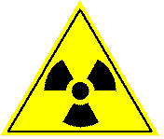


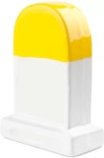


Milestones
T7.1
T7.2
T7.3
WP10
choose config
build & lab test
test @ENEA
deploy
test
deploy
test
final demo
12
13
14
22
Waste assessment completed
Brief report with the list of candidate waste(s) and the related detector performance expected.
Detector assembled
Construction of Fiber and SiLiF detector samples ready for laboratory tests
Waste monitoring grid system
Detectors ready for in field tests
Jul
2022
Detector deployment
Deployment of the integrated monitoring system in a real environment
Dec
2022
(WP10)
May
2020
May
2021
May
2022

Slide 5
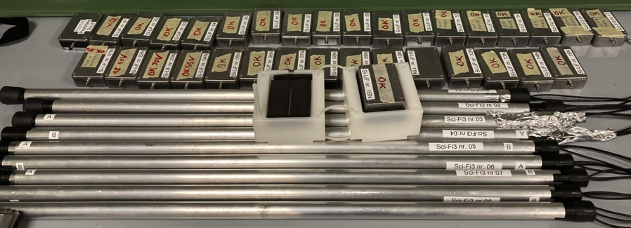
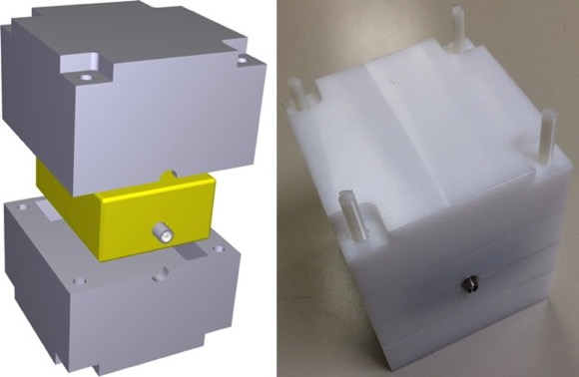
what was built
SiLiF thermal neutron detectors
PET moderators
SciFi gamma ray detectors

Slide 6
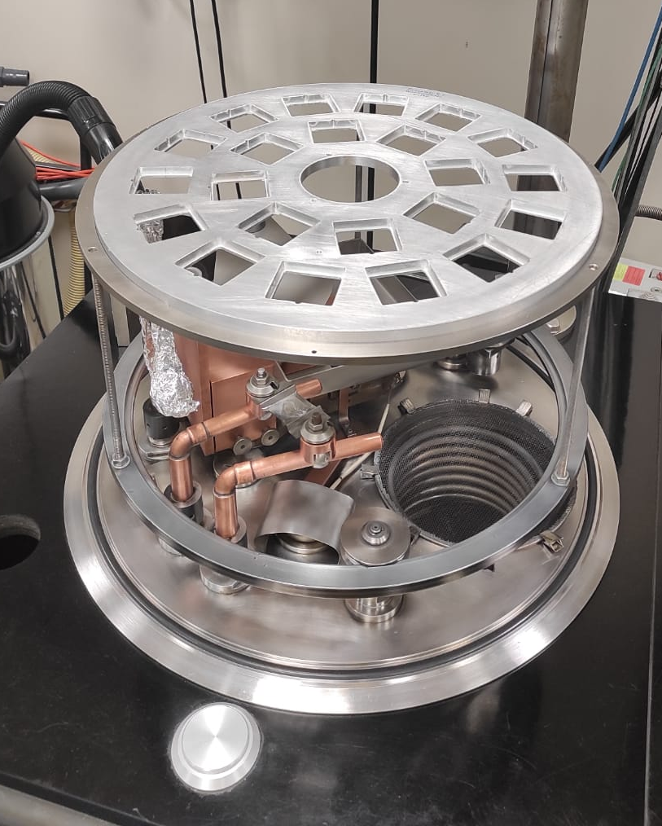
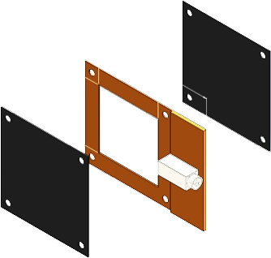
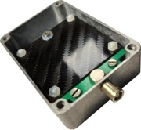
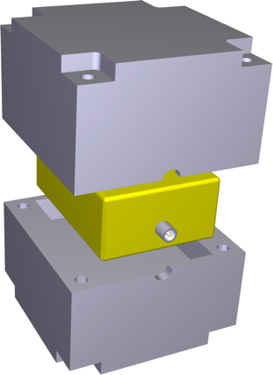
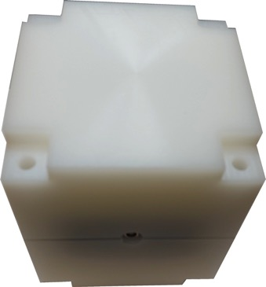
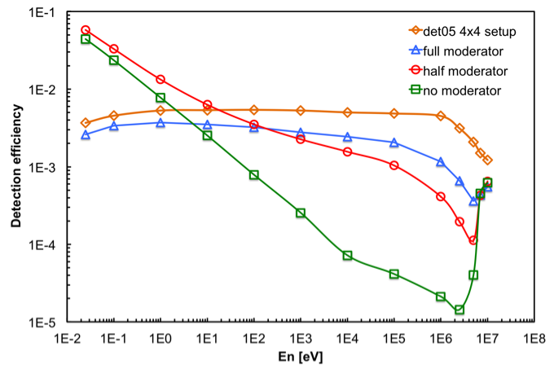
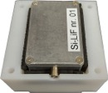
SiLiF neutron detector: Silicon + ⁶LiF
⁶LiF evaporation
on C-fiber
⁶LiF on C-fiber
Si diode
C
⁶LiF
Si
⁶LiF
⁶LiF on C-fiber
C
flat efficiency after moderation
half moderator
10 x 10 x 10 cm³
PET moderator to
slow down neutrons
4x4 moderators
GEANT4
simulation

Slide 7
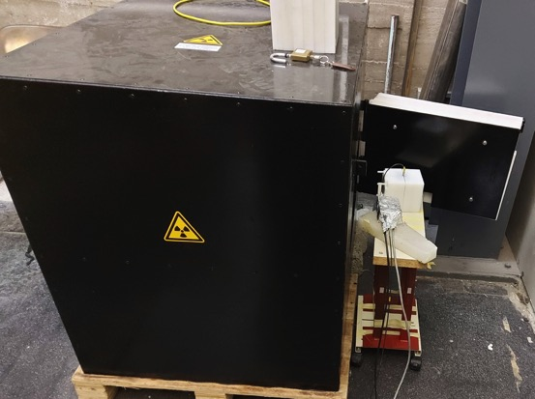
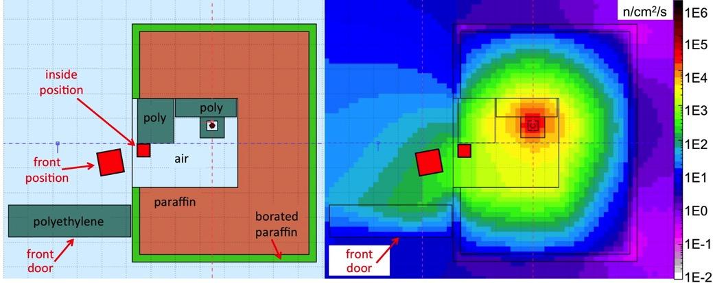
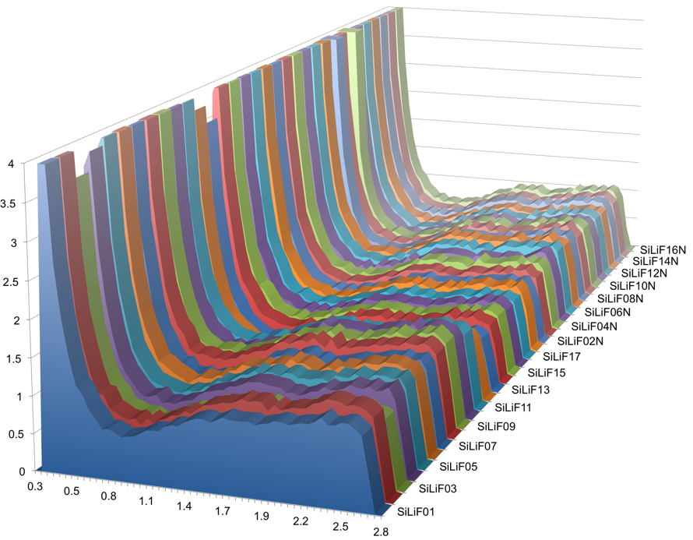
SiLiF neutron detectors built and tested
FLUKA simulation
AmBe neutron source
2.2·10⁶ n/s
background
neutrons
test in front position

Slide 8
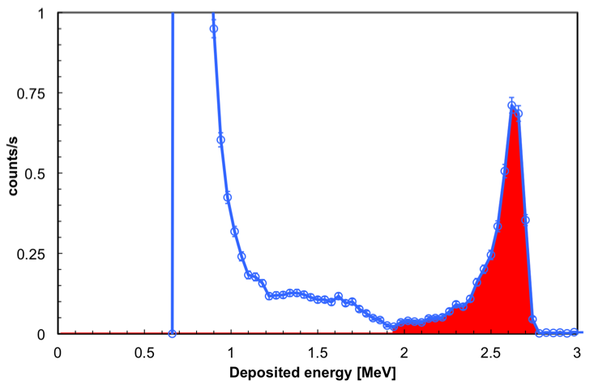
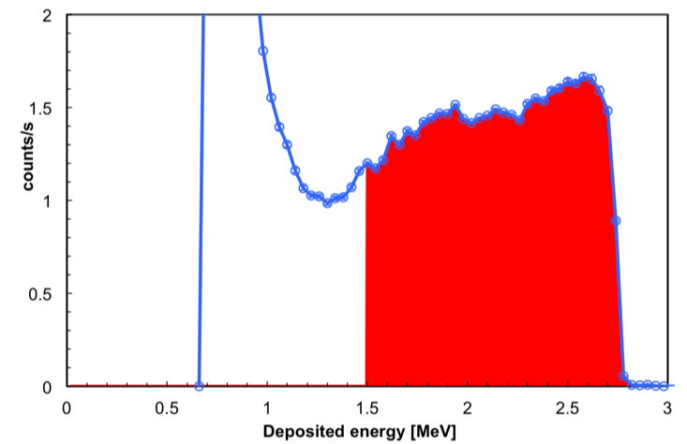
SiLiF neutron detectors: 5% efficiency measured
FLUKA simulation
AmBe neutron source
2.2·10⁶ n/s
reference detector: 1.6 µm ⁶LiF
calibrated at PTB metrology
MICADO detectors: 2x17 µm ⁶LiF
thermal eff. = 5.0%
thermal eff. = 0.41% ± 0.001%
test in inside position

Slide 9

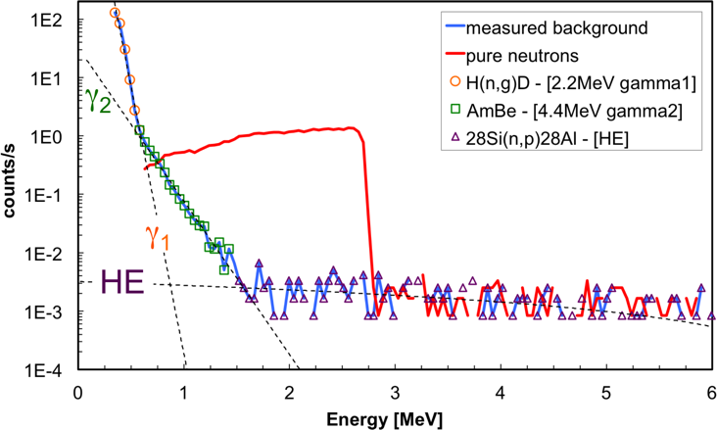
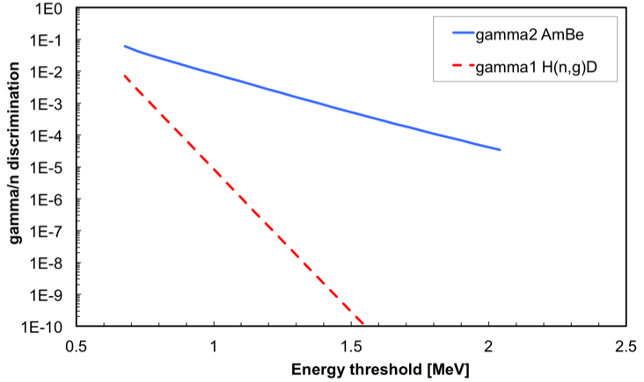
SiLiF neutron detectors: gamma/neutron rejection
measurement of background
with upside-down converters
knowledge of pure neutron
and pure background to calculate gamma/neutron discrimination power
gammas with E ≤ 4.4 MeV
gammas with E ≤ 2.2 MeV
target: 10⁻⁵ with Eγ ≤ 1.3 MeV (“optimal” according to IAEA)
obtained: 10⁻¹⁰ with Eγ ≤ 2.2 MeV (SiLiF with threshold at 1.5 MeV)

Slide 10
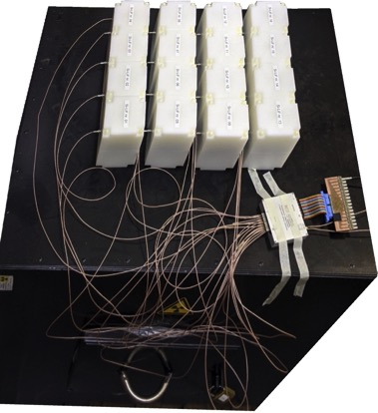
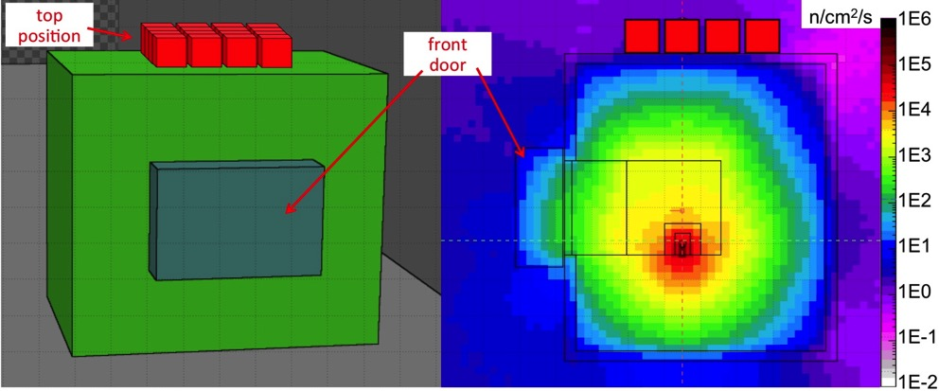
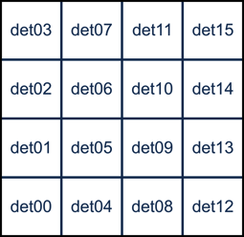
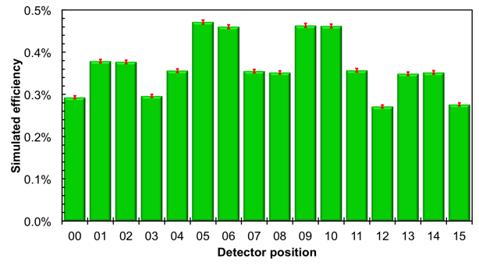
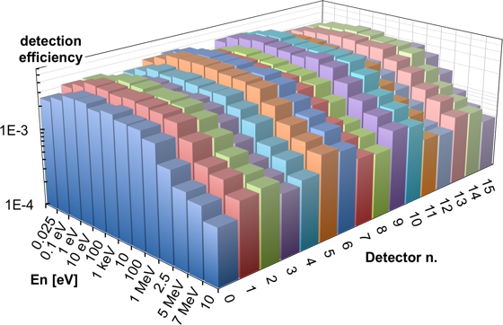
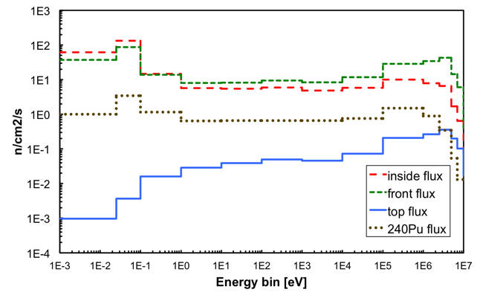
16 SiLiF neutron detectors: sensitivity tested with fast neutrons
test in top position
expected 2.09 n/s/cm²
measured 1.92 n/s/cm²
simulated overall detection efficiency
energy dependent detection efficiency
simulated neutron flux in det05

Slide 11
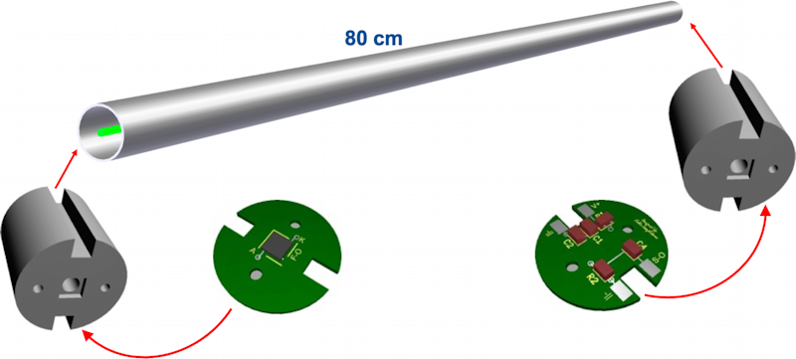
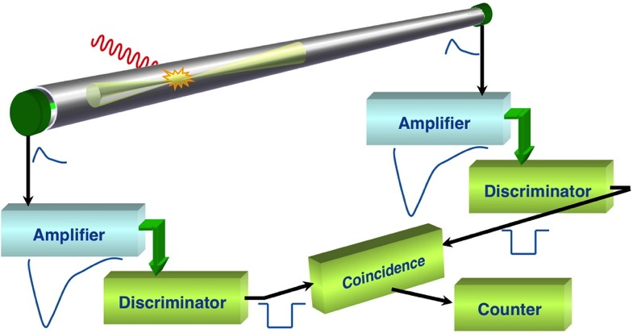
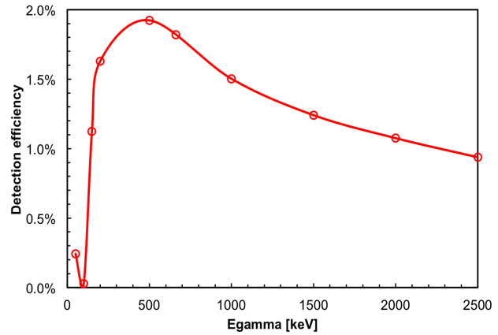
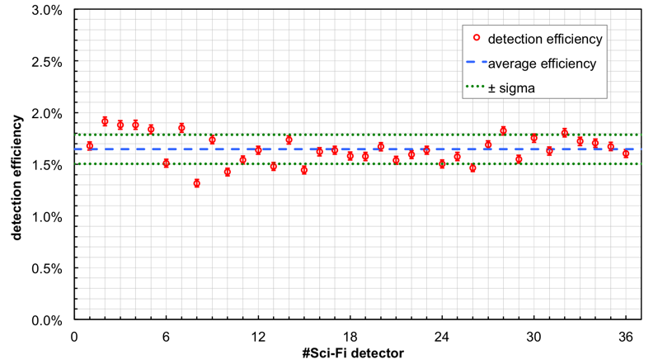
SciFi gamma detector built and tested with pointlike sources
mechanical assembling
operating principle
SiPM sensitive to
single photons
Aluminum pipe
holder
holder
SiPM 3x3 mm²
(ON Semiconductor)
with ¹³⁷Cs source
simulated detection efficiency
(and interpolation)
average measured efficiency 1.65% ± 0.18%
simulated efficiency 1.82%

Slide 12
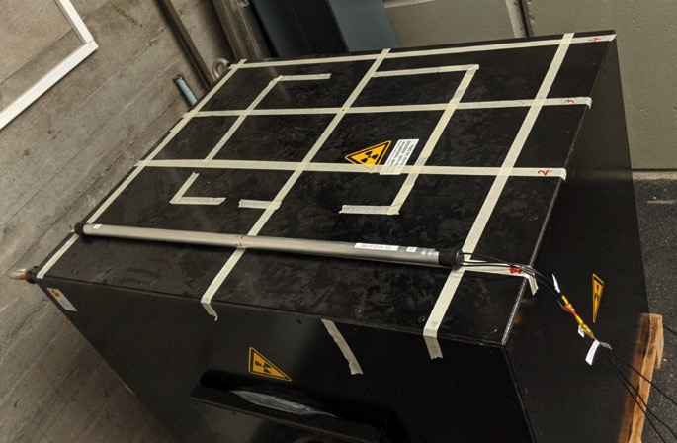
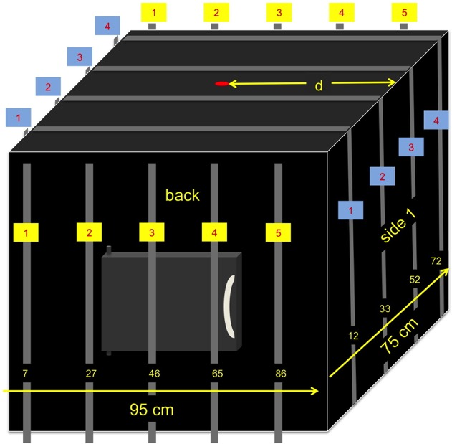
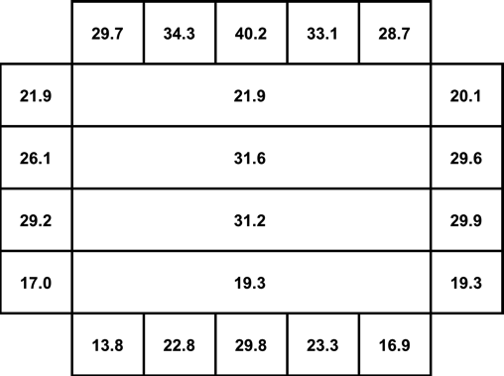
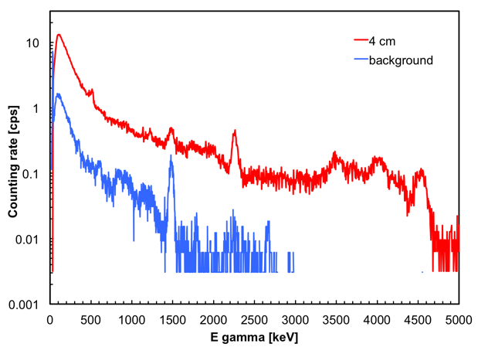
SciFi gamma detectors tested with a drum-like AmBe source box
results agree with simulations
emitted gamma spectrum
measured with LaBr₃(Ce)

Slide 13
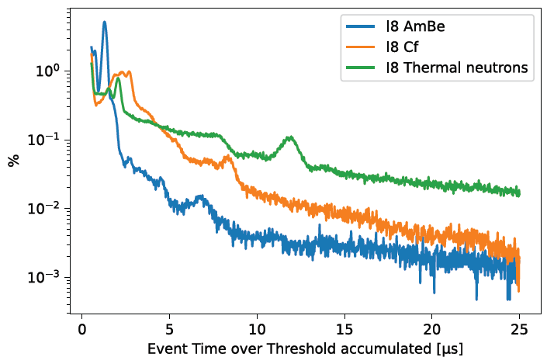
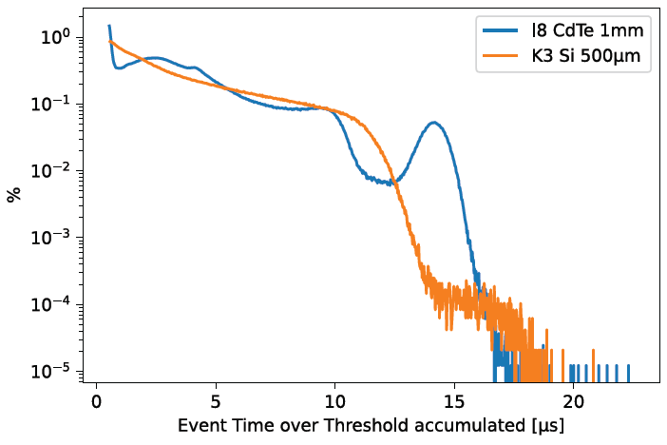
Timepix3 detector network tested
10x Timepix3 + Katherine R/O
  Efficient particle discrimination, spectrometric information in parallel with ns resolution timing information
  Si sensors of 100, 300 & 500 µm,
  Equipped with neutron converters
  CdTe sensors of 1 mm
  Operated simultaneously by specific SW
Thermal neutrons Neutrons from AmBe Neutrons from Cf Neutron spectrum in CdTe ¹³⁷Cs spectrum
662 keV

Slide 14
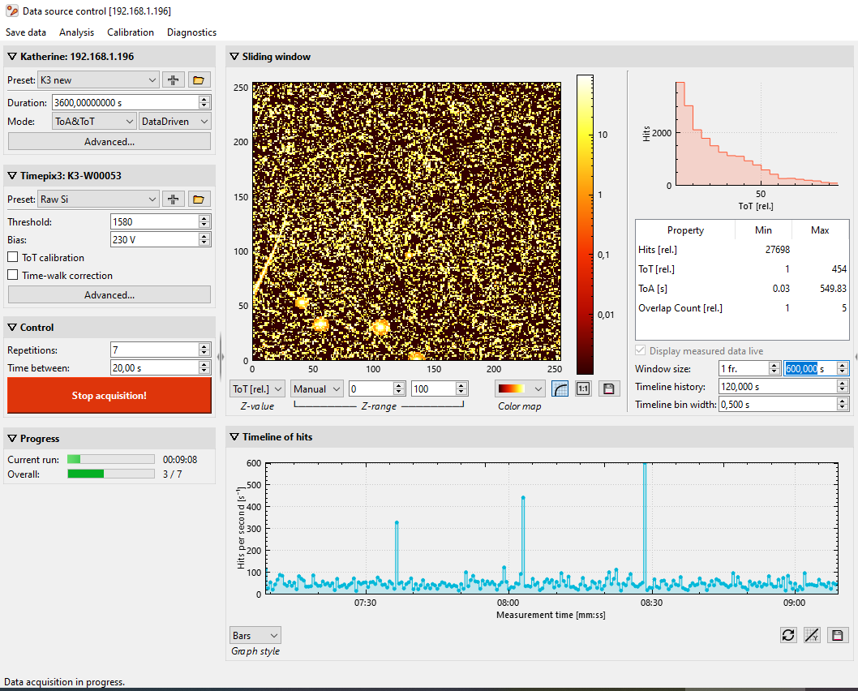
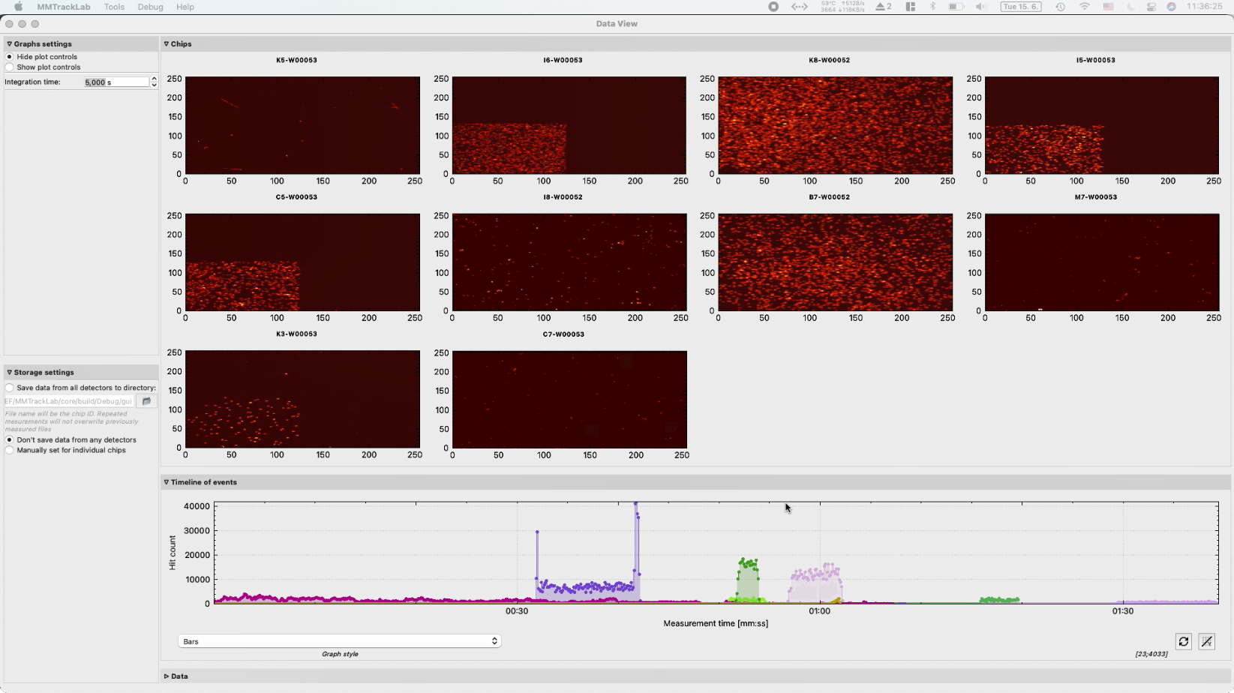
Timepix3 software developed, multiple device control

Slide 15
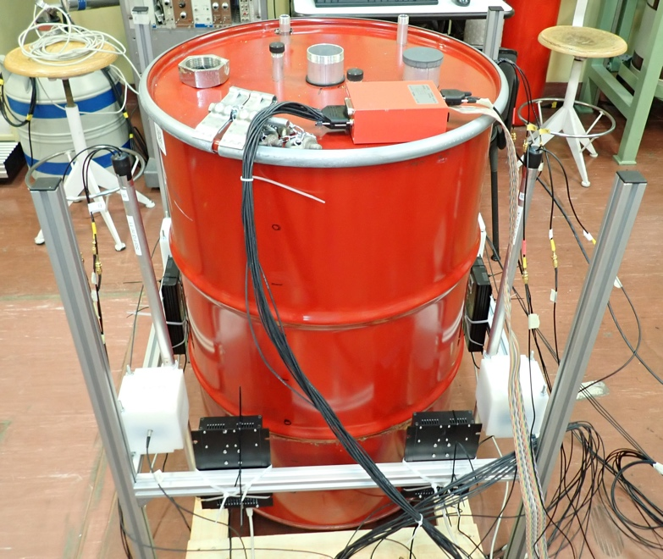
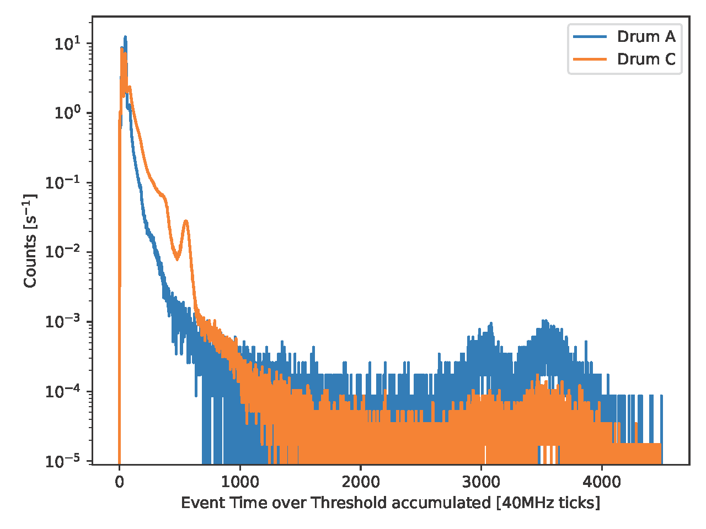
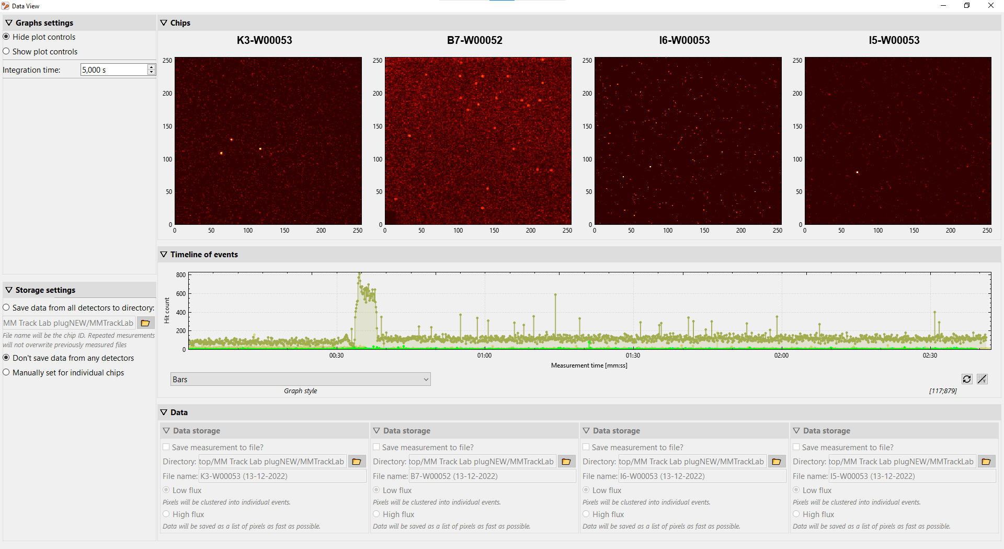
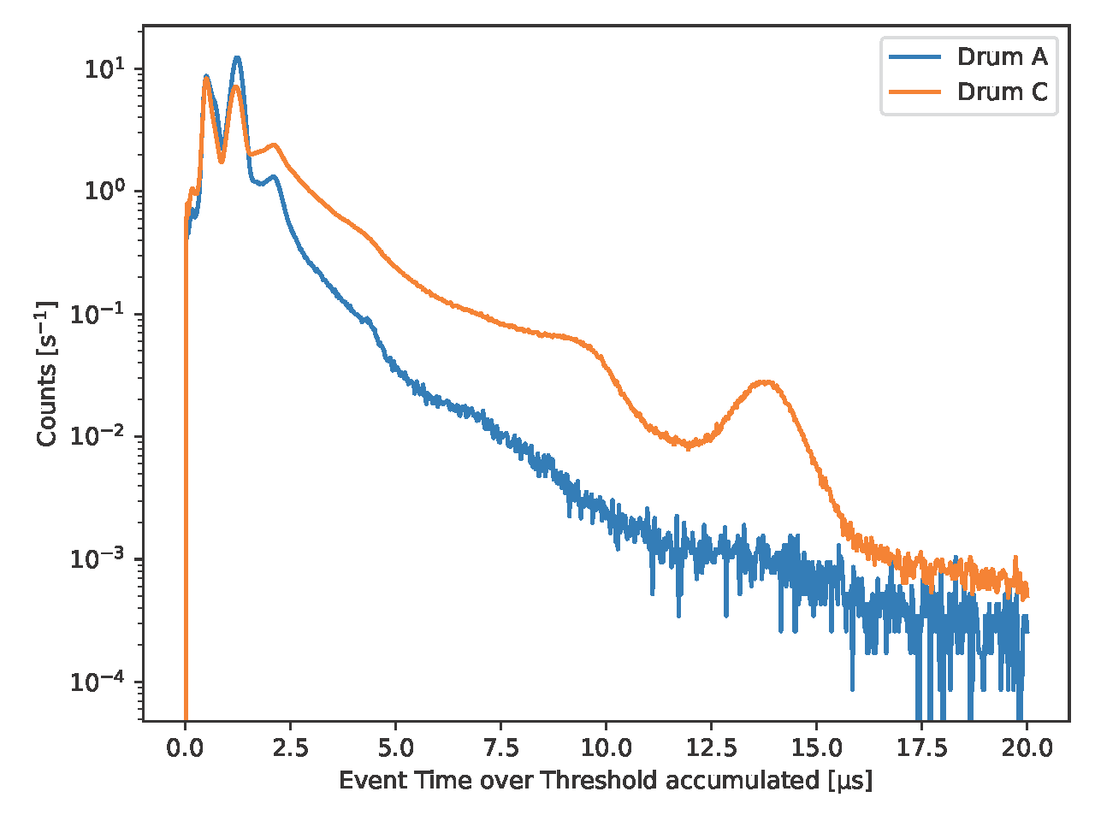
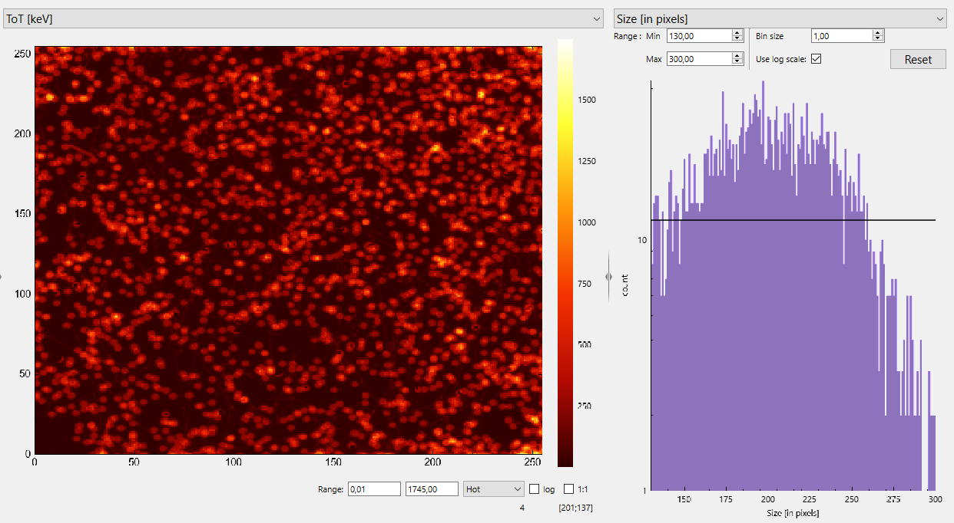
Tests at ENEA C43 lab
  Timepix3 detectors (all 4 sensor types)
α particles
from Rn decay
¹³⁷Cs
662 keV

Slide 16

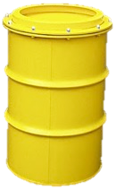
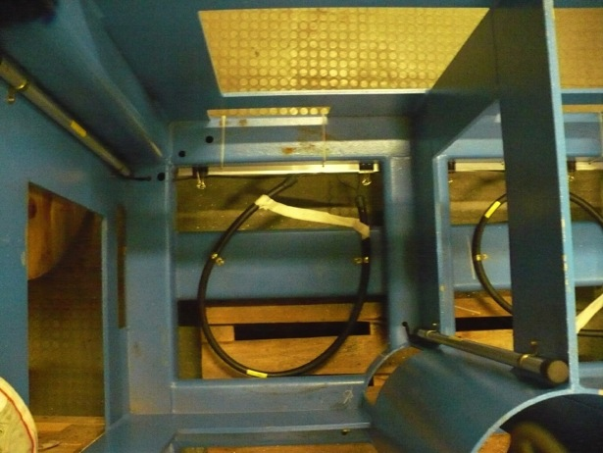

Monitoring configuration: flexible, scalable
Possible arrangements
on the drum
on the platform
SciFi (gammas)
TimePix
SciFi
SiLiF (neutrons)
Timepix3 (n and γ)
SiLiF

Slide 17
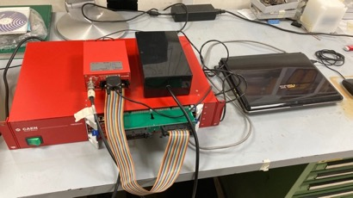
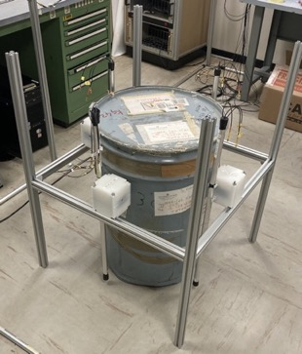
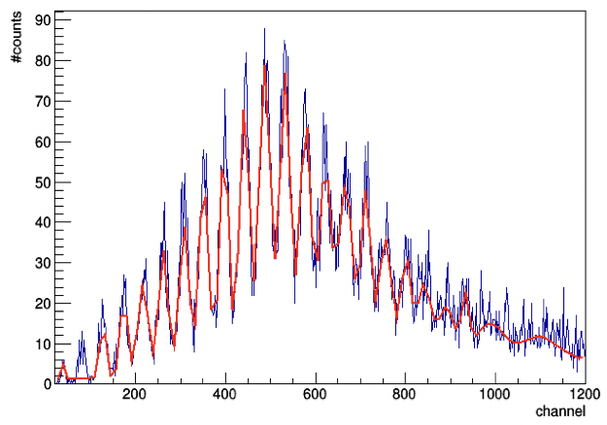
Integration and tests of detectors with CAEN electronics at INFN-LNS
Tested with special sources at ENEA
DAQ CAEN (→ DigiWaste)
flexible support structure for quick and easy reassembling using Bosch Rexroth aluminum profiles
Detectors and support structures
neutrons
gammas
SiPM sensitive to
single photons
sample data

Slide 18
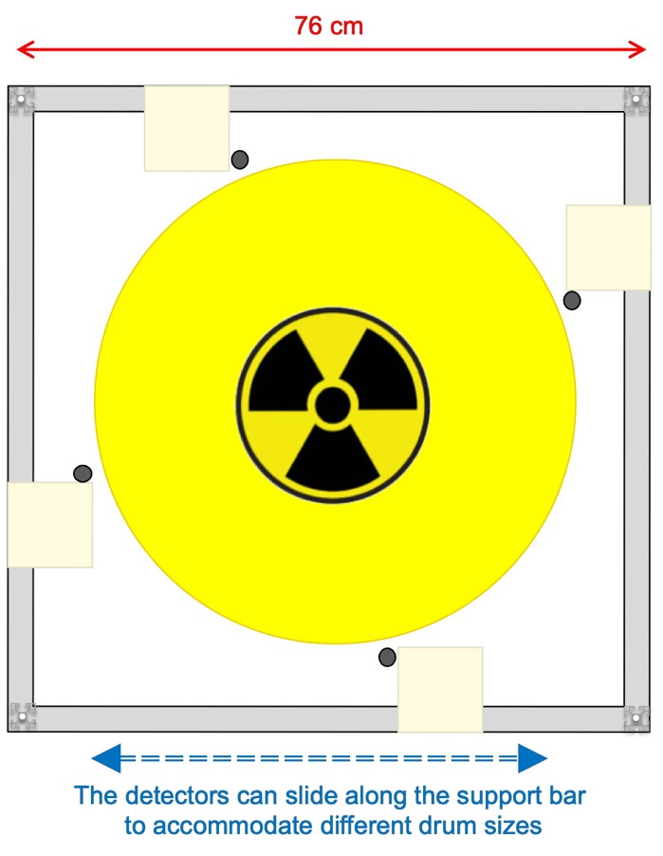
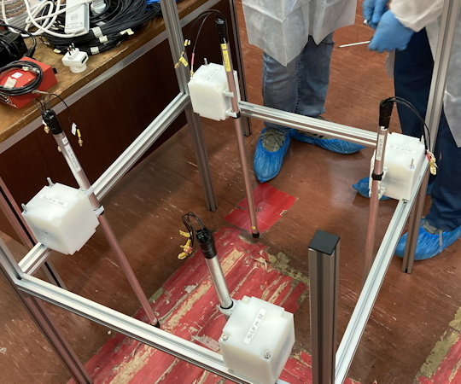
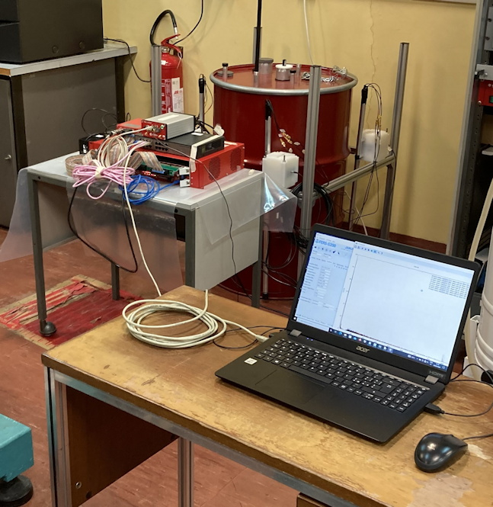
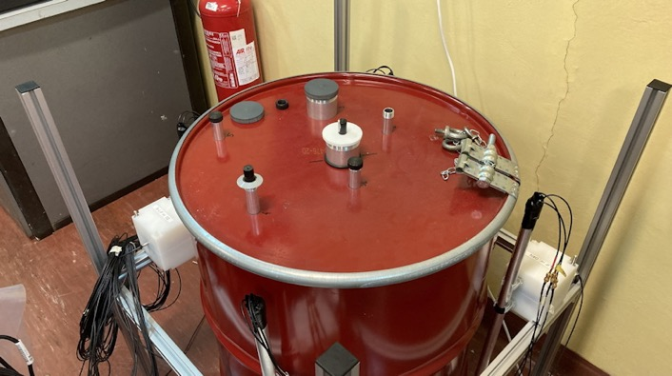
Test at ENEA C43-lab 27-30 May 2022
The simple & lightweight support structure with four SiLiF+SciFi detectors
The detectors in position to accommodate a large 220 liter mock-up drum
240Pu
4×103 n/s
1
2
Test with gamma and neutron sources in the mock-up drum
the data acquisition system
4
3
¹³⁷Cs
2.33 MBq
.

Slide 19






SciFi gamma detectors
SiLiF neutron detectors
1
2
2
4
4
3
.

Slide 20

2.33 MBq ¹³⁷Cs gamma source
²⁴⁰Pu neutron source (4·10³ n/s)
1/2 hour test
18 hour test
 | gamma/s | stat error | background | stat error
SciFi 1 | 5.28 | 0.06 | 2.76 | 0.02
SciFi 2 | 9.57 | 0.07 | 1.85 | 0.02
SciFi 3 | 26.14 | 0.12 | 2.15 | 0.02
SciFi 4 | 6.18 | 0.06 | 2.64 | 0.02
 | n/s | stat error
SiLiF4 | 0.0321 | 0.0007
SiLiF6 | 0.0417 | 0.0008
SiLiF2 | 0.0363 | 0.0007
SiLiF15 | 0.0372 | 0.0007

Slide 21


from ENEA Casaccia to ORANO La Hague

Slide 22






Test at ORANO La Hague on four drums (with Pu) 25-28 Jul 2022

Slide 23










Test at ORANO La Hague on four drums (with Pu)
SciFi gamma detectors
gamma source

Slide 24





Test at ORANO La Hague on four drums (with Pu)
SiLiF neutron detectors
RP people measured and declared << 1 n/s
(basically zero)

Slide 25
from ORANO La Hague back to ENEA Casaccia

Slide 26





Test at ENEA C43-lab 12-13 Dec 2022
mock-up C
gamma
neutron
too noisy electrical environment
1000× for SiLiF?!?!
ineffective threshold
but results in agreement with source position and activity

Slide 27


from ENEA C43-lab to Nucleco
ENEA
C43

Slide 28


Tests at Nucleco:
14-15 Dec 2022
15-22 Dec 2022
23 Dec 2022 to 26 Jan 2023

Slide 29




neutrons at Nucleco 21-Dec-22 to 11-Jan-23
stable SiLiF data rates
N-01 has no counts: wrong threshold
E-12 and W-06 have few counts: wrong threshold?

Slide 30





gammas at Nucleco 21-Dec-22 to 11-Jan-23
stable SciFi data rates
slight variations due to temperature changes
some slight change due to local operations?

Slide 31




gammas at Nucleco 21-Dec-22 to 11-Jan-23
fluctuations within 1 sigma
people from CAEN operating on the system

Slide 32












Publications
conferences & workshops
peer reviewed journals
other papers
Sensors-21-02630
SiLiF & SciFi for MICADO [talk]
Timepix3 for MICADO [e-poster]
Activity Report 2020
Rivelatori di gamma e neutroni per il monitoraggio di rifiuti radioattivi nel progetto MICADO [talk]
Instruments-05-00019
Troyes (France), 04-08 July 2022
[2 posters]
P. Finocchiaro, Providing better radiation monitoring for nuclear waste, Res. Outr. 131(2022)70
General Conference, 26-30 Sep 2022 [talk]
theses
Symposium on International Safeguards
31 Oct to 4 Nov 2022 [talk]
I rivelatori del progetto MICADO per il monitoraggio dei rifiuti radioattivi
Martina Giuffrida, Master Thesis in Physics
7-Jun-21 110/110 cum laude
Technology Park Workshop
Rome 20-21 Jan 2023
Radioactive Waste monitoring [invited talk]

Slide 33
Conclusions
  The MICADO project has been a wonderful experience
  We got in touch and collaborated with many people
  Within WP7 we had the chance of studying and improving our technologies for gamma and neutron detection
  These detectors proved to be feasible for a distributed radwaste monitoring application
  I thank all of the MICADO people, but in particular Massimo Morichi, Erica Fanchini, Luigi Cosentino, Alfio Pappalardo, Fabio Longhitano, Gaetano Elio Poma, Simone Amaducci, Sergio Lo Meo, Quentin Ducasse, Bartolomej Biskup, Lionel Tondut, Christopher Helbert, Bernard Dumercq, Luigi Lepore, Giada Gandolfo, Giuseppe Marzo, Nicolò Ratto, Nadia Cherubini, and last but not least my dear friend Marco Ripani
  ...and I apologize if I am (unfortunately) forgetting someone

