Slide 1
WP6 – Photofission station
ENEA, the 25th of January 2023
Adrien SARI

Slide 2
Introduction
The photofission reaction
Energy threshold ≈ 6 MeV for most actinides (U-235, U-238, Pu-239, etc.)
Deployed using a linear electron accelerator (“linac”)
Adapted to the characterization of radioactive waste packages with large volumes and/or concrete matrices

Slide 3
Introduction
The photofission reaction

Slide 4
Objectives
WP6 is focused on developments around a LINAC based platform. Two main purposes are related to this WP:
Optimize a stationary non-destructive measurement cell, based on a linac in order to characterize large concrete nuclear waste packages and be able to declassify some of them, especially those identified as legacy waste
Adapt photofission measurements to obtain a relocatable measurement cell, based on a LINAC and deployable on different D&D sites

Slide 5
Theoretical description of the system
Three main building blocks
A linear electron accelerator (linac)
A radioactive waste package to be characterized
A detection system for photofission particles
Delayed neutrons (usually based on He-3 filled-gas proportional counters)
Delayed gamma-rays (BGO, plastic scintillators, HPGe)

Slide 6
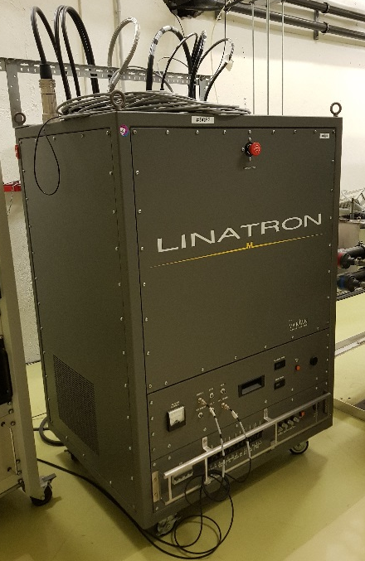
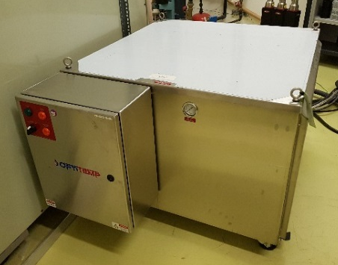
Theoretical description of the system
The Linatron® M9 housed at the SAPHIR platform (CEA Paris-Saclay)
Pulses of either 6 or 9 MeV electrons
High-energy photons produced by Bremsstrahlung in the conversion target
Touchscreen controle console
X-ray head and RF unit
Modulator
Cooling system

Slide 7
Theoretical description of the system
Two types of setups studied
Stationary system
9 MeV linac
Study based on the Linatron M9 linac which is housed at the SAPHIR platform → Electron energy available: 9 MeV
→ Monte Carlo simulation study + experiments
Mobile system
7 MeV linac
Study based on the Linatron M9 linac which is housed at the SAPHIR platform → Electron energy shifted “virtually” by simulation: 7 MeV
→ Monte Carlo simulation exclusively

Slide 8
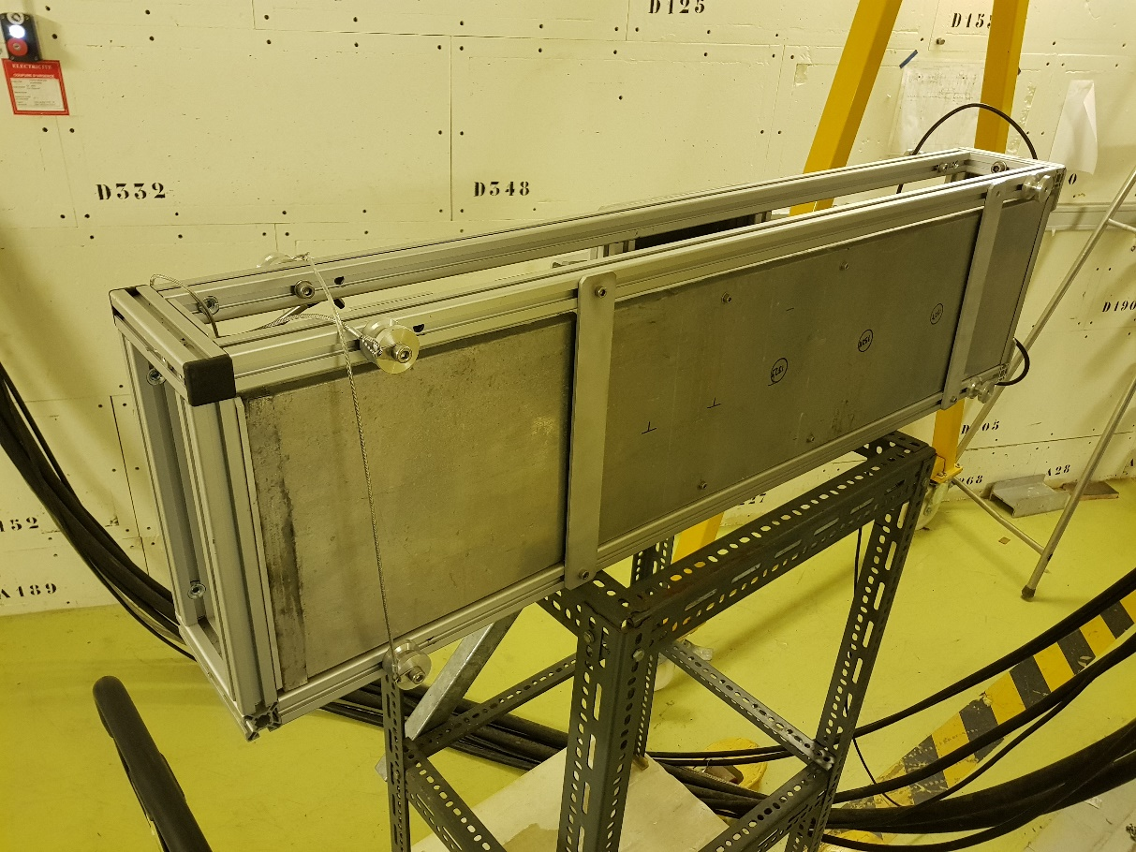
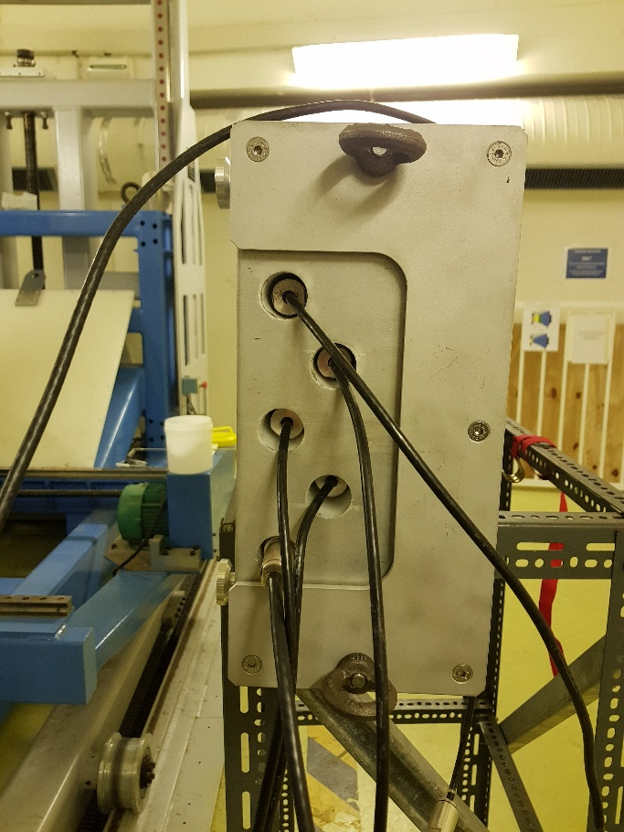
Theoretical description of the system
Detection blocks
Five He-3 filled-gas proportional counters (150NH100 model)
Block made of HDPE and surrounded by cadmium
Global view
View from the side

Slide 9
Work done
Monte Carlo simulation study
Optimization of the interrogative photon beam delivered by the linac
Assessment of the measurement performance with a 7 MeV linac
Conceptual design and shielding for a mobile photofission system (WP6/WP2)
Study of additional configurations (WP6/WP8)
Experimental work
Photofission measurement methodology and uncertainty assessment (WP6/WP8)
Experiments carried out at the SAPHIR platform with a 9 MeV linac (CEA Paris-Saclay)

Slide 10
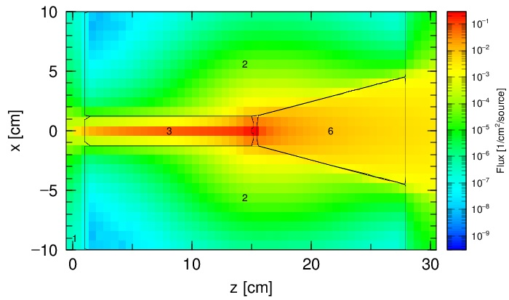
Monte Carlo simulation study
Use of two Monte Carlo codes
MCNP6.2
PHITS v.3.16
→ Gain critical mind on simulation results
Objectives of this simulation study
Characterization and optimization of the photon beam delivered by a 7 or 9 MeV linac
Assessment of the performances of the photofission technique at 7 MeV
Assessment of the shielding for the conceptual design of a mobile linac-based system

Slide 11
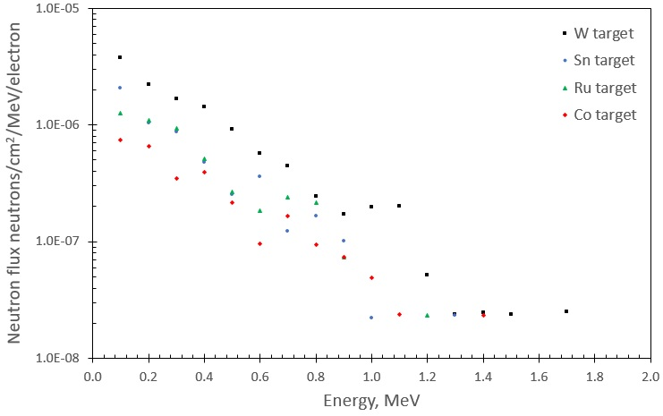
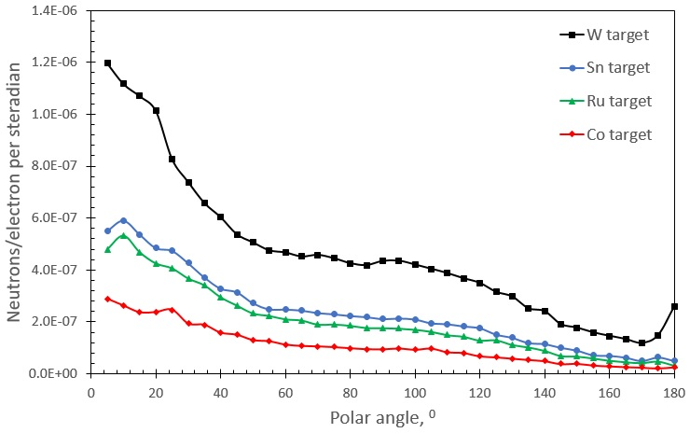
Monte Carlo simulation study
Neutron energy spectrum: various target materials (PHITS)
Neutron angular distribution: various target materials (PHITS)

Slide 12
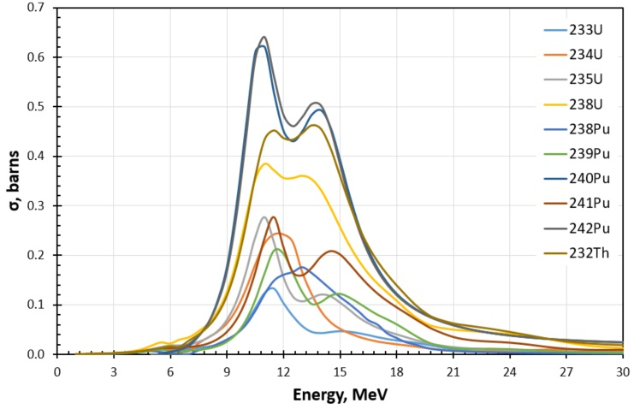
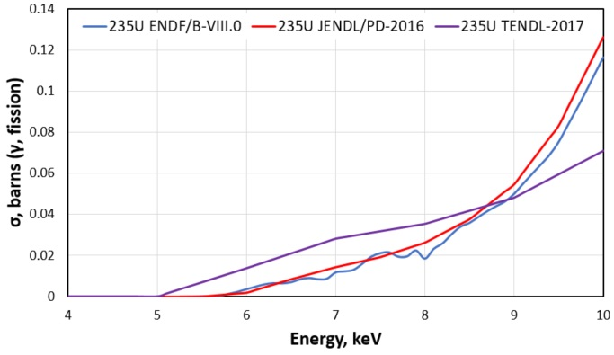
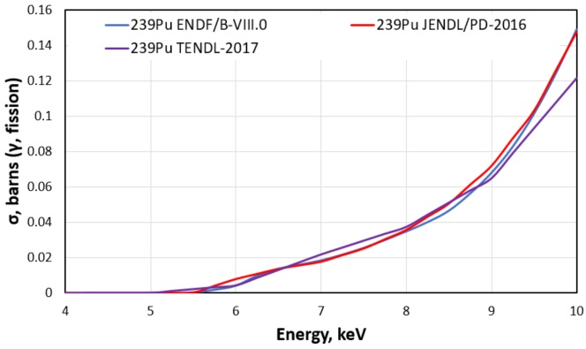
Monte Carlo simulation study
Photofission measurements at 7 MeV linac: a new challenge
Energy threshold of the photofission reactions: 6 MeV for most actinides
Three nuclear databases compared (ENDF, JENDL, TENDL)
U-235
Pu-239
→ Photofission cross-sections at 7 MeV is almost >3 times lower than at 9 MeV
→ Discrepancies between the nuclear databases => differences in results between PHITS and MCNP6

Slide 13
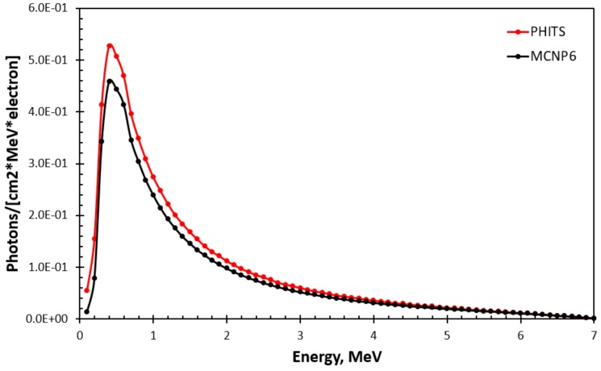
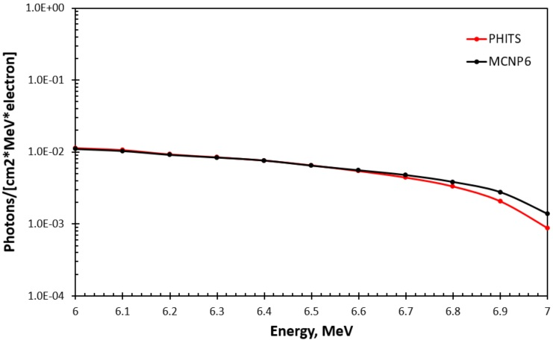
Monte Carlo simulation study
Characterization of the photon beam of a 7 MeV linac
PHITS versus MCNP6
Example obtained for the energy spectra
→ Similar discrepancies were observed for the linac operated at 9 MeV
→ They primarily come from the differences in the nuclear databases (ENDF for MCNP ; JENDL for PHITS)

Slide 14
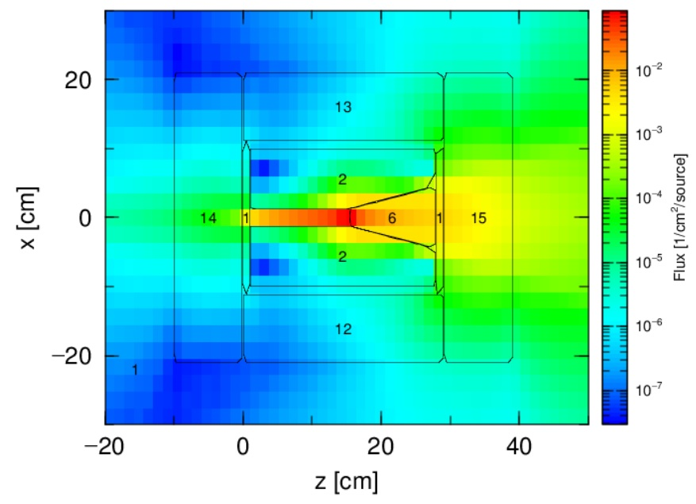
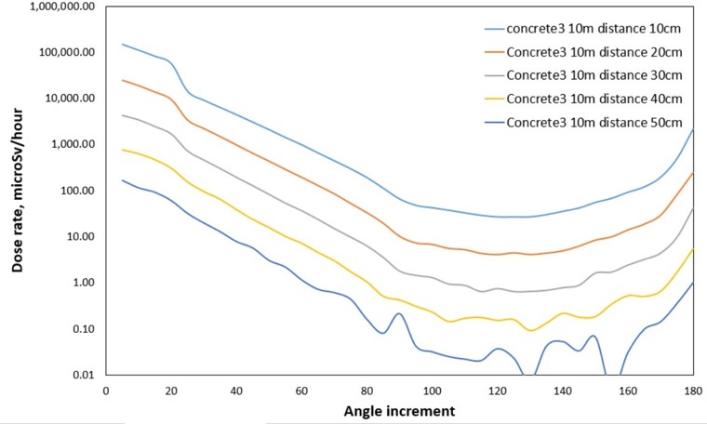
Monte Carlo simulation study (WP6/WP2)
Conceptual design of the mobile system: shielding around a 7 MeV linac
Heavy concrete (density of 4.64 g/cm³) - various thicknesses
10 cm
20 cm
30cm
40cm
50cm
→ 75 cm of heavy concrete required on the front wall
→ 50 cm of shielding of heavy concrete required on the other sides

Slide 15
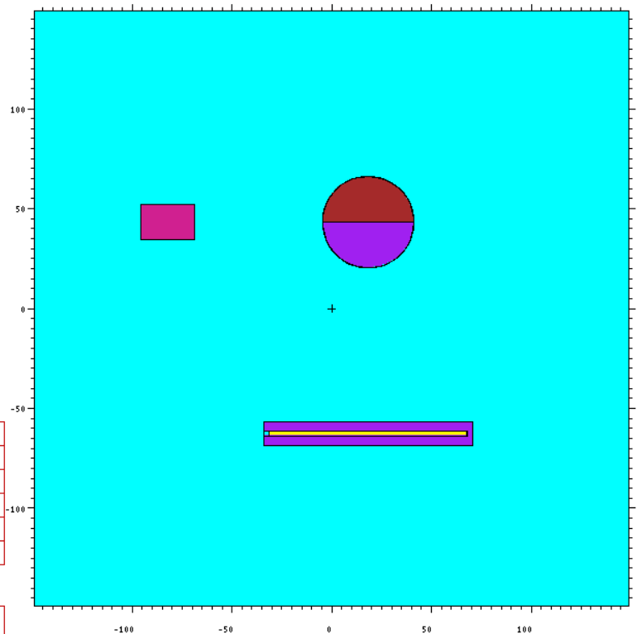
Monte Carlo simulation study (WP6/WP8)
Study of several additional cases
Measurement assumptions
Irradiation of 10 min
Electron peak current: 100 mA
Pulse duration: 2.5 µs
Electron energy: 7 MeV
Detection block with five ³He tubes (150NH100)
Delayed neutrons counted in interpulse model
View of the MCNP6 simulation model

Slide 16
Measurement methodology
Uncertainty assessment in collaboration with WP8
2a
3
Photofission measurement hot spots
Quantification U+Pu
U <> Pu
Identification
1
4
Scanning along the vertical axis
Actinide mass
2b
Photofission tomography
Optional technique used in « expertise mode »

Slide 17
Measurement methodology
Uncertainty assessment (for illustration: “step 2a” versus “step 2b”)

Slide 18
Experimental work

Slide 19
Experimental work

Slide 20
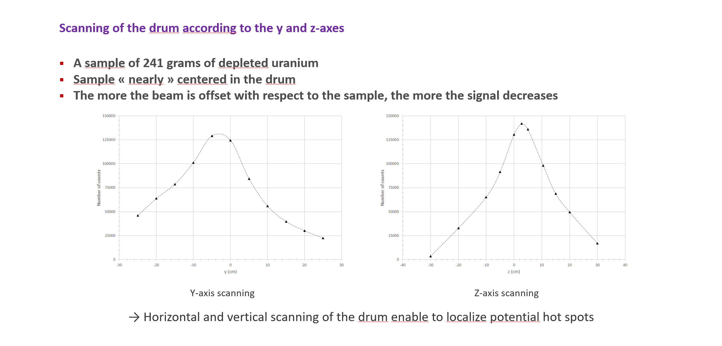
Experimental work

Slide 21
Experimental work

Slide 22
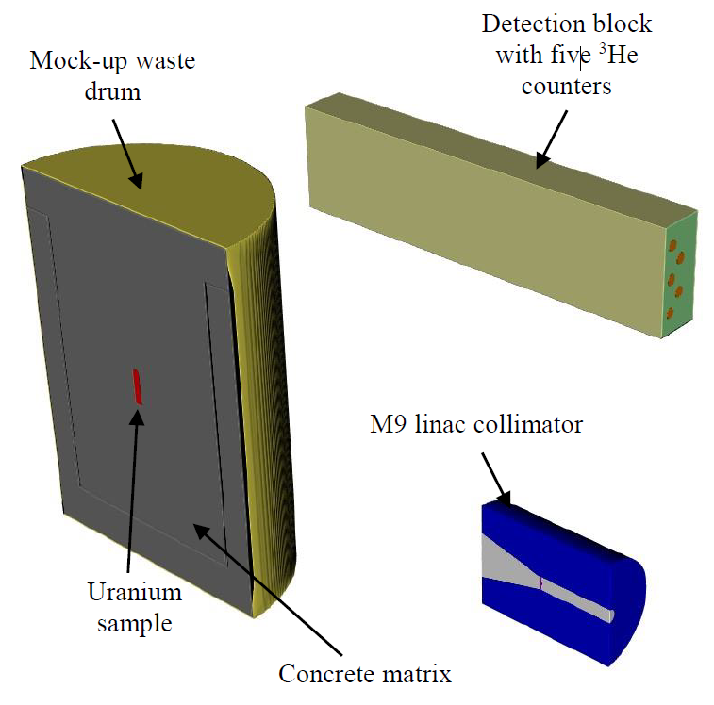
Additional Monte Carlo simulations
Asessment of virtual cases at 7 MeV
220 L-drum and 3 matrices: concrete, PVC, steel
Simulation of delayed neutron counts obtained in interpulse mode at 100 Hz for various irradiation times
Signals obtained at 7 MeV are about 15 times lower than at 9 MeV
An irradiation time about an hour would be realistic for an industrial application

Slide 23
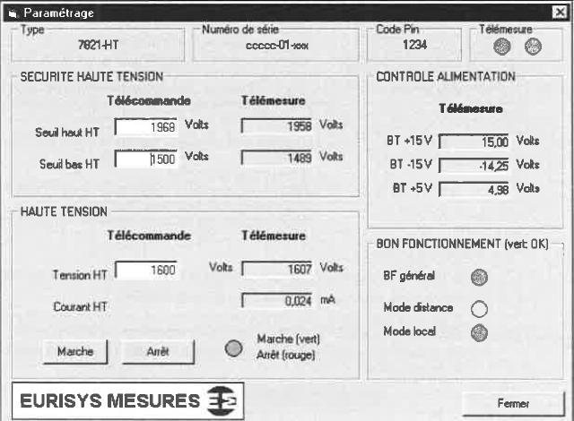
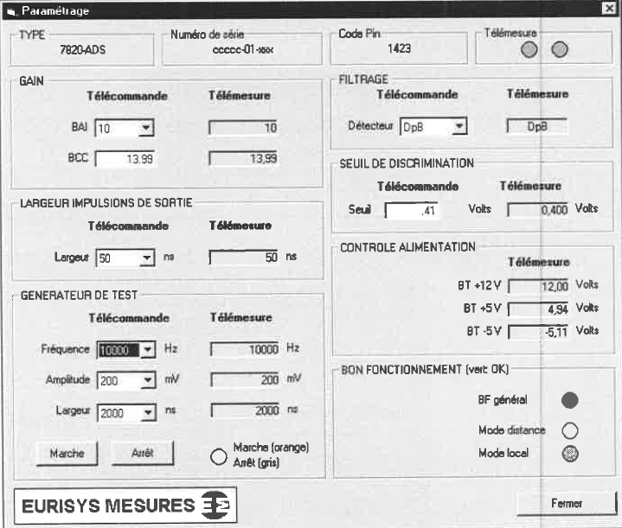
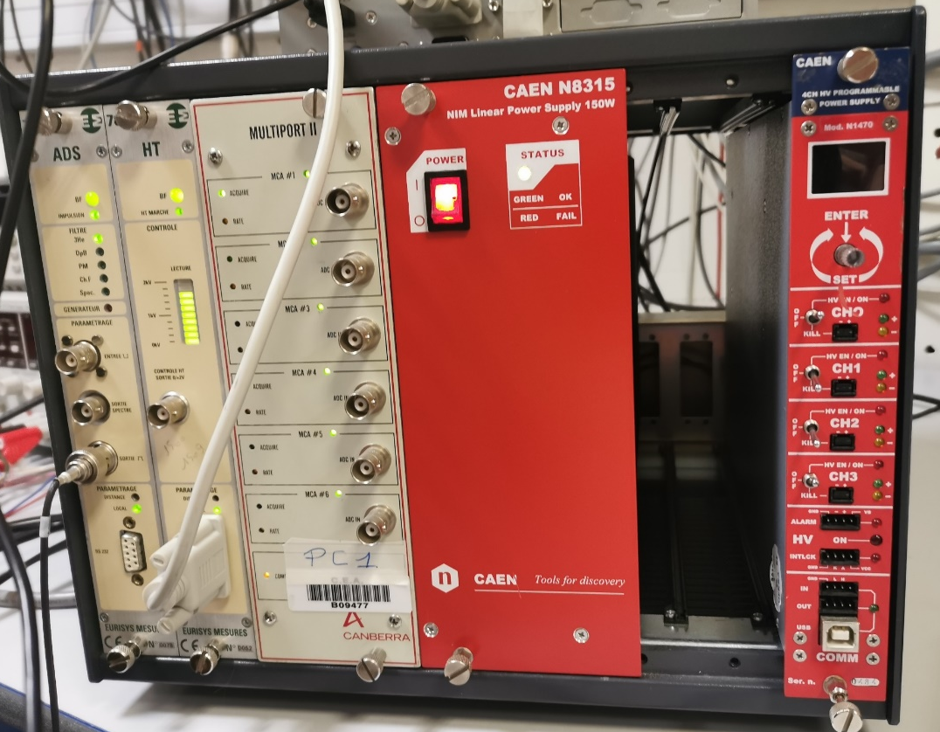
Experimental work
Canberra 7820 – 7821 modules
2 NIM modules (not supported anymore by Canberra)
7820: ADS amplifier for signal amplification and spectra
7821: HV module
Configuration of each module through one cable
Non user-friendly user interface

Slide 24
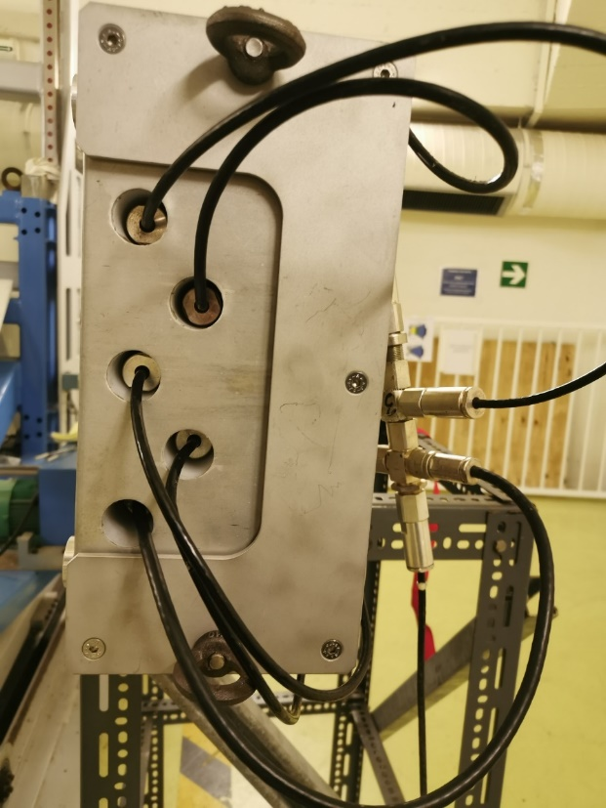
Experimental work
Canberra 7820 amplifier
Limited gain selection → 10, 100 or 1000
Limited bandwidth → ~20 MHz (20 ns rise time)
1 input channel → bundling of several detectors with connectors
BCC circuit → second stage amplification with bandwidth reduction
Limited resolution on the discrimination circuit → 40 mV
Timing application
Output of 7820 linked to an MCA (Canberra MULTIPORT II)
Only 4096 bins
Poor bining in macro-pulse mode (duration of several minutes)
Necessity to provide a trigger for interpulse mode
Signal is summed between each pulse → loss of data
Interpulse and macropulse need to be setup sequentially
Proprietary user-interface → post-treatment needs to be done separately

Slide 25
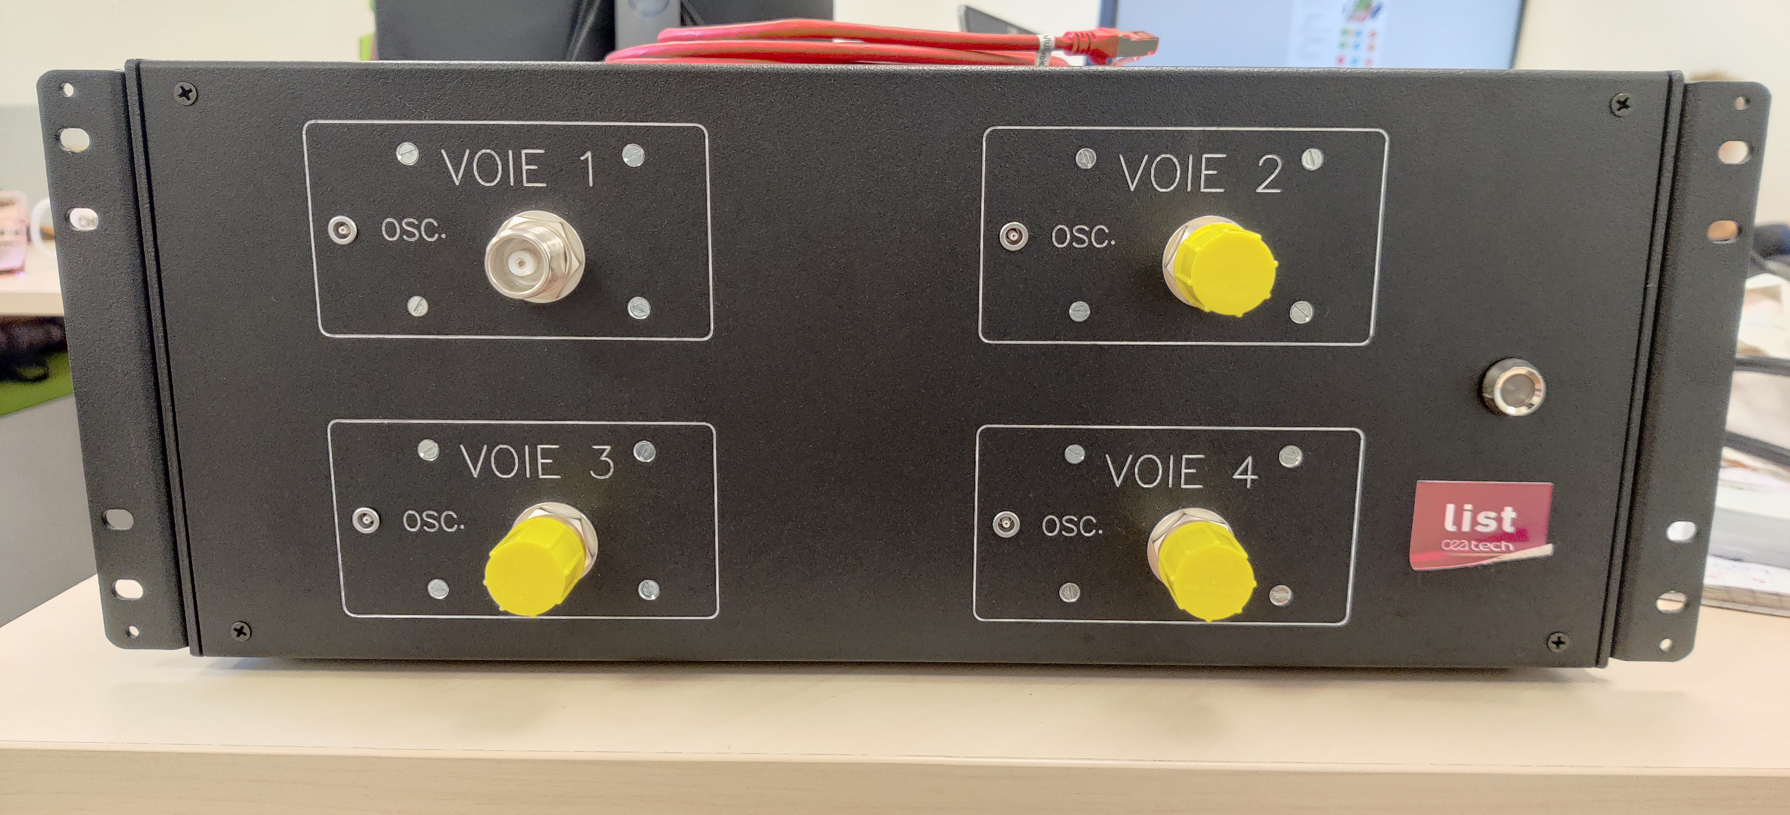
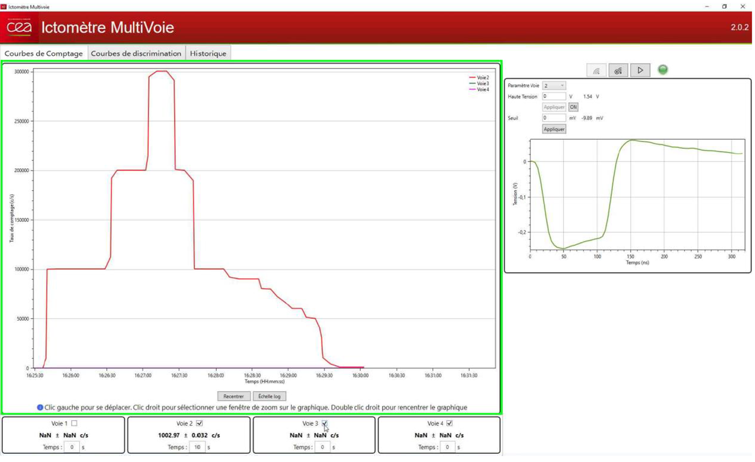
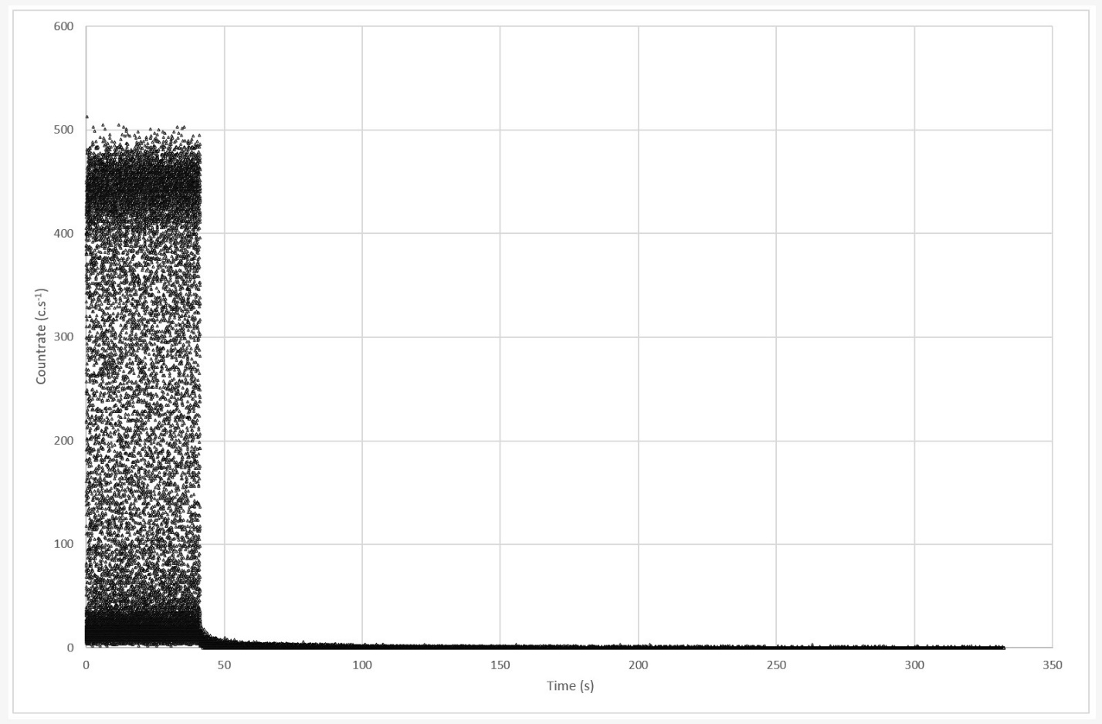
Experimental work
New digital readout electronics developed by CEA List
4 channels each equipped with:
ADC 250 MHz 14 bits
Current preamplifier with adjustable gain
Embedded Programmable Logic Features (FPGA)
Oscilloscope
Counter
Timing application
Home-made user interface → can be customized for future applications
1 ms binning with continuous data saving
Transition from interpulse to macropulse modes without interruption
No data is lost in interpulse or between the two modes

Slide 26
Summary
Monte Carlo simulation study
Use of two Monte Carlo codes (MCNP6 and PHITS)
Optimization of the photon interrogative beam of the linac
POC of photofission measurements with a 7 MeV mobile system (WP6/WP2)
Several additional calculations for uncertainty assessment (WP6/WP8)
Experimental work at the SAPHIR platform (CEA Paris-Saclay)
Tests on 220 liter-nuclear waste mock-up drums with a 9 MeV stationary system
Development by CEA List of new digital readout electronics and significant enhancement compared to traditional 7820-7821 Canberra modules
Photofission measurements integrated in the DigiWaste ToolBox (WP6/WP9)

Slide 27
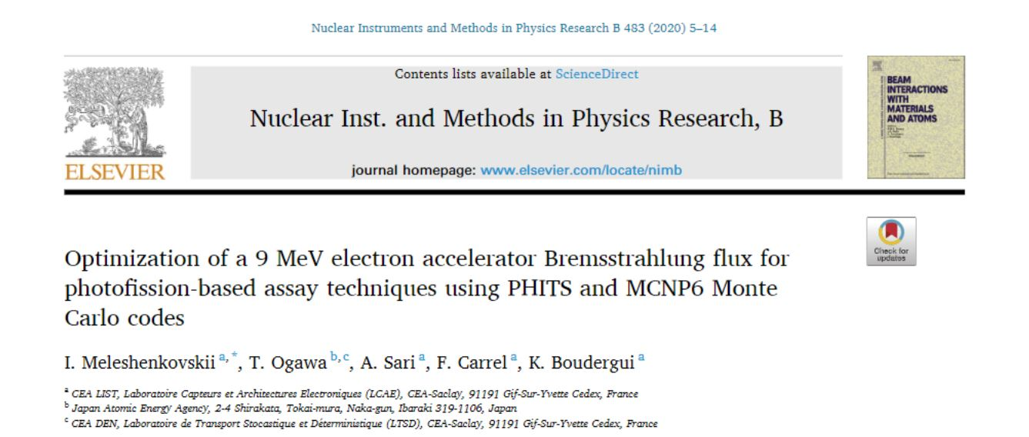
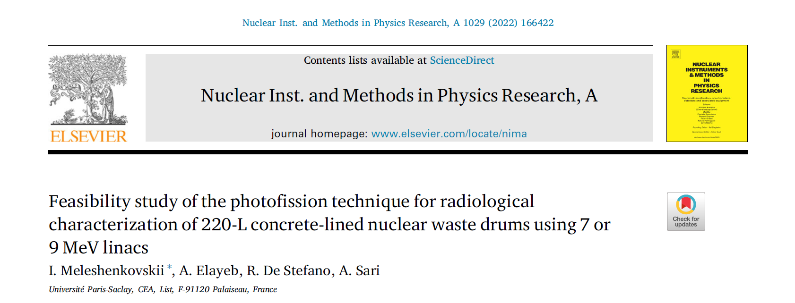
Dissemination
International conferences
Two oral presentations
Two poster presentations
Articles
Two peer-reviewed papers
One conference proceedings

Slide 28
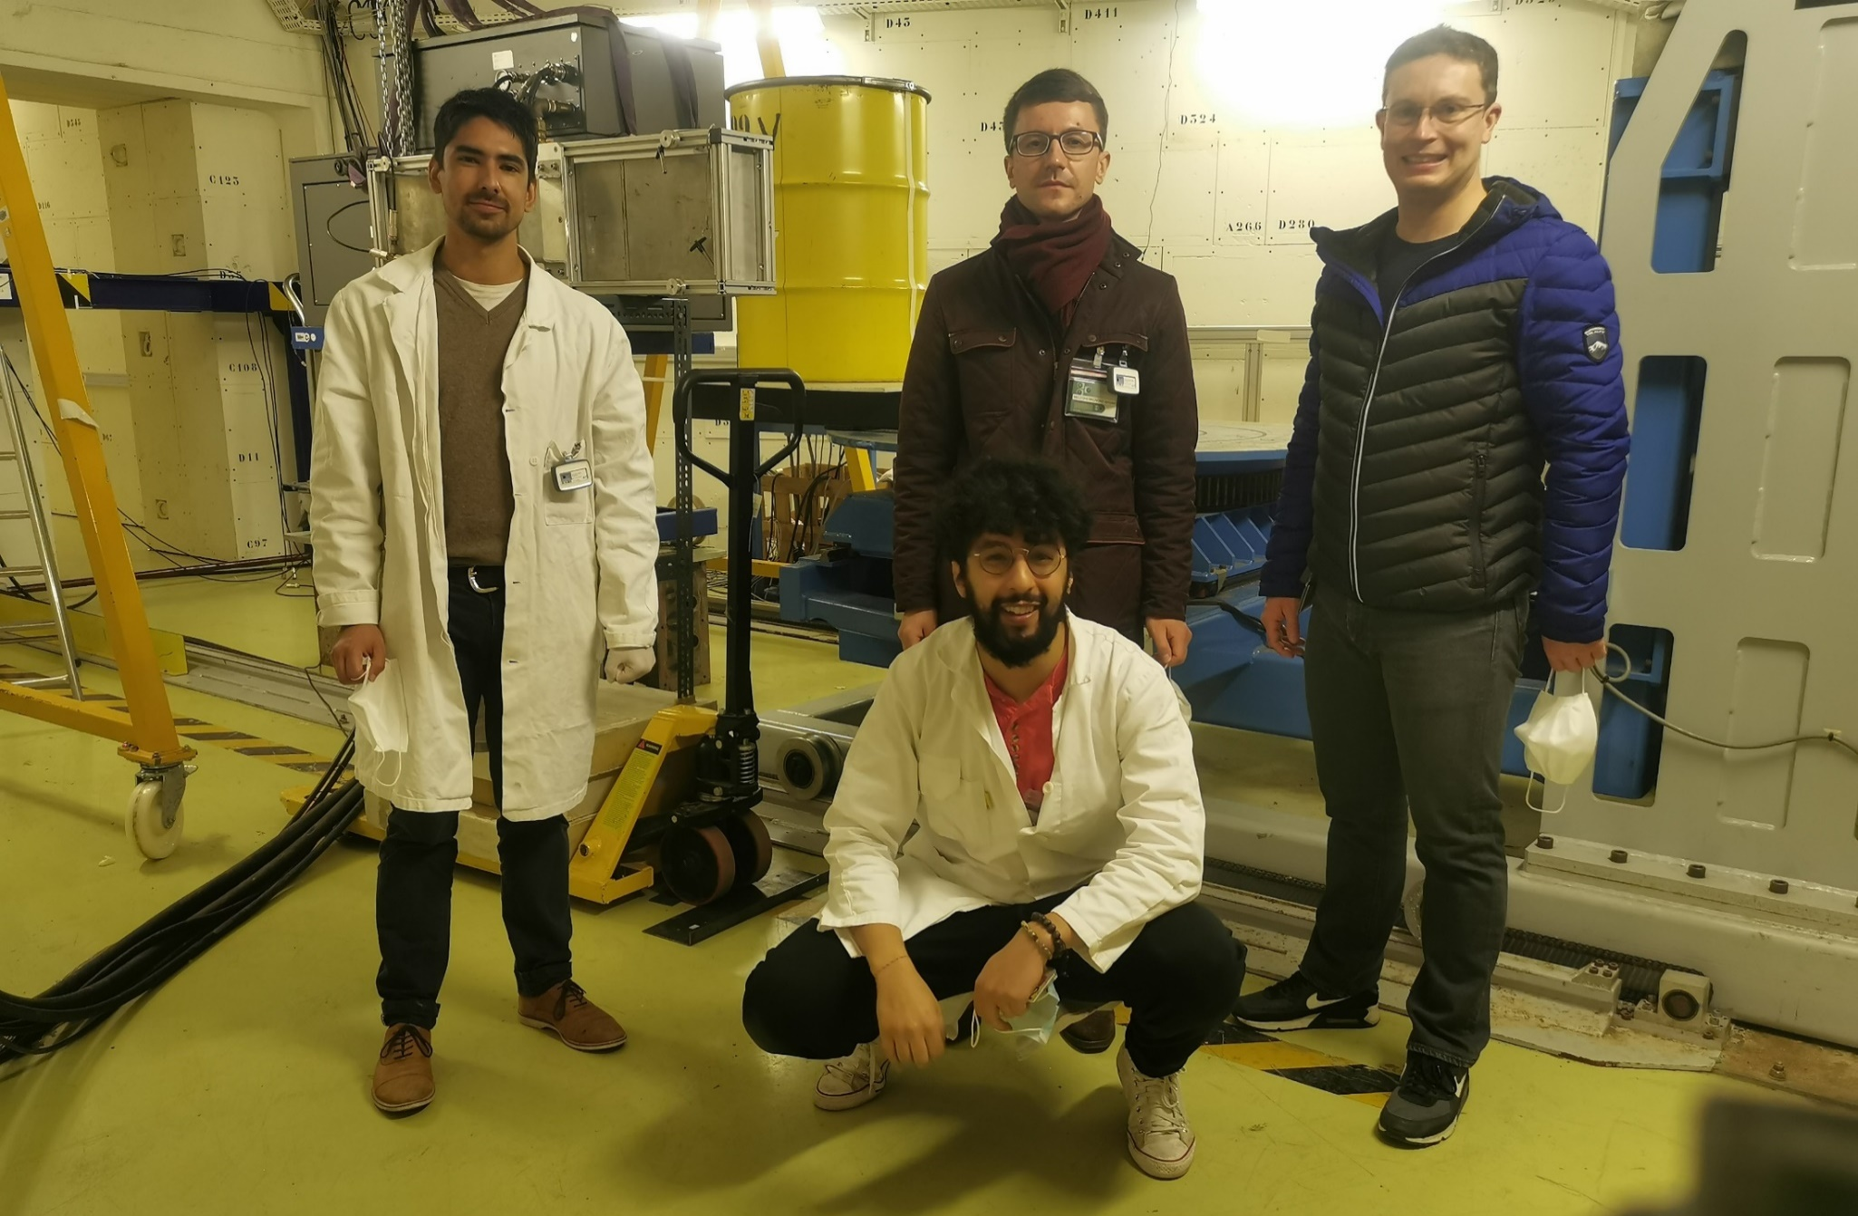
Acknowledgements
The SAPHIR team
Iaroslav MELESHENKOVSKII
Aly ELAYEB
Roberto DE STEFANO
The electronics team
Yoann MOLINE
Alexandre DABAT-BLONDEAU
The SAPHIR team for the MICADO project

