Slide 1
The Integrated Gamma Station
Rome, 2023 January 25th
Luigi Lepore

Slide 2
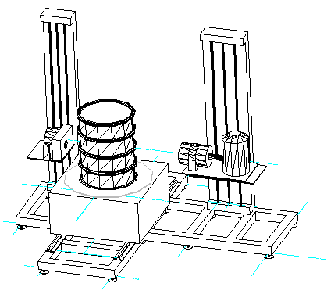
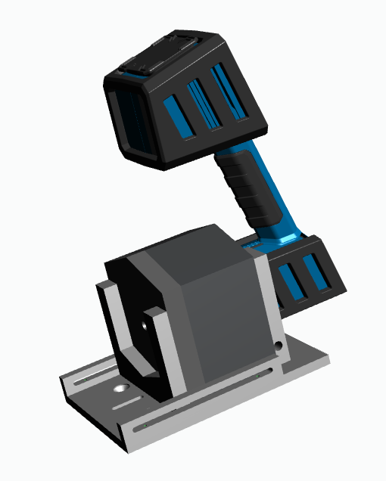
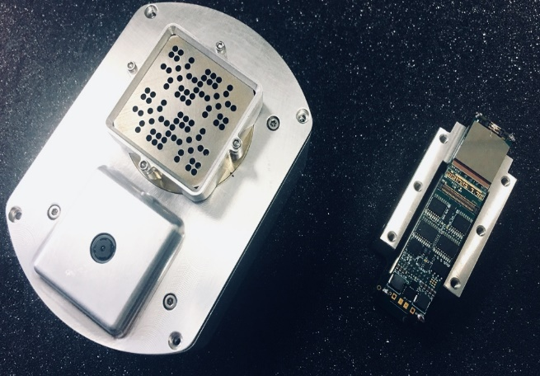
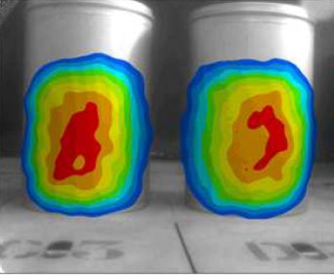
Introduction (1/2)
Integrated Gamma Station (IGS): combination of different gamma detection technologies “helping” each other to a comprehensive non destructive gamma characterization
ENEA Tomographic
Gamma Scanner (TGS)
CEA Nanopix Miniaturised
gamma camera imager
CAEN RadHAND

Slide 3
Introduction (2/2)
The techniques taken into consideration are (all Non-Destructive methods):
dosimetry measurements and count rate inspection in Open Geometry (OG) with CAEN RadHAND;
gamma imaging in open geometry with CEA Nanopix;
Segmented Gamma Scanning (SGS) with ENEA TGS;
Angular Scanning (AS) with ENEA TGS;
Emission and Transmission tomography (ECT; TCT) with ENEA TGS.
Cooperation of techniques allows to improve the comprehensive characterization, in several aspects that will be shown.

Slide 4
Objectives (1/3)
The IGS will be able to provide:
multiple Radioactive Waste Packages (RWPs) sizes accommodation and characterization;
Determination of the waste matrix material and density spatial distribution based on the evaluation of linear attenuation coefficients (transmission measurements);
radioactive “hot-spot” localization and count rate distribution estimation;
radioisotopes identification, and spatial distribution of the radioactive sources;
Decision about characterization technique to be applied, calibration and activities estimation based on high resolution gamma spectrometry.

Slide 5
Objectives (2/3)
The aim of the MICADO gamma station is to overcome the traditional “expert user” approach to the RWP non destructive characterization, via a “smart logic” system, by programming the software controlling the gamma station in RWP characterization.
→ help non-expert users to perform suitable radiological characterization
“Decision parameters” will be set-up so that experimental values collected from RWP inspection could produce decision about most suitable gamma characterization technique to apply, automatically.
→ training of the control software based on “expert user” real experience
The “expert user option” will be allowed, being aimed to answer to particularly complex items or special cases for which the programmed “smart logic” could not return accurate evaluations.

Slide 6
Objectives (3/3)
The key issue for the coordination of data is to keep devices and information connected to a central storage unit the RCMS DigiWaste Database.
Cooperation and Automation could provide:
effective simplification, uniformity, repeatability and increased reliability of the complete characterization procedure toward the final results;
reduced human intervention, minimizing the possibility of human error in the whole procedure;
reduced human intervention, maximizing conventional safety and radiation protection for the operator or user;
reduction in the timespan to carry out the complete analysis;
improvement of quality of the comprehensive final characterization results (a practical example will be given).

Slide 7
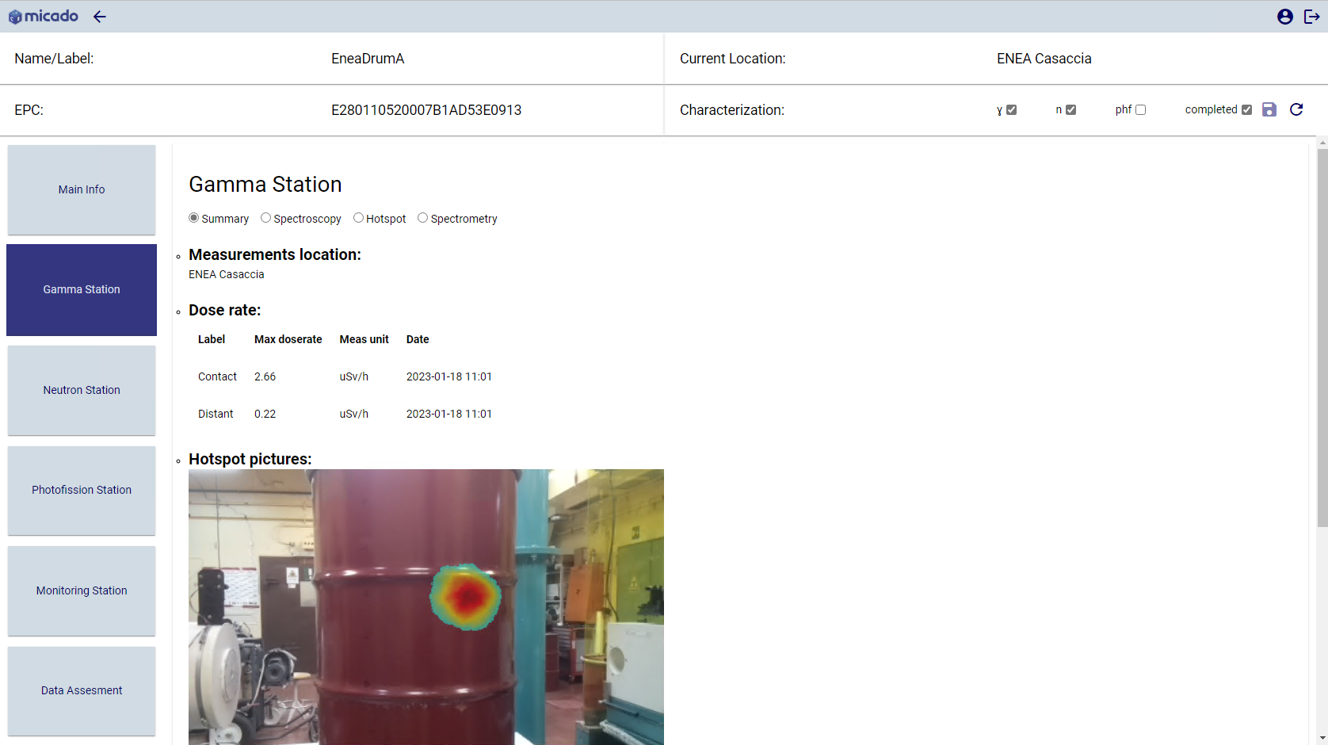
Objectives (3/3)
Different measurements referring to the same item (RFID tag) are living all together on the database:
CAEN RadHAND;
CEA Nanopix gamma camera;
ENEA TGS;
Each technique can improve by using results by other methods!

Slide 8
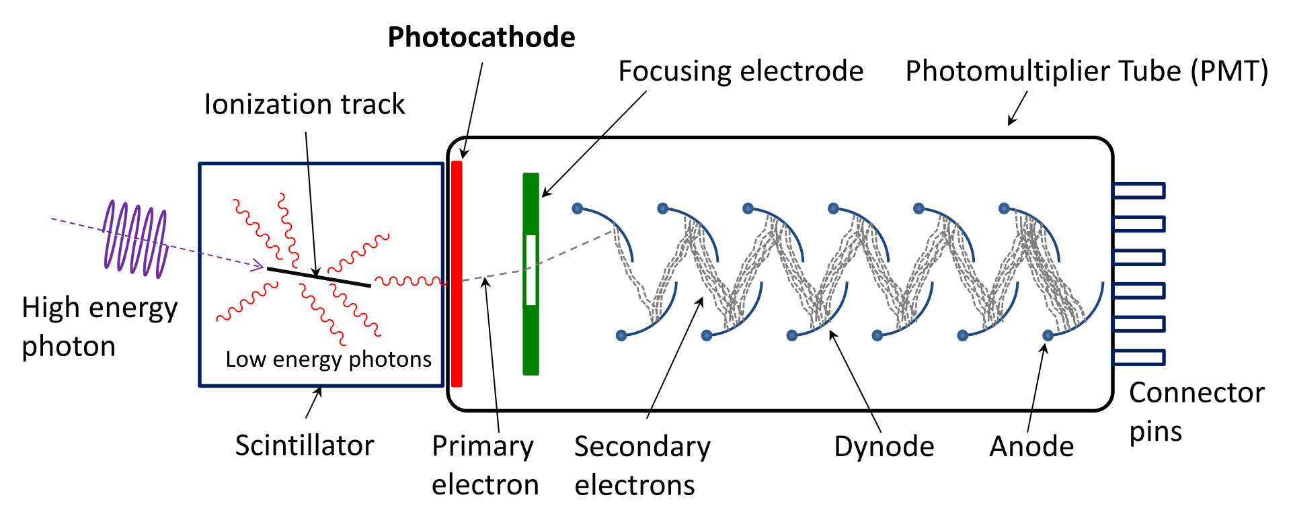
Basics of gamma techniques
How a Scintillation Detector works: gamma ray → light → voltage signal
Germanium detector is conceptually similar: gamma ray → light → voltage signal.
Voltage signal is proportional to the gamma ray interacted with the sensitive volume of the detector. It is possible to recognize radionuclides from their signature gamma rays.

Slide 9
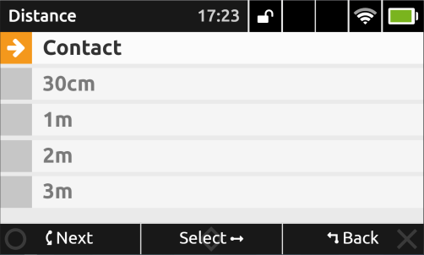
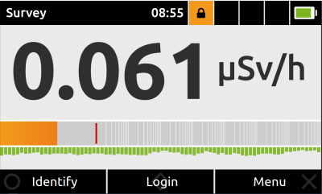
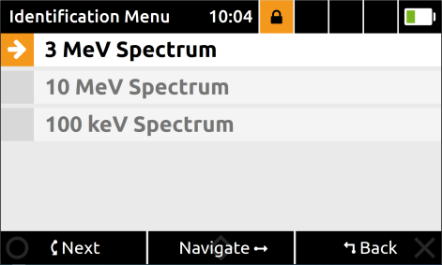
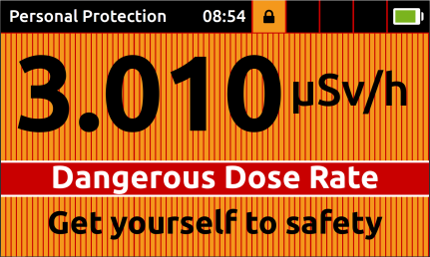
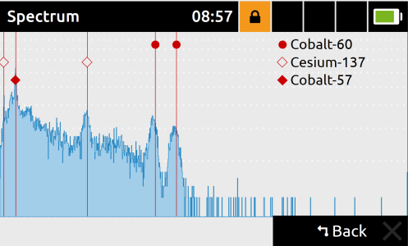
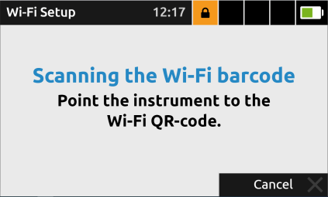
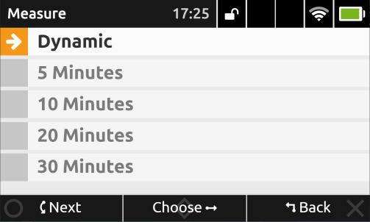
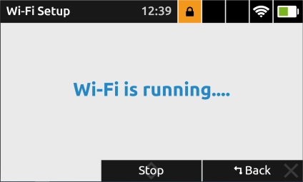
RadHAND Overall Development
Implementation of the possibility to select different measurement distances
SOFTWARE INTEGRATION
Alert Threshold
Identification Spectra screen
Implementation of Wi-Fi Connection
Implementation of different selectable identification counting times
Integration in the nuclide's library of a set of isotopes typically found in LLW
Cr-51, Co-58, Fe-59, Nb-94, Nb-95, Zr-95, Ag-110m, Sb-124, Sb-125

Slide 10
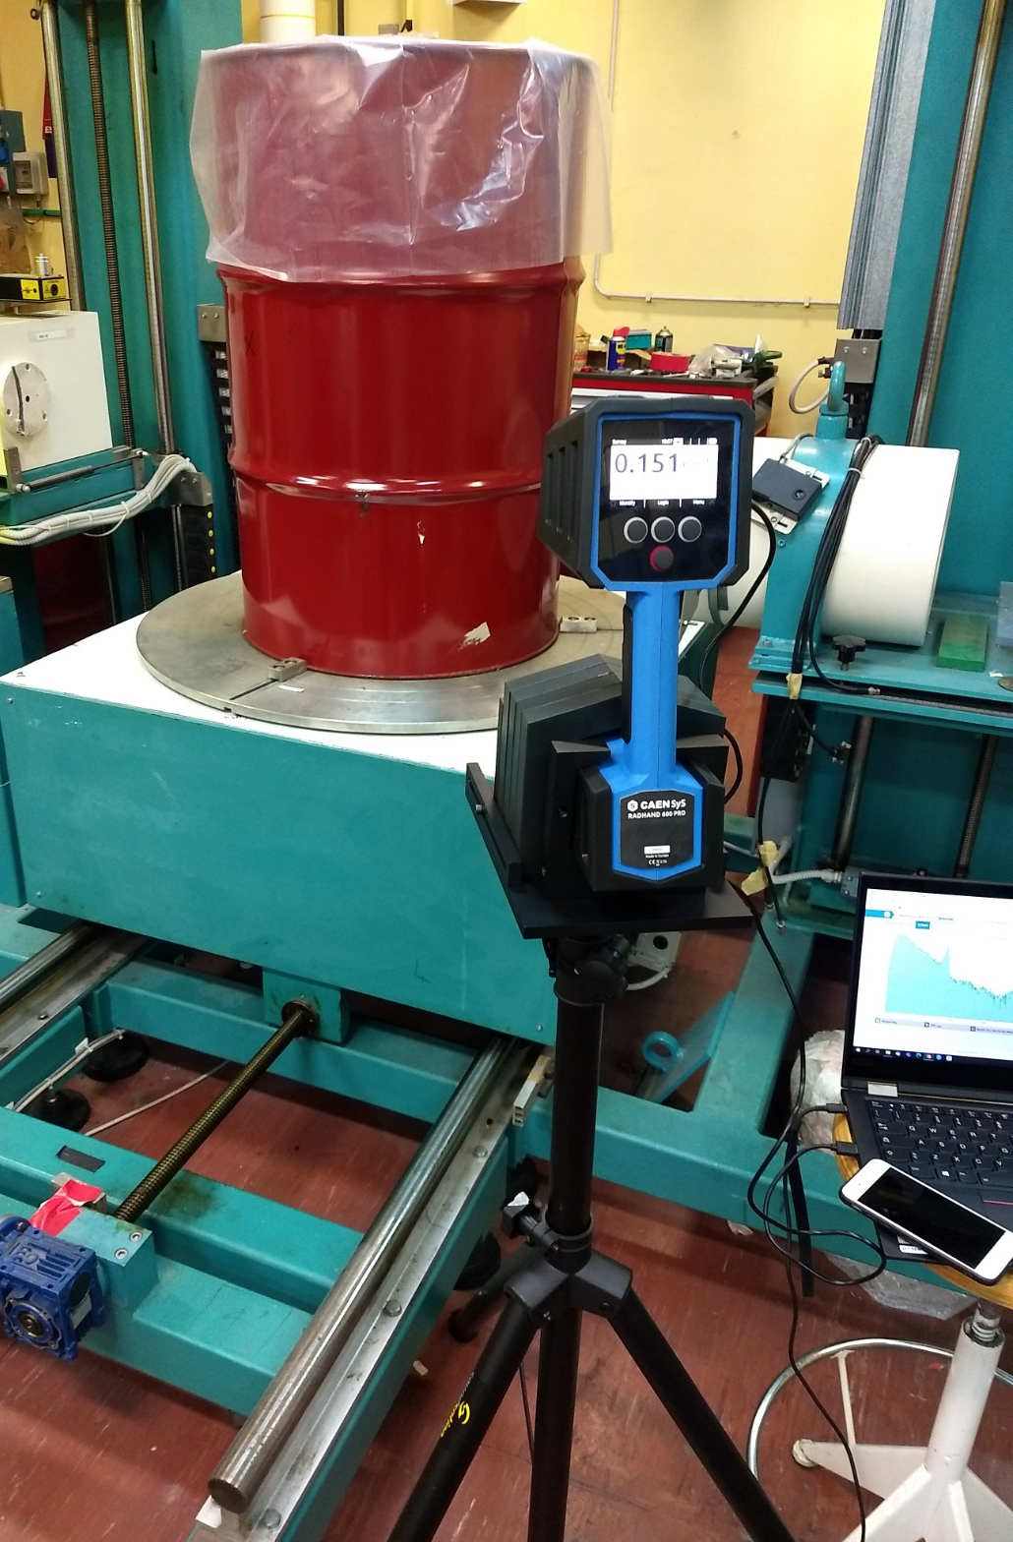
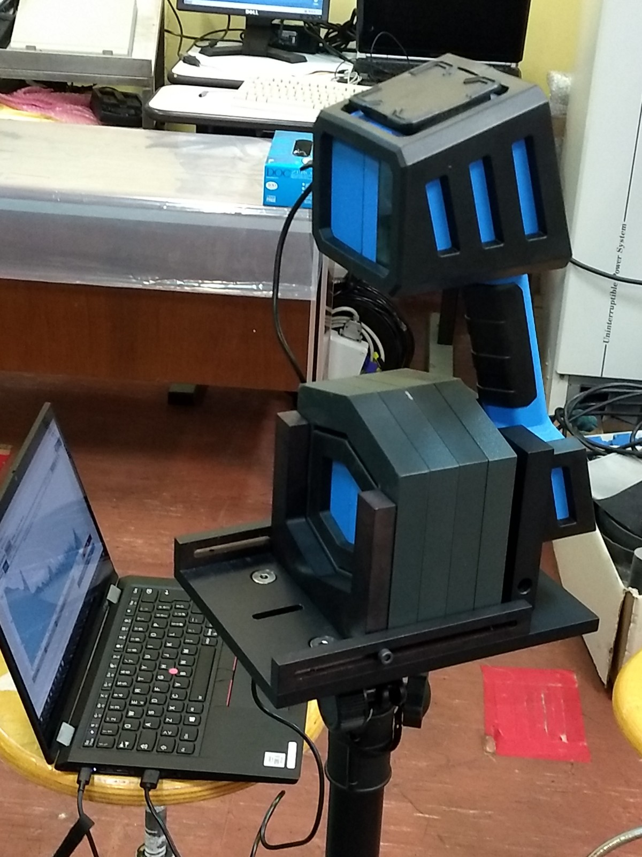
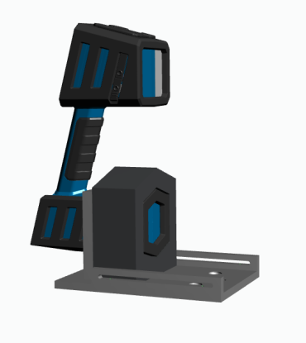
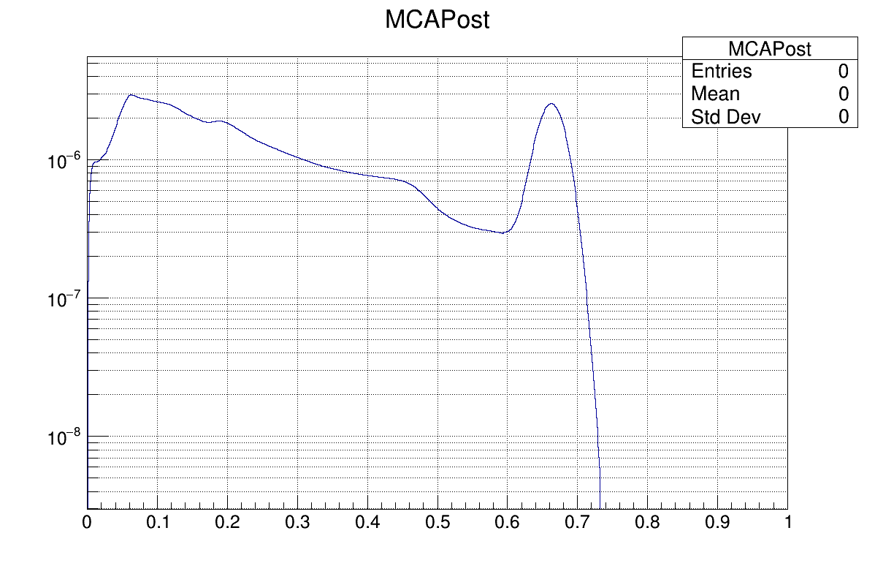
RadHAND Overall Development
HW integration… Feasibility Study… the beginning
Tripod support system developed
First prototype developed
Collimator for fixed measurement developed
MCNP simulations performed
Geometry and material identified
Collimator supplier identified
Collimation kit purchased

Slide 11
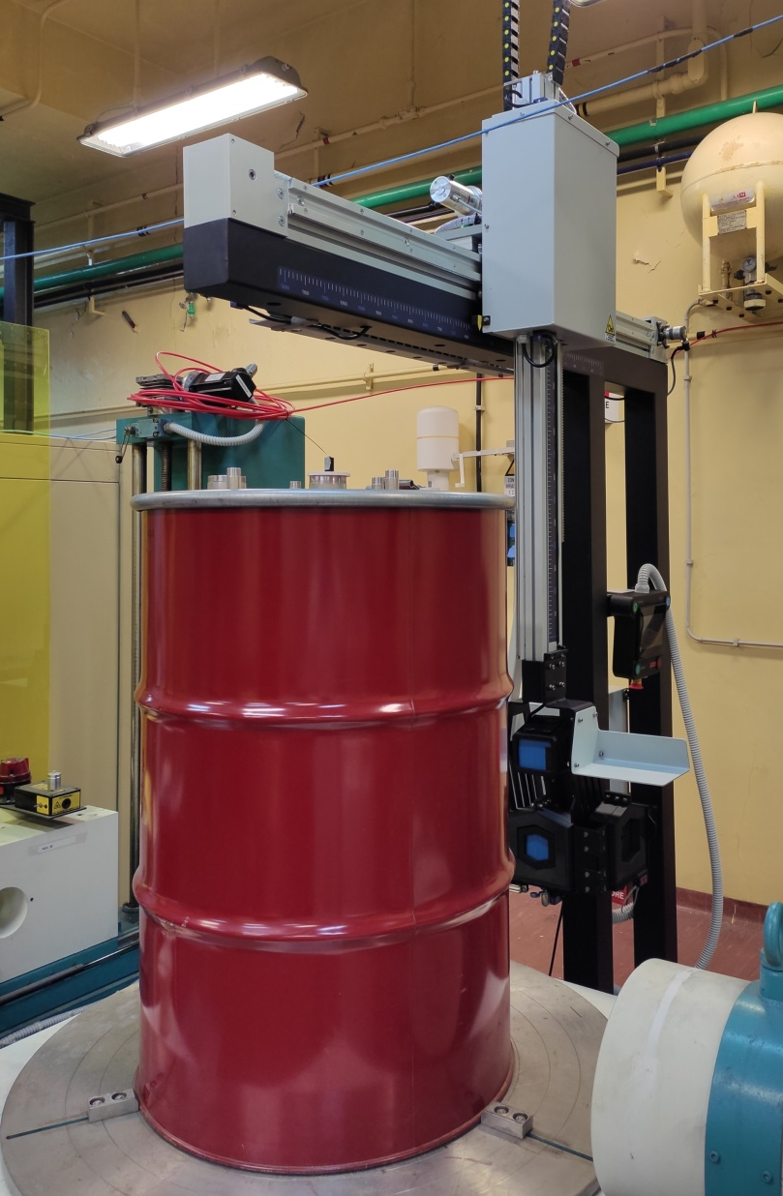
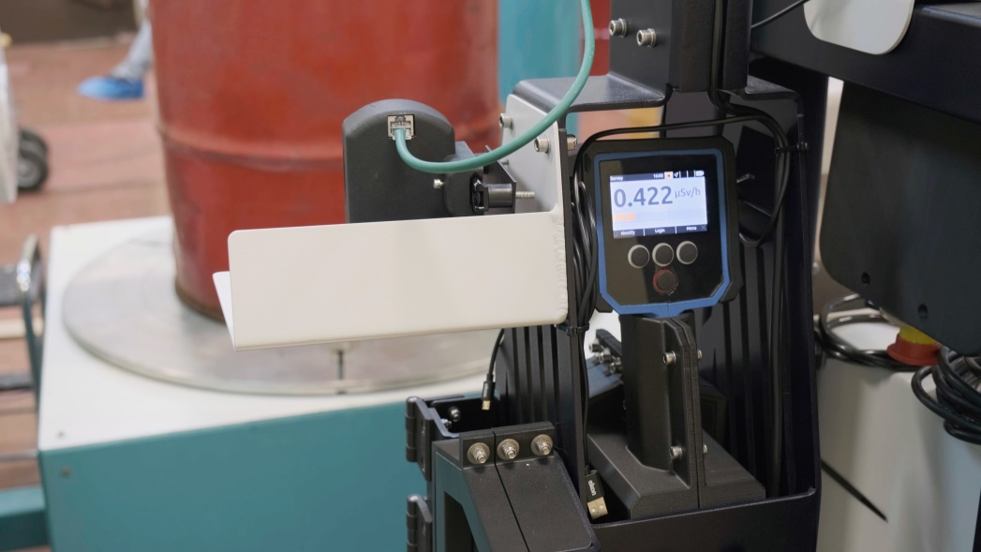
RadHAND Overall Development
HW integration… Realization and Installation

Slide 12
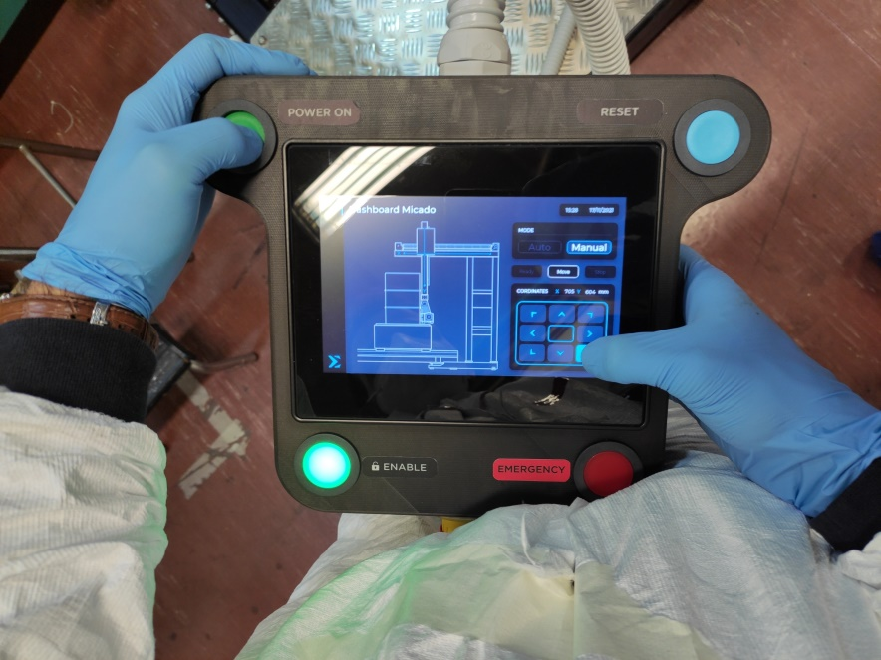
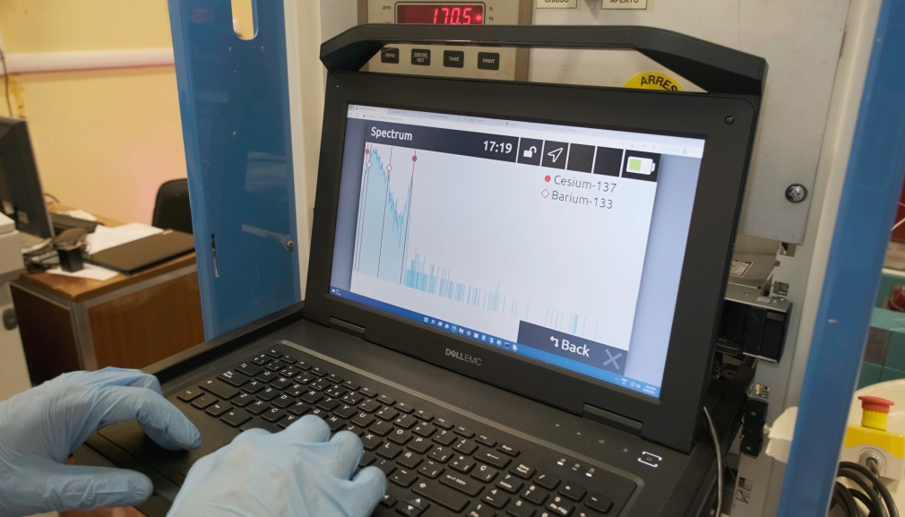
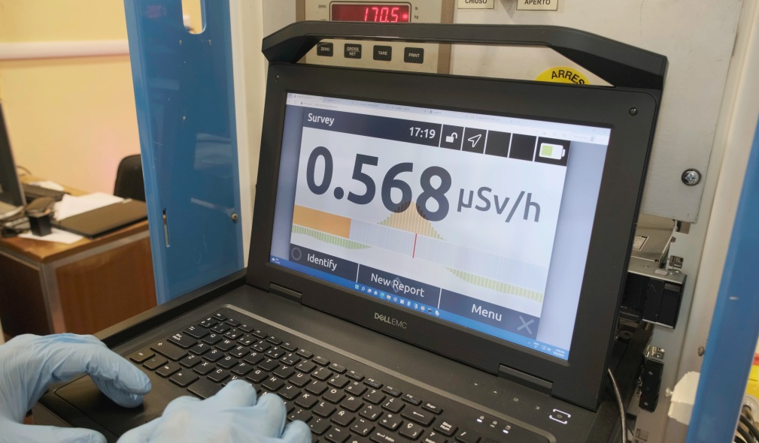
RadHAND Overall Development
System movement via a touch panel display
RadHAND SW remotely controlled from Web Interface and National Instruments control software

Slide 13
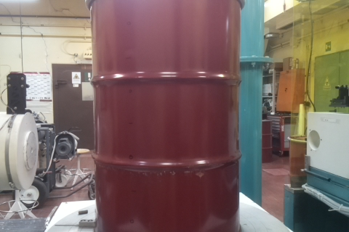
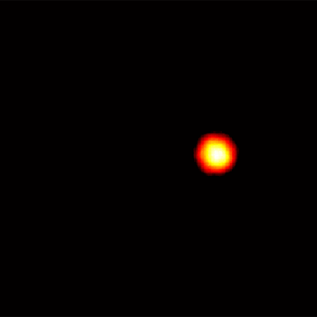
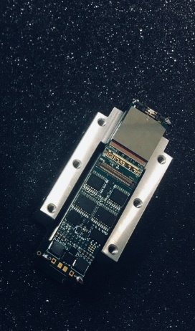
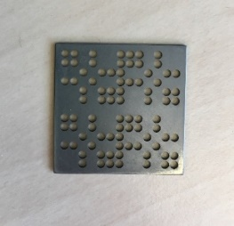
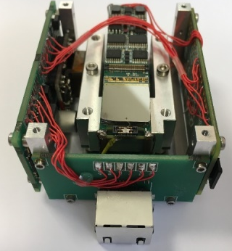
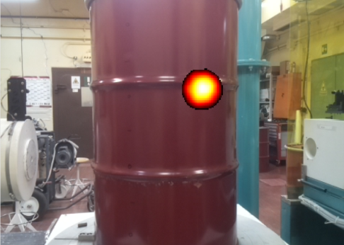
Nanopix system – Gamma Imaging
Visualize radioactive hotspots
Nanopix gamma imager
Visible image
Gamma image
Miniaturized coded aperture
Miniaturized pixelated detector
Embedded electronics
10 x 7 x 5,5 cm³
413 g
Superimposed image

Slide 14
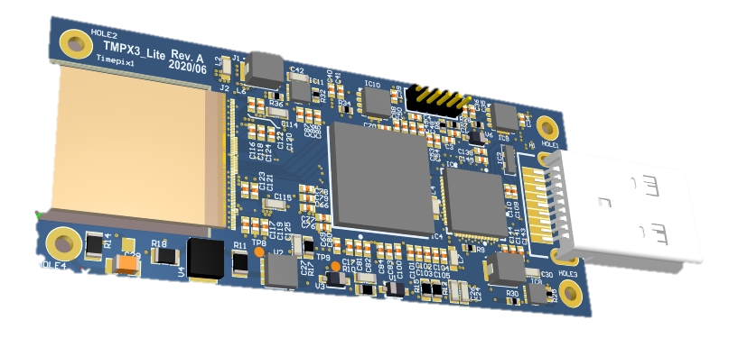
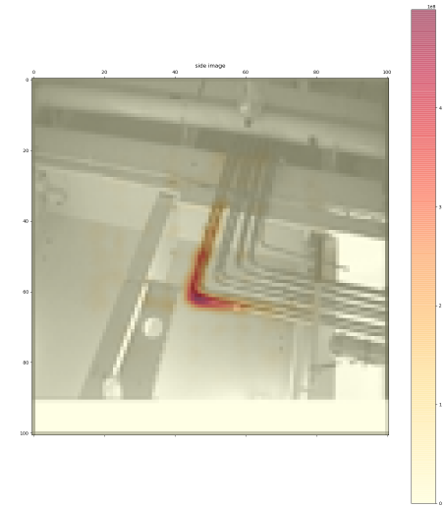
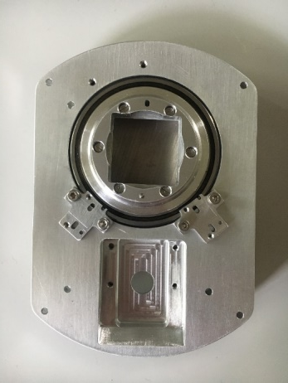
Upgrade of Nanopix gamma camera
Upgrade of the detector block
Readout electronics
Sensor
Upgrade of the system
Processing electronics
Mechanic
Development of advanced algorithms
Intel FPGA components are unavailable
Tests carried out with an upgraded Nanopix without Timepix3:
new mechanics,
upgraded electronics,
upgraded software.
Timepix to miniaturized Timepix3
New processing electronics for upgrade to Timepix3
Improved algorithms and prior for faster and automated convergence
Implementation of feedbacks from “field use” to improve the system mechanic and software.
Improved reconstruction of non punctual structures using Gibbs fields
Improvement of the semiconductor
3 mm CdTe sensor

Slide 15
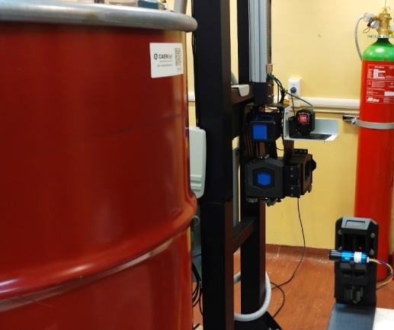
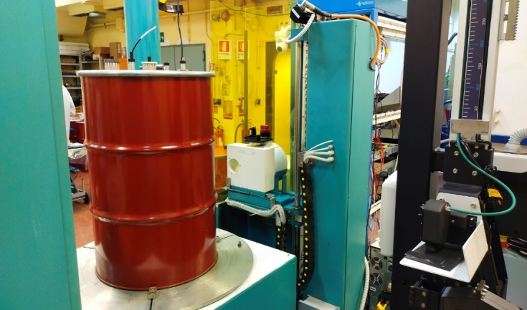
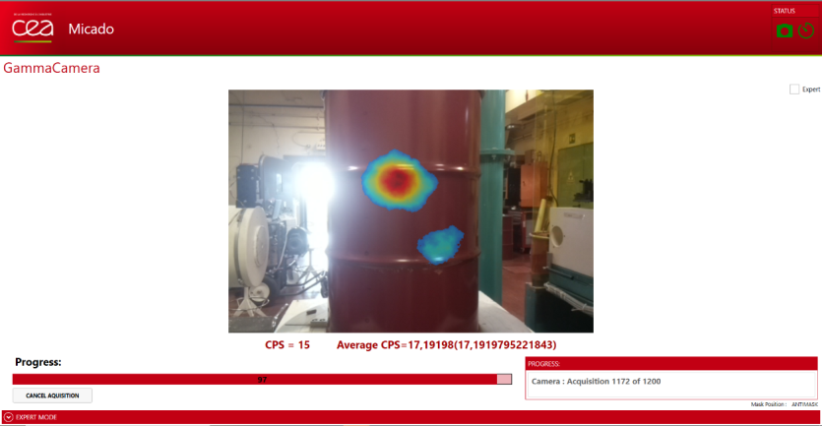
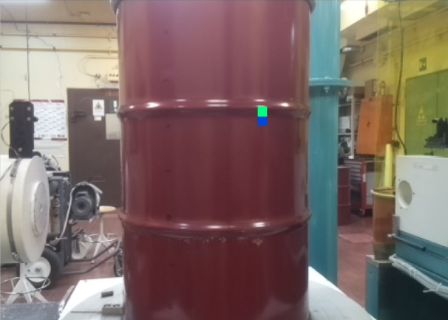
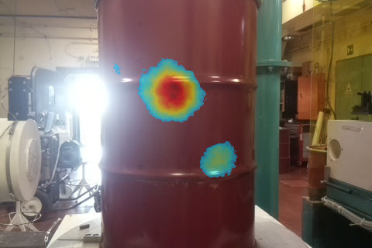
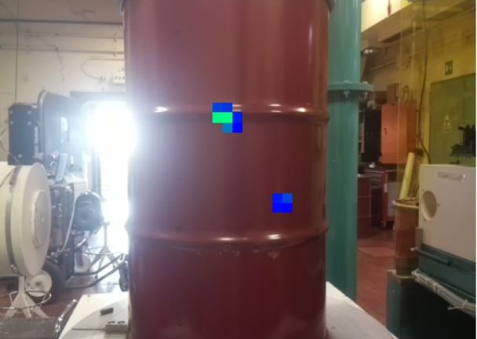
Integration of Nanopix on SRWGA
Nanopix is positioned next to RadHand to perform measurements on MICADO waste drums.
Dedicated software to perform measurements, communicate with the MICADO database.
Nanopix
103 cm
Correct localization of hotspots in the drums.
Use of improved algorithms for a better localization.

Slide 16
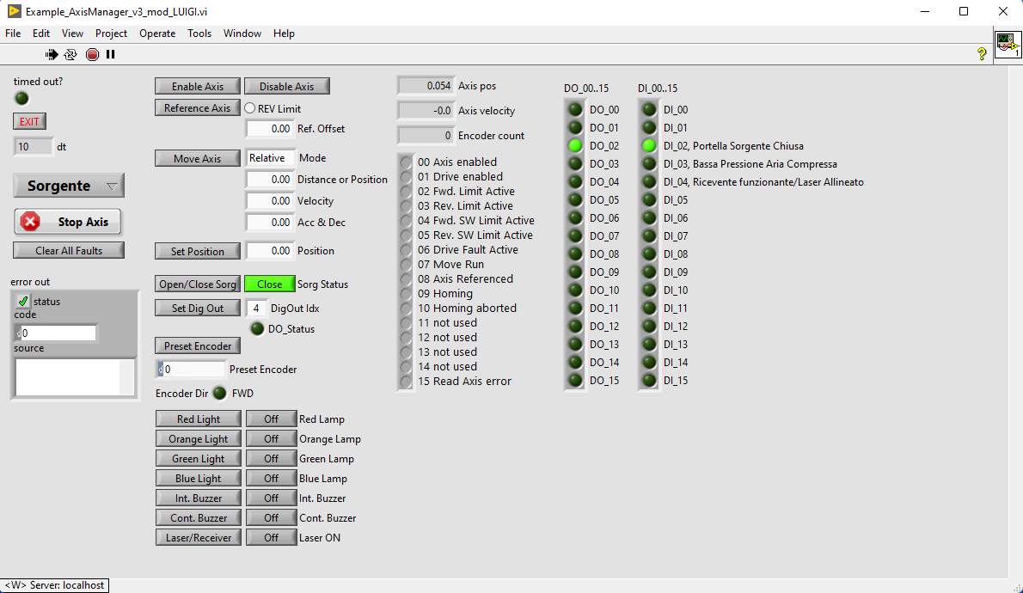
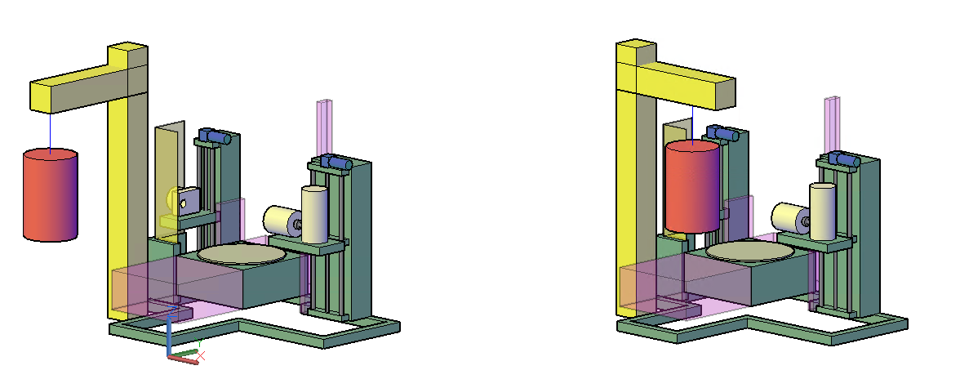
ENEA Tomographic Gamma Scanner - Upgrade
ENEA TGS UPDATE (ongoing)
New motor drives and controllers ✓
New programming electronics ✓
(TGS programming is ongoing…)
New wiring, alignment systems, etc. ✓
Modification of safety devices (lamp,
interlock, barriers, etc.) ✓
New HPGe detector ✓
(Monte Carlo works ongoing)
Production of the multi-material reference drum for efficiency calibration ✓
ENEA TGS FUTURE UPDATE
220 l drum new loading system? ✓
Automatic collimator-changer for HPGe detector? … to come

Slide 17
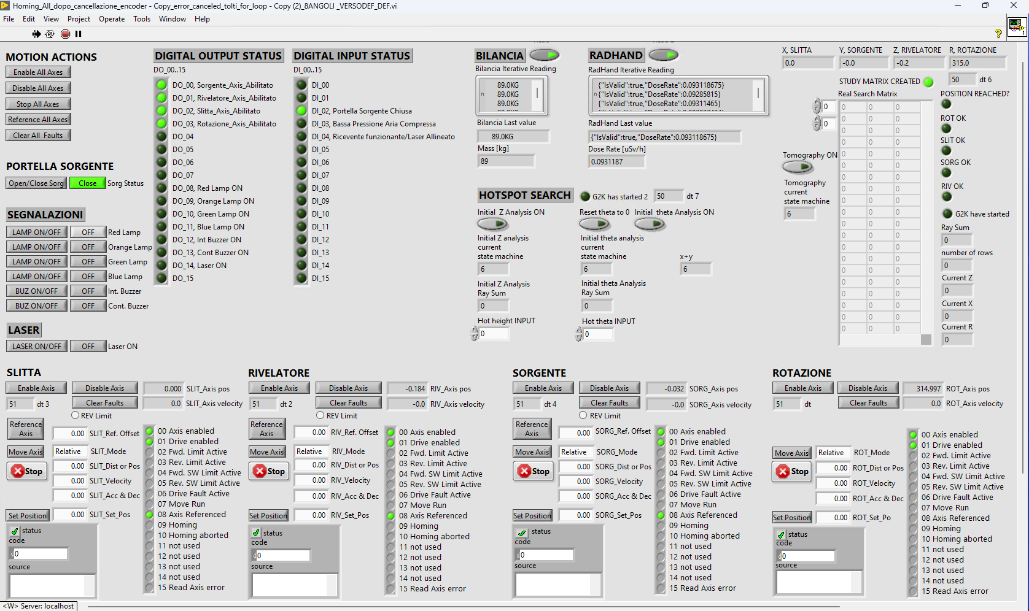
ENEA TGS - Upgrade

Slide 18
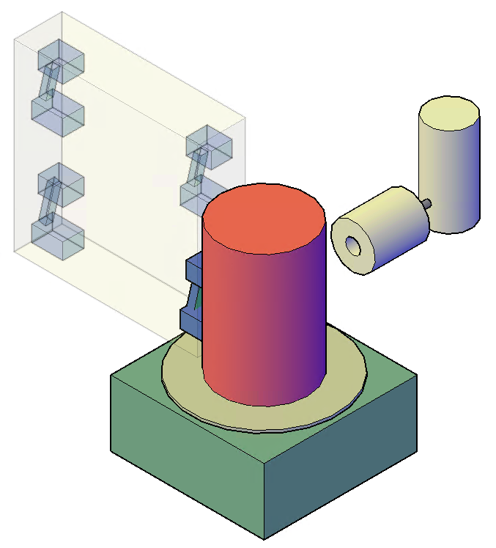
System integration – HW/SW actions
(delays due to CoV-2 emergency)
Final integrated setup:
CEA Nanopix installed just in November 2022.
The RadHand/Nanopix moving system (SIGMA) finalized.
Systems integration:
TGS control system (NI LabView) is integrating SIGMA system information and it is acquiring data from RadHand and RWP weighting system.
Measurement campaigns:
Extensive tests and measurement campaign from June 2022 till few days ago. The work will continue…
RadHand
ENEA SRWGA HPGe

Slide 19
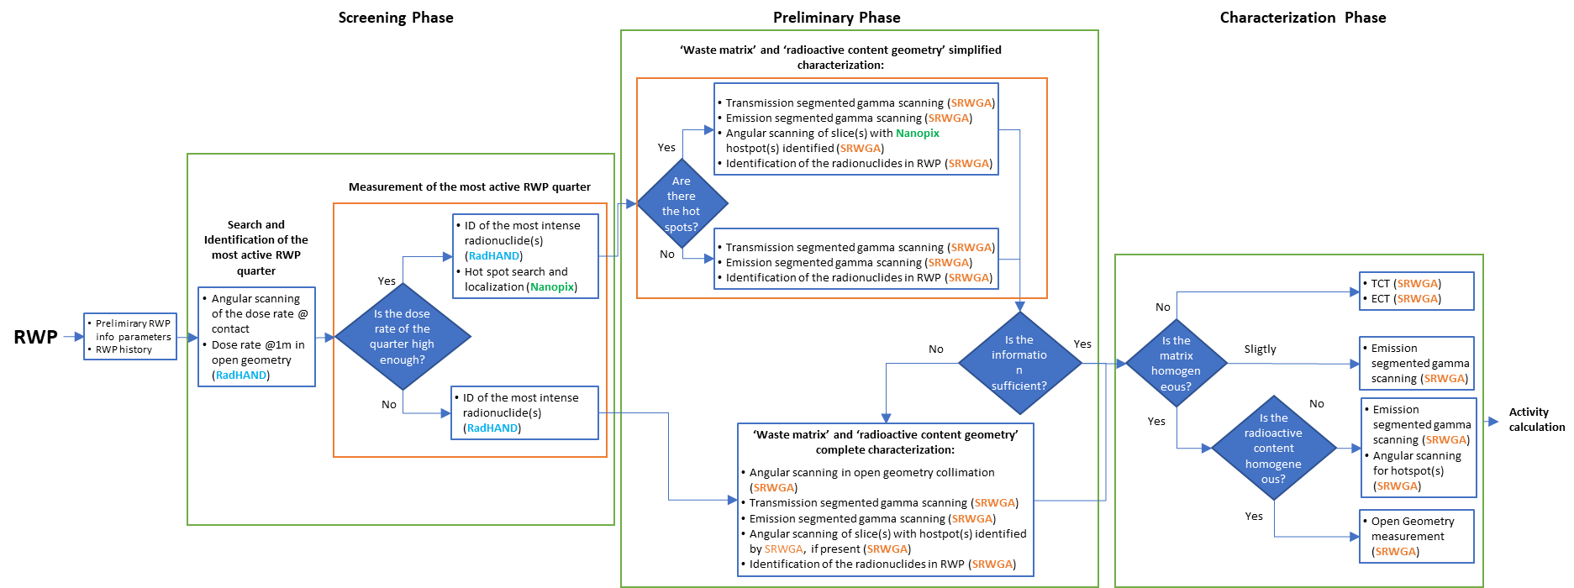
The MICADO Procedure within WP4

Slide 20
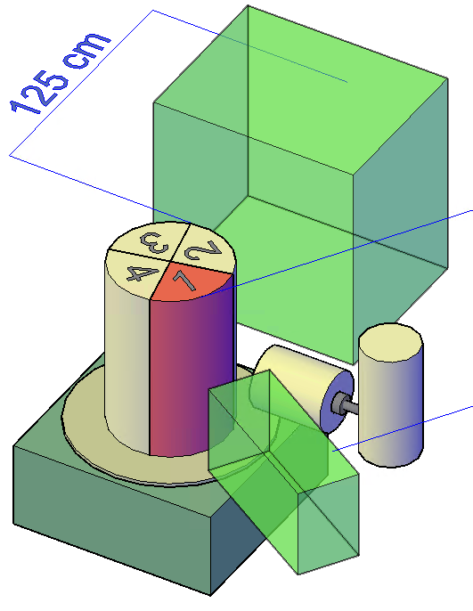
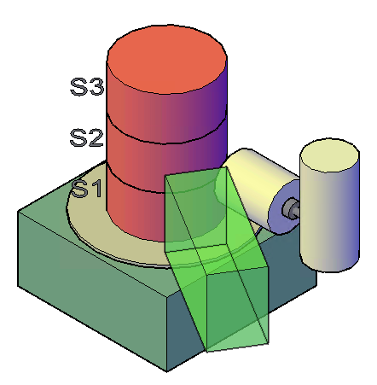
The MICADO Procedure within WP4
RWP loading on platform, measuring size and weighting
Manual application of the RFID tag, in front of the HPGe detector
Automate RFID reading with the antenna
HPGe Vertical profiling (15 rotating-slice, 6-cm-height, 1-minute-long)
→ find “Hot” height
HPGe Rotational profiling @“Hot” height (20 angular spectra, 1-minute-long) → find “Hot” theta angle
The “HOT” point is placed in front of the RadHand, and it is put at the surface of the drum by means of its moving system, to determine:
the maximum dose rate at contact.
the maximum dose rate @ 1m (once the RadHand is put 1 m aside).
RadHand inspection of 12 sectors (P0… P11), giving for each position:
1 dose rate value, 3 minutes averaged;
1 gamma spectrum (acquisition of 3 minutes) to raw radionuclides identification and to qualitative activity distribution estimation. Also HPGe is acquiring spectra while RadHand is running.
Then RadHand\Gamma Camera are placed @ 1m aside from the surface hotspot but at the half height of the drum. At this position,
a 30 minutes acquisition is given for both RadHand and Nanopix Gamma Camera.

Slide 21
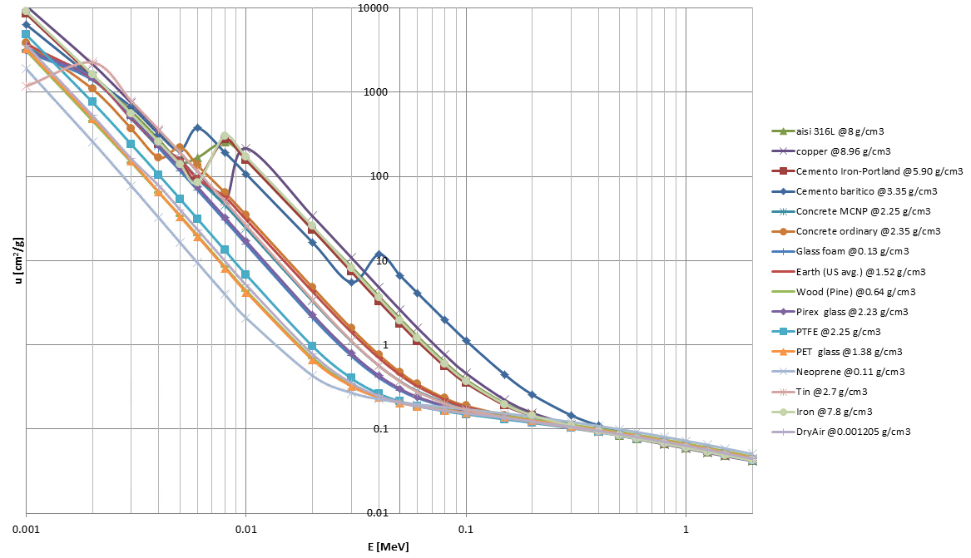
The MICADO Procedure within WP4
Dose Rate profiling, analysis of spectra acquired, fast radionuclide identification and Gamma Camera imaging can contribute to infer the radioactive sources geometrical distribution inside the RWP.
Waste matrix material and density distribution inside RWP still needs to be studied. According to results at the previous point, transmission analyses are performed (slice transmission or transmission tomography).
With results in both previous bullets,
the characterizazion strategy is decided:
Open Geometry
Segmented Analysis/Angular Analysis
Tomography
and appropriate calibration is chosen.

Slide 22
MOCK-UP DRUMS FOR WP4-5-7 FINAL TESTS
3 MOCK-UP DRUMS simulating 3 different items to test MICADO Platform (220 l drums).
We decided 3 cases that can be faced in real applications, according experience in radioactive waste vs. the type of Plants/Laboratory.
Reprocessing Plant/MOX Fuel production facility
Research Reactor/Research Laboratory
Legacy Waste
All MICADO systems ready and available at ENEA C43 Laboratory since August 2022 (WP4, WP5 and WP7) have been used to characterize those 3 drums, for a comprehensive evaluation by MICADO Platform.
Original plan: expected real drums owned by SOGIN to be tested.
Not enough time for items to be transferred from SOGIN to ENEA 😔

Slide 23
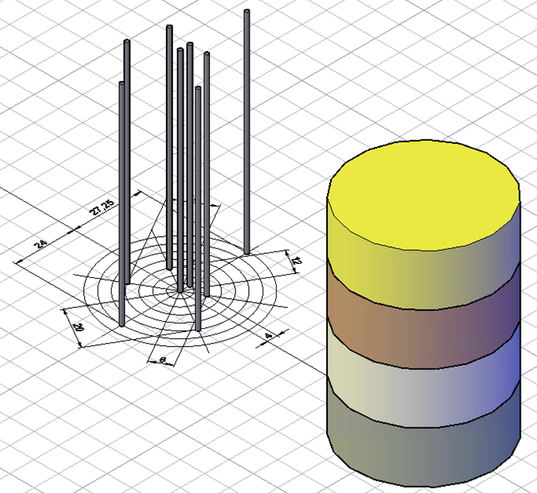
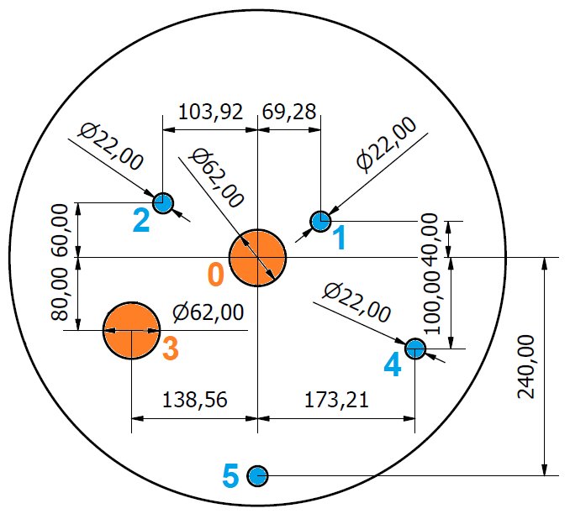
MOCK-UP DRUMS FOR WP4-5-7 FINAL TESTS
MOCK-UP DRUM “A”: Reprocessing Plant/MOX Fuel production facility
Waste matrix: metal, burnable materials (paper, plastic, cotton, etc.)
mock-up MULTIMATERIAL REFERENCE DRUM
Radiological content:
Plutonium, CBNM 61 (about 5 g di Pu) at R0 (see sketch) – height “wood slice, about 55 cm from bottom” (wood to simulate burnable material): “STICK 1”
Plutonium, CBNM 70 (about 5 g di Pu) at R3 (see sketch) – height “metal slice, about 33 cm from bottom”: “STICK 2”
Uranium, 96U, about 7 g (10% in U-235) at R3 (see sketch) – height “metal slice, about 33 cm from bottom”: “STICK 2”

Slide 24
MOCK-UP DRUMS FOR WP4-5-7 FINAL TESTS
MOCK-UP DRUM “B”: Research Reactor/Research Laboratory
Waste matrix: technological matrices, i.e. burnable (paper, plastic, cotton, etc.)
mock-up NEOPRENE (220 l whole height filled with homogeneous neoprene)
Radiological content:
Cs-137 linear source, about 10 MBq at R0 (whole height)
Co-60, NDA13+NDA14, about 300 kBq in total at R3 – height “metal slice of multi-material reference drum, about 31 cm from bottom”: “STICK 3”

Slide 25
MOCK-UP DRUMS FOR WP4-5-7 FINAL TESTS
MOCK-UP DRUM “C”: Legacy Waste
Waste matrix: metal, burnable (paper, plastic, cotton, etc.)
mock-up MULTIMATERIAL REFERENCE DRUM
Radiological content:
Plutonium, CBNM 61 (about 5 g di Pu) at R3 (see sketch) – height “wood slice, about 55 cm from bottom”: “STICK 1”
Plutonium, CBNM 70 (about 5 g di Pu) at R0 (see sketch) – height “metal slice, about 33 cm from bottom”: “STICK 2”
Uranium, 96U, about 7 g at 10% in U-235 at R0 (see sketch) – height “metal slice, about 33 cm from bottom”: “STICK 2”
Cs-137 linear source, about 10 MBq at R2 (whole height)
Co-60 NDA13+NDA14, about 300 kBq in total at R4 (see sketch) – height “metal slice, about 55 cm from bottom”: “STICK 3”
Eu-152 NDA21, about 600 kBq at R5 (see sketch) – height “metal slice, about 55 cm from bottom”: “STICK 4”

Slide 26
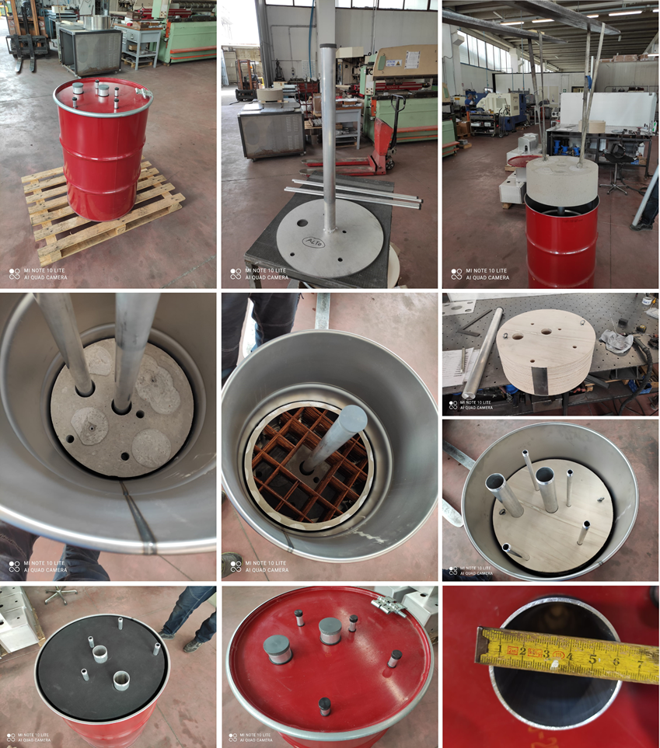
The MICADO Procedure within WP4 - Example
MOCK-UP DRUM “C”: Legacy Waste
Waste matrix within the reference drum (from the bottom): concrete
metal,
Wood,
Plastic (neoprene)
4 layers, 22 cm tall each, at different densities

Slide 27
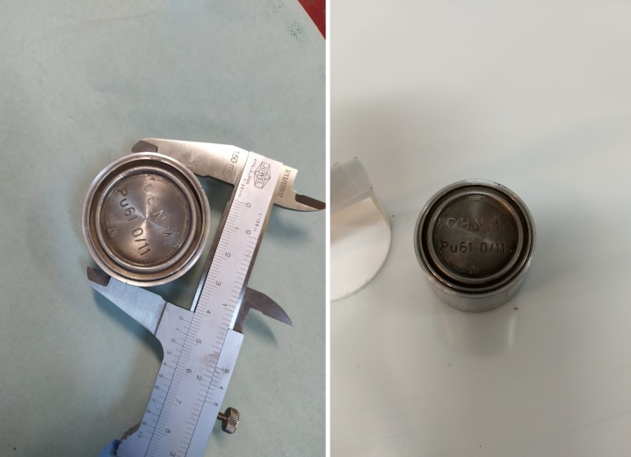
The MICADO Procedure within WP4 - Example
MOCK-UP DRUM “C”: Legacy Waste
Radiological content:
Plutonium, CBNM 61 (about 5 g di Pu) in “wood slice”,
Plutonium, CBNM 70 (about 5 g di Pu) in “metal slice”,
Uranium, 96U, about 7 g at 10% in U-235 in “metal slice”,
Cs-137 linear source, about 10 MBq (whole height),
Co-60 NDA13+NDA14, about 300 kBq in “metal slice”
Eu-152 NDA21, about 600 kBq in “metal slice”

Slide 28
The MICADO Procedure within WP4 - Example
«HOT» Zeta=40 cm
Theta=0
+
«HOT» Theta=140 °

Slide 29
The MICADO Procedure within WP4 - Example
Co-60
Cs-137
Eu-152
U-235
Example of 4 of the 25 hotspot identified (2-D sketches)

Slide 30
The MICADO Procedure within WP4 - Example
Co-60
Cs-137
Eu-152
U-235
Am-241
MOCK-UP DRUM “C”: Legacy Waste
Radiological content:
Plutonium, CBNM 61 (about 5 g di Pu) in “wood slice”,
Plutonium, CBNM 70 (about 5 g di Pu) in “metal slice”,
Uranium, 96U, about 7 g at 10% in U-235 in “metal slice”,
Cs-137 linear source, about 10 MBq (whole height),
Co-60 NDA13+NDA14, about 300 kBq in “metal slice”
Eu-152 NDA21, about 600 kBq in “metal slice”

Slide 31
The MICADO Procedure within WP4 - Example
Radionuclide | Certified Activity (Bq) | Calculated Activity (Bq)
Co-60 | (2.50 ± 0.03) · 10⁵ | (2.68 ± 0.69) · 10⁵
Cs-137 | (10.00 ± 0.30) · 10⁶ | (8.97 ± 0.49) · 10⁶
Eu-152 | (4.46 ± 0.05) · 10⁵ | (7.31 ± 0.41) · 10⁵
U-235 | (6.70 ± 0.47) · 10⁴ | (6.68 ± 0.80) · 10⁴
Am-241 | (9.04 ± 0.30) · 10¹⁰ | (12.40 ± 0.80) · 10¹⁰
Radionuclide | Matrix | MDA (Bq) | Critical level (Bq)
Co-60 | Metal | 5.99 · 10³ | 2.98 · 10³
Cs-137 | Neoprene | 4.13 · 10² | 2.06 · 10²
 | Wood | 3.17 · 10² | 1.58 · 10²
 | Metal | 7.88 · 10² | 3.93 · 10²
 | Concrete | 7.53 · 10³ | 3.76 · 10³
Eu-152 | Metal | 3.53 · 10³ | 1.77 · 10³
U-235 | Metal | 1.26 · 10³ | 6.29 · 10²
Am-241 | Wood | 4.76 · 10⁷ | 2.38 · 10⁷
 | Metal | 8.89 · 10⁶ | 4.44 · 10⁶
MOCK-UP DRUM “C”: Legacy Waste
Radiological content:
Plutonium, (about 5 g di Pu) in “wood slice”,
Plutonium, (about 5 g di Pu) in “metal slice”,
Uranium, about 7 g at 10% in U-235 in “metal slice”,
Cs-137 linear source, about 10 MBq (whole height),
Co-60 NDA13+NDA14, about 300 kBq in “metal slice”
Eu-152 NDA21, about 600 kBq in “metal slice”
22 vertical slice; 14 horizontal division, 8 angles =
2464 spectra, 50 s livetime acquisition each.

Slide 32
The MICADO Procedure with WP5 - Example
MOCK-UP DRUM “C”: Legacy Waste analysed within WP5 also
 | Certified mass (g) | Calculated mass (g)
Pu-240eff | 3.39 ± 0.05 | 4.55 ± 0.20
Note that currently the regression model used for calibration of the neutron chamber (obtained from the neural network algorithm that will be shown by WP5 later) does not include drums with matrix and source heterogeneity…
… but neutron measurements confirmed Pu presence with a deviation about +34%. It is a very good agreement!
WP4 gamma technologies and WP5 neutron measurements could be a benchmark each other.

Slide 33
The MICADO Procedure with WP7 - Example
MOCK-UP DRUM “C”: Legacy Waste analysed within WP7 also
gamma
neutron
Signal from one set of detectors lost because of electrical noise but
results in agreement with source position and activity

